Slide 1
France within the E.U
Outline
Intro: a complicated story
I Brief history 1950’s- today
II The main principles
III Focus on France in the Eurozone: 1999 to 2024
A- general information
GDP
Public debt
Exchange rate- devaluation/depreciation
Mundell Trinity
Advantages and disadvantages of a single currency
Impact of inflation
The ECB monetary policy
B- Problems within the EU: growing heterogeneity within the zone
Current account balances in the EU- North and South
Ex: France and Germany competitiveness : a case of non-cooperation
The sovereign debt crisis (2009) and the ECB’s reaction
Deflation and the setting-up of quantitative easing
Recent developments: Covid-19 pandemic (2020) and the return of inflation (2022)

Slide 2
France within the E.U
Intro
Introduction: a complicated story
France: a founding and key member of the EU: Robert Shumann, Jean Monnet, the German-French couple
yet the only country in Europe where ‘the state and the nation form one single entity’ (Roger Fauroux- Minister of trade 1988-1991 Rocard’s government)
Examples of France’s opposition to some of the major moves:
- rejection of the European Community of Defence (1954), refusal of Britain’s entry 1963-67 by de Gaulle
- Reluctance to the enlargement of the EU to Eastern European countries (for fear of ‘social dumping’)
- NO vote to the Constitutional Treaty 2005 perceived as a threat to the French social model
- A delayed integration of European laws into the French Law
A form of Euroscepticism, as shown by the law turn-out for European elections, and the success of political movements who question the participation/membership of France in the EU; In the spring of 2023, only 34% had confidence in the EU, compared with 47% of Europeans. (source: https://theconversation.com/)
The rejection of the Mercosur (2025)
Notes:
‘hostility and distrust since the 2005 referendum. The European dream has become a threat for a majority of French citizens, for whom “Brussels equals liberalism equals the Anglo-Saxon model”.(https://www.politico.eu/article/frances-european-malaise-runs-deep/)
https://theconversation.com/the-french-identify-as-europeans-and-yet-are-also-notoriously-eurosceptic-228661

Slide 3
France within the E.U
Intro
Introduction: a complicated story
Main reasons
- A tradition of political independence and economic sovereignty in the context of cold War period (De Gaulle)
A tradition of ‘capitalisme administré’ with a strong presence of the State, and the fear that ‘Brussels equals liberalism equals Ango-Saxon model. During the 30 Glorious years France’s trade policy remained protectionist, reluctance towards common market (contrary to smaller, Northern European countries)
Fear of loss of sovereignty: fear that Europe will dismantle nation-states to impose globalization and restrictions of democracy and citizens’ rights: “The European interest has become a kind of raison d’état used by governments to make deals on the back of their peoples”, the philosopher Marcel Gauchet has stated
Yet, Europe sometimes used as a scapegoat by politicians from both sides.
Notes:
‘hostility and distrust since the 2005 referendum. The European dream has become a threat for a majority of French citizens, for whom “Brussels equals liberalism equals the Anglo-Saxon model”.(https://www.politico.eu/article/frances-european-malaise-runs-deep/)

Slide 4
France within the E.U
Brief history 1950’s- today
I History of the EU from early 1950’s to today
https://www.youtube.com/watch?v=Oxl4KVBFviE
From 6 to 28 – then 27
1951 CECA (Communauté économique du charbon- coal et de l’acier –steel)
Germany, France, Italy, Belgium, Luxembourg and the Netherlands
1957 Rome Treaty : European Economic community + Euratom, towards a common market, common policy in agriculture, transport and principle of competition
Belief that economic integration will lead to political integration
1968: Custom Union
1979: birth of the European monetary system
1986: Single European Act, leading to the European Single market: the 4 freedoms
1993 Birth of the E.U. with the Maastricht Treaty
1999: Creation of the Euro in the 12 countries of the Eurozone
2005 Rejection of European Constitution by France and the Netherlands
2016 Brexit-
Since 2016: growth of anti-European political movements in most European countries
Notes:
Euratom: proposed by Jean Monnet, Among the main aims of the Euratom Treaty were:
promoting research and disseminating technical information
setting uniform safety standards to protect the public and industry workers
facilitating research
ensuring civil nuclear materials are not diverted to other uses, particularly military

Slide 5
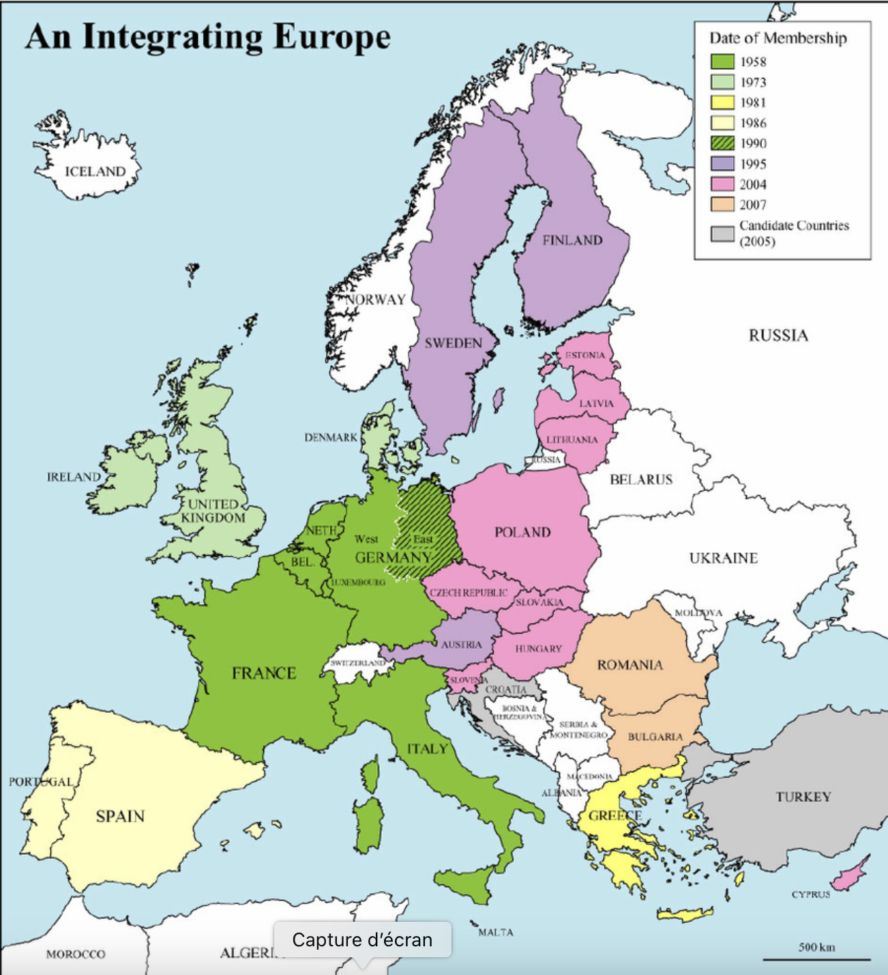
France within the E.U
Brief history 1950’s- today
I History of the EU from early 1950’s to today
Source: https://www.researchgate.net/profile/Andrew-Cumbers/publication/228765149/figure/fig1/AS:300880285978624@1448746858268/Map-of-European-Union-Enlargement.png
1956: 6 founding members
1973 + UK + Denmark
1981 + Greece
1986 + Spain and Portugal
1990: Germany’s reunification
1995 + Austria, Finland, Sweden
2004 + Eastern European countries+ Baltic States + Cyprus
2007 + Roumania and Bulgaria

Slide 6
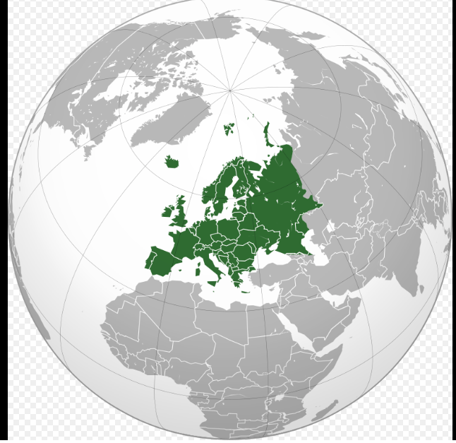
France within the E.U
I History of Europe from early 1950’s to today
‘petit cap occidental de l’Eurasie’ (Paul Valéry)
3,8 M km2 (7th biggest globally), 3 time zones
(5 in the US, 4 in Mexico, 11 in Russia)
446,7 M inhabitants= 5.7% of global population (340 M in the US)
(China and India= 18% +18%)
The oldest pop in the world in 2030 with
median age of 45 (40 in the US, 35 in Asia , 29,6 in Mexico, 21 in Africa)
And yet the EU in 2022 comes 3rd for its GDP in PPP (14,9% of
global GDP) behind China (18,4%) and the US (15,5%) ….
while
EU countries individually gradually retreat to the 10th to 20th place
This share of the EU in global trade has been declining over the recent period
(lost 9 points in 15 years)
Source: Wikipedia
Notes:
https://fr.wikipedia.org/wiki/Europe#/media/Fichier:Europe_orthographic_Caucasus_Urals_boundary_(with_borders).svg
https://www.statista.com/statistics/275555/median-age-of-the-population-in-mexico/
2025: Germany 3rd, France 7th, Italy 8th, UK 6th) https://www.statista.com/statistics/268173/countries-with-the-largest-gross-domestic-product-gdp/

Slide 7
France within the E.U
EU’s main principles
II The main principles
All policies from Treaty of Rome until 2020 are based on the freedom of circulation for commodities, services, citizens and capital within the common market. Turning point for common market 1986 in the liberal context of the 1980’s: Deregulation, and market competition
Rules of competition within the EU :
assessment at a European level of competitive market, not at a global level, thus hindering the birth of European champions; it is slowly changing (may change now with Trump’s re-election in the US)
the fines of Microsoft in the 2000’s, condemned for abusive dominant position
the prohibition of mergers:
2017 Deutche Börse+ NYSE Euronext for fear of monopolies on derivatives
2019 Alstom + Siemens for fear of monopoly on fast trains and signalisation
Tata + Thyssen Krups in the steel industry
State subsidies are allowed only in ‘exceptional circumstances’
Specific case for services provided by former public companies in charge of ‘key strategic’ sectors
- The example of the liberalisation of the sector of telecommunication : obligation to open national markets to competition Jan 1998, not exactly a success, not a common market but fragmentated national markets, prices still high and sometimes degraded service
Notes:
Microsoft, condemned in 2004’, 2006, 2008 for abusive dominant position with Windows and Internet explorer
https://ec.europa.eu/commission/presscorner/detail/en/ip_04_382
https://ec.europa.eu/commission/presscorner/detail/it/ip_19_2948

Slide 8
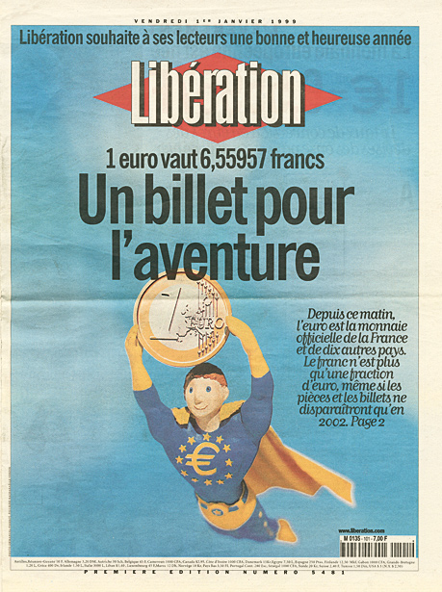
France within the E.U
France in the Eurozone
III Focus on France in the Eurozone: 1999 to 2024

Slide 9
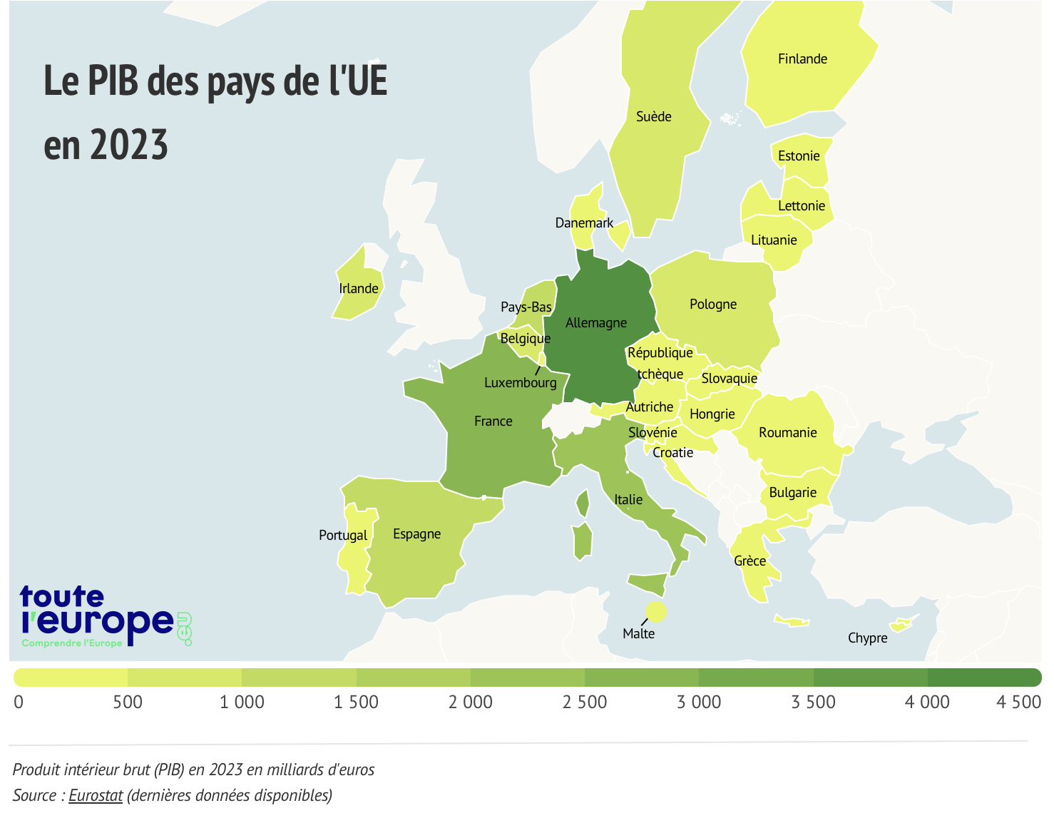
France within the E.U
GDP
III Focus on France in the Eurozone: 1999 to 2024
2023: EU GDP 17,1 Trillion $
US: 27 Trillion $
- In 2008, the eurozone and the US had equivalent gross domestic products (GDP) at current prices of $14.2 trillion and $14.8 trillion respectively (€13.1 trillion and €13.6 trillion).
- Fifteen years on, the eurozone's GDP is just over $15 trillion, while US GDP has soared to $26.9 trillion
4100
2800
2100
1500
As for the median American salary, it's $77,500, almost 1.5 times France's $52,800, according to the WSJ.
Source: Eurostat 2023
Source Le Monde Sept 4th 2023
Notes:
https://www.lemonde.fr/en/opinion/article/2023/09/04/the-gdp-gap-between-europe-and-the-united-states-is-now-80_6123491_23.html

Slide 10
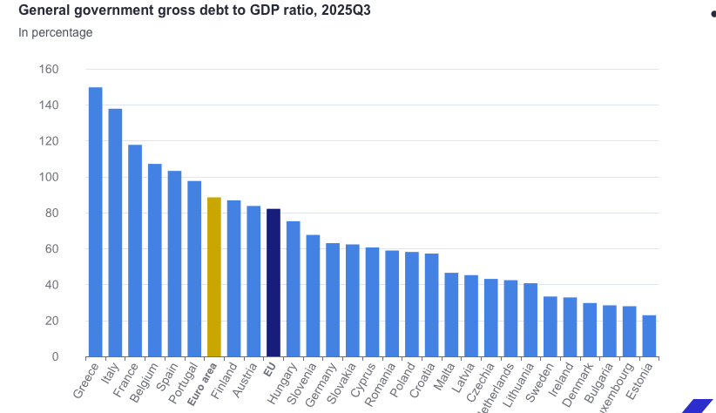
France within the E.U
Public debt
III Focus on France in the Eurozone: 1999 to 2024
Ratio Public debt /GDP
Source: Eurostat 2025
Definition of public debt:
sum of loans issued by the State, local authorities and social security bodies year after year (accumulation of public deficits/surpluses) and not yet repaid. Public debt (a stock) is linked to public deficit (a flow) for a given country which measures the difference between public spending in a given year and tax revenues for the same year
France in 2025: the stock of public debt is 3345 B €, 113.9 % of GDP (Insee)
Reminder: Maastricht Treaty, ratio government debt/GDP should not exceed 60%

Slide 11
France within the E.U
Exchange rate
III Focus on France in the Eurozone: 1999 to 2024
Definition of exchange rate, Forex and exchange rate system
1) The value of a currency for the purpose of exchanging it for another (Oxford)
Example 1 Euro= X USD, 1USD= X’ Euro
2) FOREX (or FX) over-the-counter (OTC) global marketplace that determines the exchange rate for currencies around the world. Participants in these markets can buy, sell, exchange, and speculate on the relative exchange rates of various currency pairs ( in a system of floating rates). (https://www.investopedia.com/terms/forex/f/foreign-exchange-markets.asp)
3) Exchange rate system: all the rules and regulations that govern the exchange rate of a currency
Free-floating or fixed floating
Most liquid trading pairs: $/€, $/Yen
The choice of a system of exchange rate has a major impact on a country’s economic poliy

Slide 12
France within the E.U
Devaluation/depreciation
III Focus on France in the Eurozone: 1999 to 2024
Advantages of a depreciation/devaluation of currency
Winners?
Exporters (companies + employees )
Domestic tourist industry
Should lead to more eco growth and improvement of
Current account deficit
Losers?
Importers
People on fixed income
Residents who travel abroad

Slide 13
France within the E.U
Mundell
III Focus on France in the Eurozone: 1999 to 2024
Mundell-Fleming impossible trinity
A
When defining an exchange rate system, there are three objectives
1) A fixed and stable foreign exchange rate
2) Free capital movement (absence of controls)
3) An independent monetary policy
A Central bank can pursue only two of the three
The introduction of a single currency led to adopting 1) and 2), thus impossible to lead a sovereign monetary policy;
important political decision made by economists, not everybody agrees it’s the right choice (Ex Dani Rodrick)
Eurozone is not an optimal currency area (little labor mobility, few transfer mechanisms, no fiscal federalism in comparison with the US or Canada for ex)
➔ In the context of the Eurozone, France (as all countries of the Eurozone) has renounced its sovereign economic policy (contrary to Sweden for ex)
Intermediary exchange rate system
Fixed exchange rate
Independent monetary policy
Fixed exchange rate system
Floating exchange rate system
B
C
Free movement of K
Source: Wikipedia
Notes:
https://en.wikipedia.org/wiki/Impossible_trinity
Dani Rodrik, advocates the use of 1 and 3, explaining that more controls of K leads to growth (as was the case in the Bretton-woods system 1944-1973); lack of K controls leads to a series of crises

Slide 14
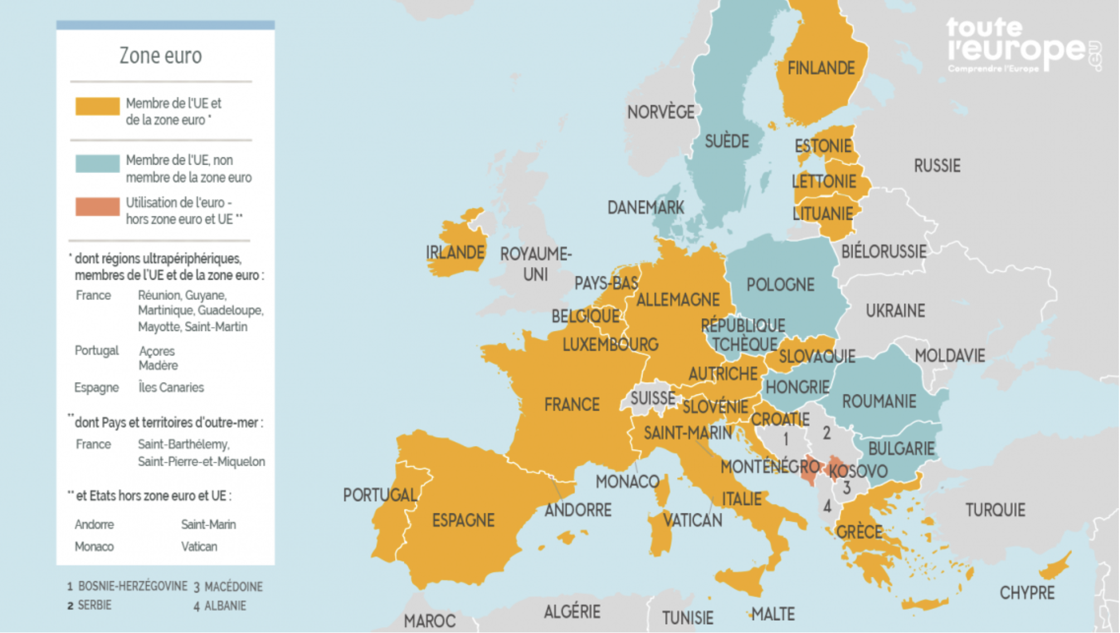
France within the E.U
Map of Eurozone
III Focus on France in the Eurozone: 1999 to 2024
The EU and the Eurozone
Source : https://www.touteleurope.eu 2024

Slide 15
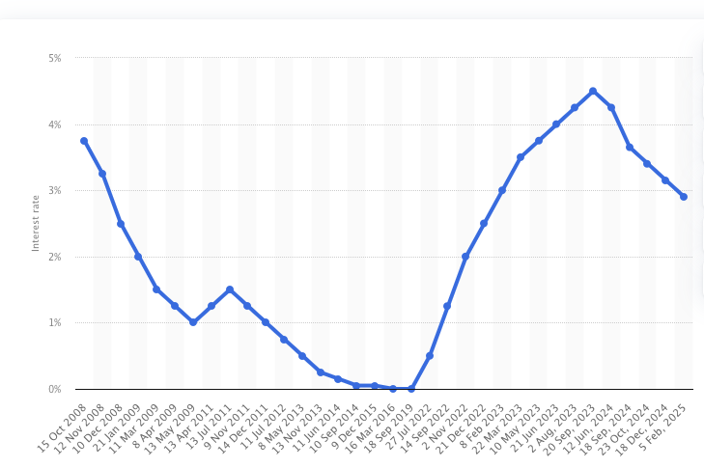
France within the E.U
Advantages of the €
III Focus on France in the Eurozone: 1999 to 2024
Advantages of a single currency
No more currency risks within the Eurozone
Lower transaction costs
More exchanges of goods and services between countries thanks also to greater competition between companies
Lower interest rates in certain countries based on the good credit history of the whole zone for Greece, Spain, Ireland
ECB Interest rates 2008-2025
Source: Statista 2025
Very low rates can be an incentive to get into debt
Notes:
The low interest rates have been a powerful incentive to get into debt (cf real estate bubble in Spain and Ireland for ex), powerful incentive to consume (while Germany was freezing wages under the Schröder’s govt- Hartz laws) ➔ huge deficits in current accounts for Southern European countries (while Germany was increasing its surplus)

Slide 16
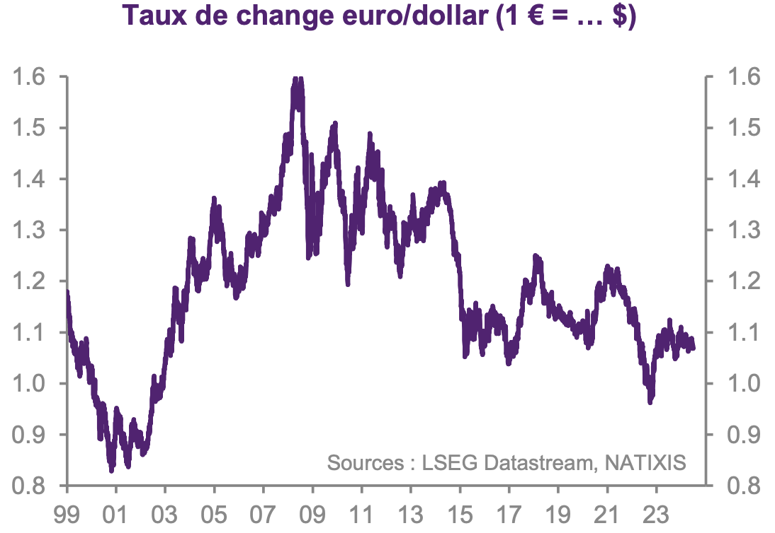
France within the E.U
III Focus on France in the Eurozone: 1999 to 2024
Drawbacks of the €
But devaluations are no more possible
Each country of the zone loses the ability to lead its monetary and exchange rate policy ➔ loss of a valuable instrument of economic policies
The Euro now floating against other currencies; its value is based on supply and demand of private operators
Advantage: enables to benefit from free circulation of capital + A sovereign monetary policy at the European level
Disadvantage: great volatility of the exchange rate
Exchange rate of the € against the $ between 1999 and 2024

Slide 17
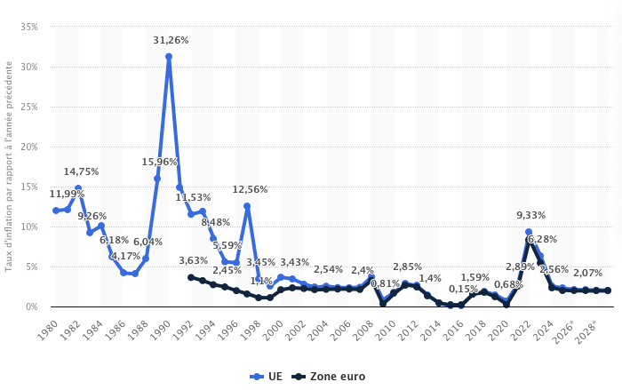
France within the E.U
Inflation in EU and Eurozone
III Focus on France in the Eurozone: 1999 to 2024
Inflation
Inflation rates between 1980 and 2024+ projections
Initial shock of inflation following the fall of Berlin Wall
Then, from 1992 to 2022 less than 5%
Feb 2022: War in Ukraine ➔ tensions on raw materials and spike in the cost of energy (gas imports from Russia)
Reminder: objective of ECB for inflation: max 2%
Source: Statista

Slide 18
France within the E.U
ECB policy
III Focus on France in the Eurozone: 1999 to 2024
How the ECB finances the European economy
Setting up of a unified eurozone interbank market, to meet daily refinancing needs of commercial banks (liquidity exchanges)
The ECB thus controls monetary creation by banks
- Use of the STR € Euro-Short-Term rate since 2019 (average interest rate charged by commercial banks on overnight interbank loans) – used to be called EONIA (Euro Overnight Index Average)
Objective of ECB
maintaining inflation rate under 2% in the medium-term
Main tool: Key rates (regulated rate at which ECB lends liquidity to commercial banks or remunerates short-term deposits)
If ECB identifies a risk of high inflation…
➔  key rates (ECB) ➔  €STR) ➔  interest rates for households and companies’ loans ➔ credit crunch (negative impact on the growth of money supply and economic activity) ➔ decrease of inflation
Notes:
https://www.banque-france.fr/en/monetary-strategy/guide-monetary-strategy
https://www.ecb.europa.eu/home/search/review/html/monetary-policy-instruments.en.html

Slide 19
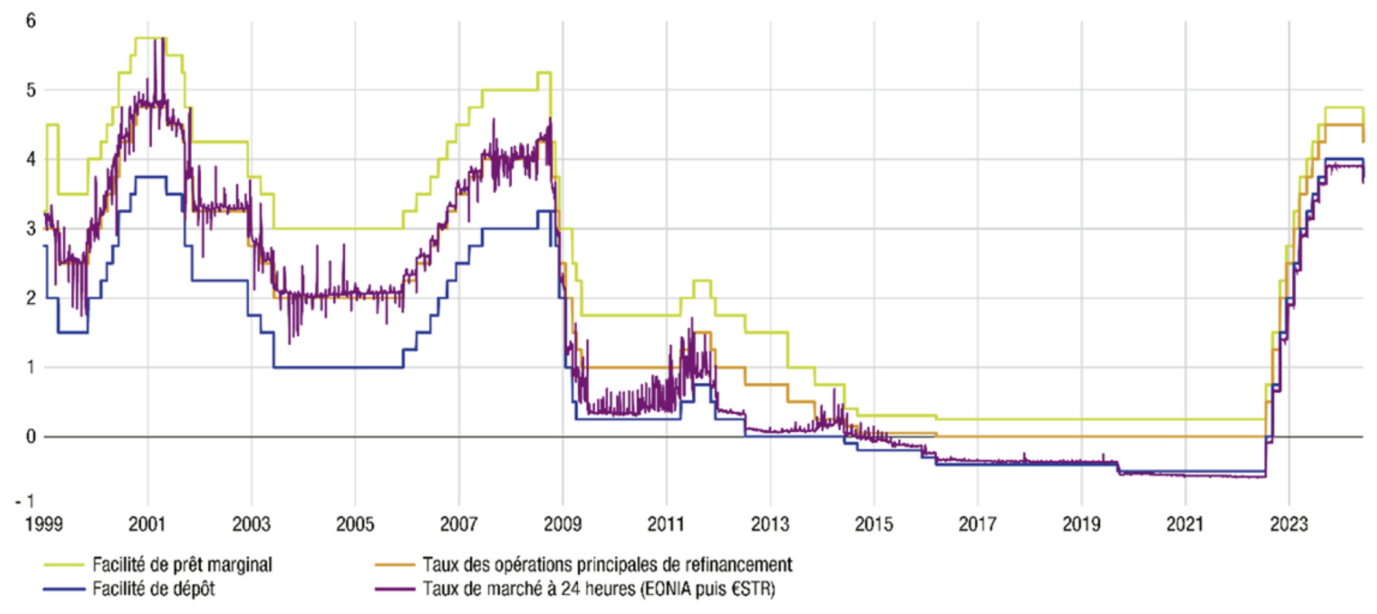
France within the E.U
ECB policy
III Focus on France in the Eurozone: 1999 to 2024
Key rates of the ECB and overnight interbank loans
Source: Banque de France 2024
Note: the short-term interest rate influences the long-term rate for household and companies’ loans
Marginal lending facility
Main refinancing rates
Deposit facility
$STR (24H)

Slide 20
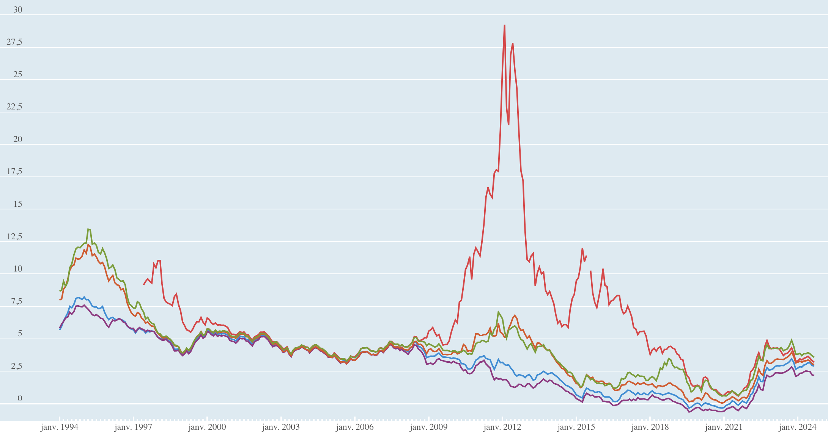
France within the E.U
interest rates on state borrowing
III Focus on France in the Eurozone: 1999 to 2024
Long-term interest rate on obligations of a few European states
In % par year (monthly average), 1994-2024
Interest rates on 10 year government bonds issued in April 2002 by Germany (5,2%), France (5,2%), Spain (5,3%), Italy (5,4%) and Greece (5,5%)
Interest rates on 10 year government bonds issued in Sept 2024 by Germany (2,2%), France (2,9%), Spain (3%), Italy (3,6%) and Greece (3,2%)
Importance of these rates on the repayment of debt
2005 Ex French debt= 67% of GDP, payment of interest= 2,7% of national wealth
2020 debt= 120% GDP, payment of interest= 1,4% of national wealth
Greece Italy Spain France Germany
Source: OECD 2024
Notes:
The importance of these rates ex: French debt in 2005= 67% of GDP, so the payment of interest= 2,7% of national wealth
In 2020: 120% of GDP, and payment of interest= 1,4% of national wealth

Slide 21
III Focus on France in the Eurozone: 1999 to 2024
Jarring current accounts in the EU
JARRING CURRENT ACCOUNTS of the Southern and Northern European countries between 1999 and 2011
From 2002 to 2008, the surpluses of northern European countries correspond to the deficits of Southern Europe (incl France)
After 2008-9, Southern European countries are forced to reduce their deficits and implement austerity policies

Slide 22
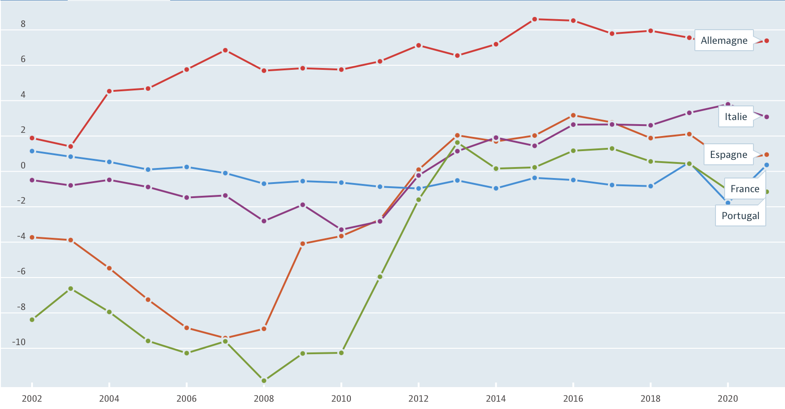
Current account balances
Current account balances of Germany, France, Italy, Spain and Portugal in % of GDP from 2002 to 2021
In 2008, deficit of 9% for Spain and 12% of GDP for Portugal. The subprime crisis in 2008 has led these countries to improve their C.A. balance
2020: Spain +0,8%, Italy +3,7%
In the 2000’s, important loans from Germany to the Southern European countries, this situation changed in 2008, when Germany stopped lending money within the Eurozone
➔ leading to a slowdown of economic activity and massive unemployment (2013: Spain 25%, Portugal 17%, Italy 13%, France 10%, Germany 5%)
Notes:
https://cepr.org/voxeu/columns/rapid-current-account-rebalancing-southern-eurozone

Slide 23
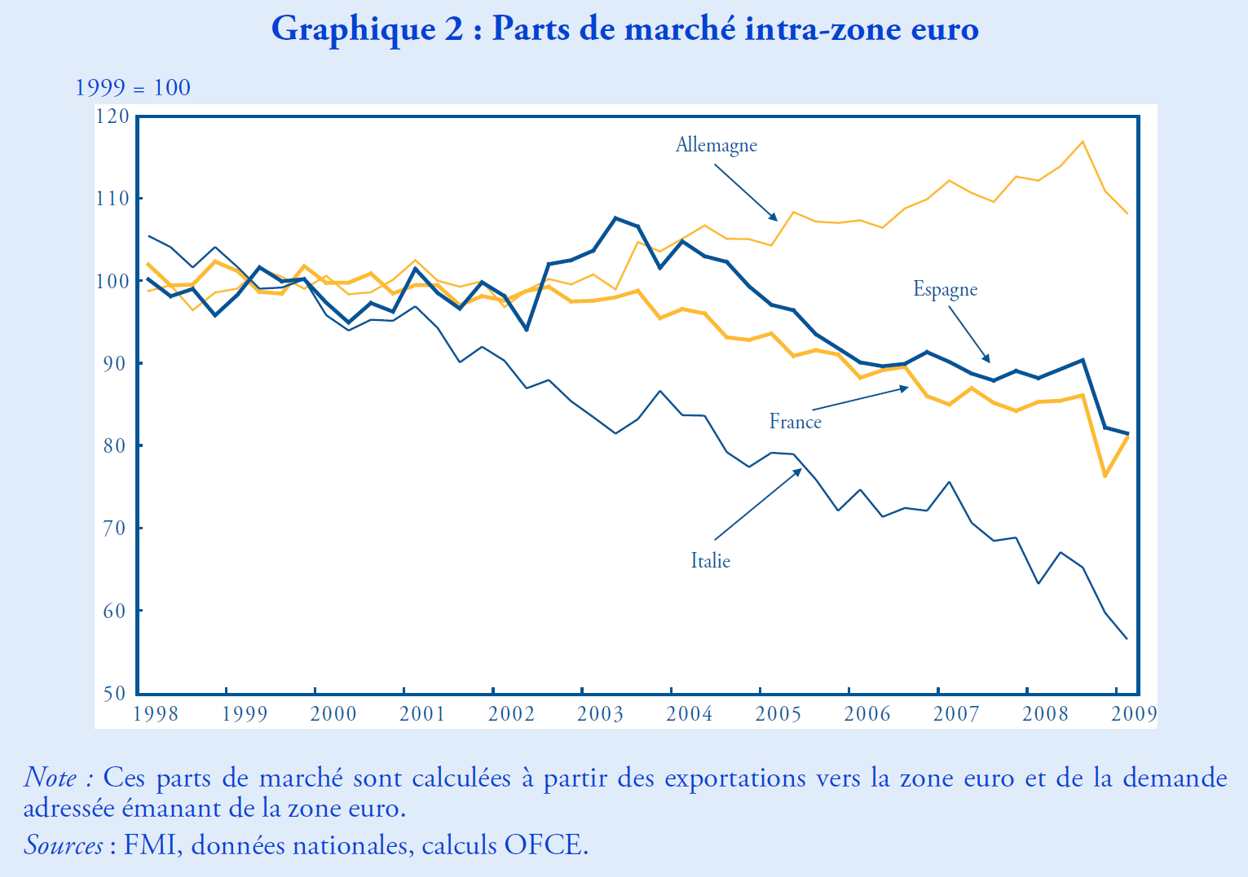
France and Germany’s competitiveness policy, a case of non-cooperation
Market shares within the Eurozone 1998-2009
Market share of Germany in the EU between 2001 and 2010: + 15% while France, Italy and Spain’s shares were decreasing
German trade surplus then led to an increase of the €, which degraded Southern European countries’ competitiveness even further
Source : OFCE, 2010
Notes:
.

Slide 24
Evolution of Unit Labour Costs in the market sector
2000-2009, in %
France and Germany’s competitiveness policy, a case of non-cooperation
Explanation of the difference between France and Germany’s ULC:
Inflation higher in France (1,8% while - than 1% in Germany)
Hartz laws 2003-24: liberalisation of the job markets (minijobs..) and downpressure on wages in the post-reunification context
Source : Alternatives Economiques, 2011
ULC =necessary labour cost for the production of one Unit of real GDP
Depends on
Real wages per head
Productivity per head
Inflation (deflated GDP)

Slide 25
All in all, from the 2000’s to 2015…
Conclusion for 2000-2015
➔ Increased competitiveness of Germany (both price and non-price) to the detriment of France, Spain, Italy,
Post 2008: Spain, Portugal, Ireland and Greece had to decrease their Labour Cost Units to compensate for the loss of competitiveness toward Germany
➔ Particularly true for the industry
➔ Trade surplus for Germany, which granted loans to Southern Europe that had to finance its deficit (until 2009-10)
➔ Sovereign debt crisis (2009 to 2012): threat of Grexit, and the debt crises of Spain, Portugal, Ireland and EU bail-outs, leading to austerity policies. Then economic stagnation, deflation…
➔ AT the EU level, (compared to the US) decreasing household spending, stagnating private and public investment, current account surplus (2,7% of GDP in 2024), threat of deflation
Notes:
https://www.banque-france.fr/system/files/2025-01/ECB-press-release_2025-01-13_Euro-area-quarterly-balance-of-payments-and-international-investment-position-third-quarter-of-2024.pdf

Slide 26
2015:ECB’s reaction to the risk of deflation
The ECB decreased its key rates to less than 0% to discourage banks from keeping assets in the ECB and to stimulate loans
The implementation of a non-conventional monetary policy of Quantitative Easing (QE)
Source : BCE ;
Banque de France, 2024
Notes:
https://www.banque-france.fr/statistiques/taux-et-cours/les-taux-monetaires-directeurs

Slide 27
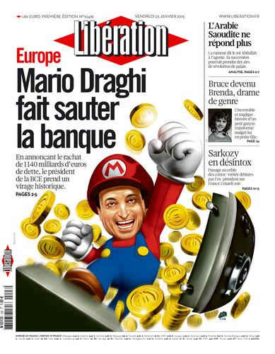
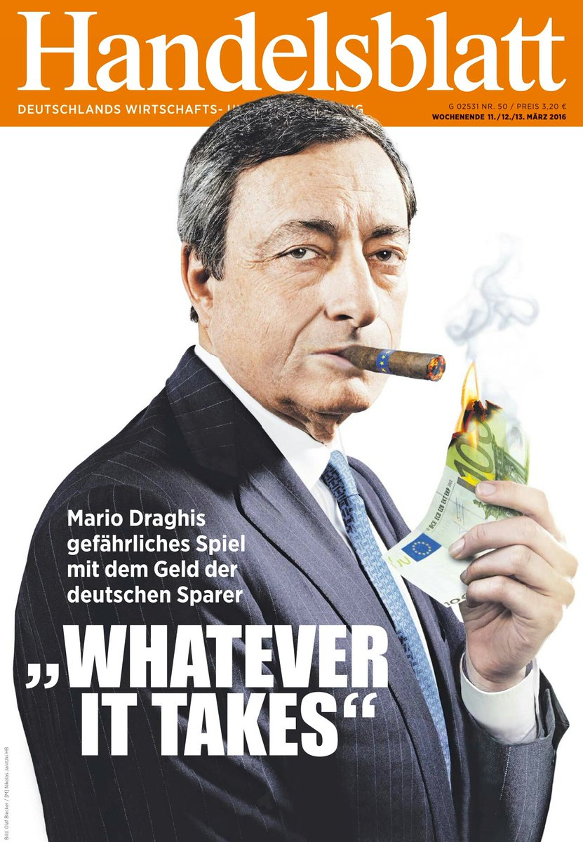
Source : Libération, 2015
Handelsblatt, 2016
QE
Since 2015 , the BCE has set up a program of asset purchases, including a substancial proportion of government debt securities
Objectives:
Decrease rates in the medium/long term
Decrease the cost of EU countries’ public debts
Encourage banks to buy other types of assets (private bonds, shares, etc)
Decrease the exchange rate of the Euro
Notes:
https://www.banque-france.fr/statistiques/taux-et-cours/les-taux-monetaires-directeurs

Slide 28
QE
Debt owned by the ECB
Every month the ECB buys securities to fight against deflation, in a context where interest rates were about 0%
This program was stopped in 2018, then re-launched in 2019, and then reinforced following the Covid-19 pandemic.
It was stopped in June 2022 following the return of inflation
Source : Natixis, 2020
Notes:
https://www.lesechos.fr/finance-marches/marches-financiers/030785985975-la-politique-monetaire-de-la-bce-en-5-dates-2125376.php
https://www.lesechos.fr/finance-marches/marches-financiers/030785985975-la-politique-monetaire-de-la-bce-en-5-dates-2125376.php
http://abonnes.lemonde.fr/economie/article/2016/06/08/la-bce-commence-a-acheter-des-dettes-d-entreprises_4942450_3234.html

Slide 29
QE
Public sector bonds owned by the ECB (in % of GDP)
In comparison with the UK, the US and Japan
AT the end of 2018, the ECB owned a stock of debt securities representing 20% of the GDP of the Eurozone. // Japan 80%

Slide 30
Consequences of Q.E.
QE
Eurozone: 10 year interest rates on government bonds in %
Eurozone: fixed interest rates for households and companies
Following the announcement of implementation of QE in 2015, sharp drop of the long-term interest rates for public debt obligations in the Eurozone
The same process took place for private debt securities

Slide 31
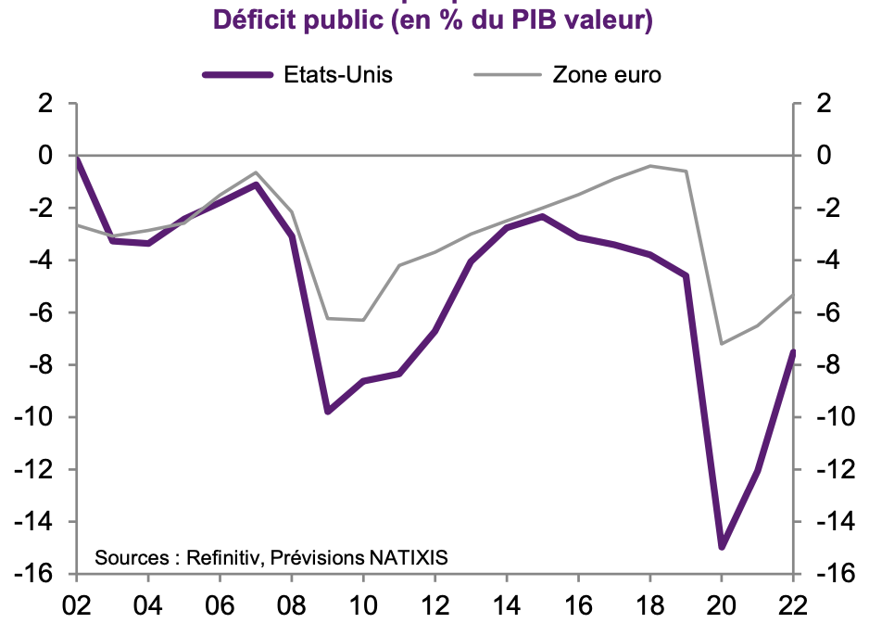
Reaction of the ECB to the Covid-19 crisis
Public deficit of the Eurozone and the US (in % of GDP)
Rules for budgetary discipline according to Maastricht Treaty
a deficit-to-GDP ratio not exceeding the reference value of 3% ·
a debt-to-GDP ratio not exceeding the reference value of 60%.
Covid-19 crisis: less fiscal revenue, expansionist monetary policies
➔sharp increase of public debt in the EU and in the US
Notes:
https://ec.europa.eu/eurostat/web/government-finance-statistics/excessive-deficit-procedure

Slide 32
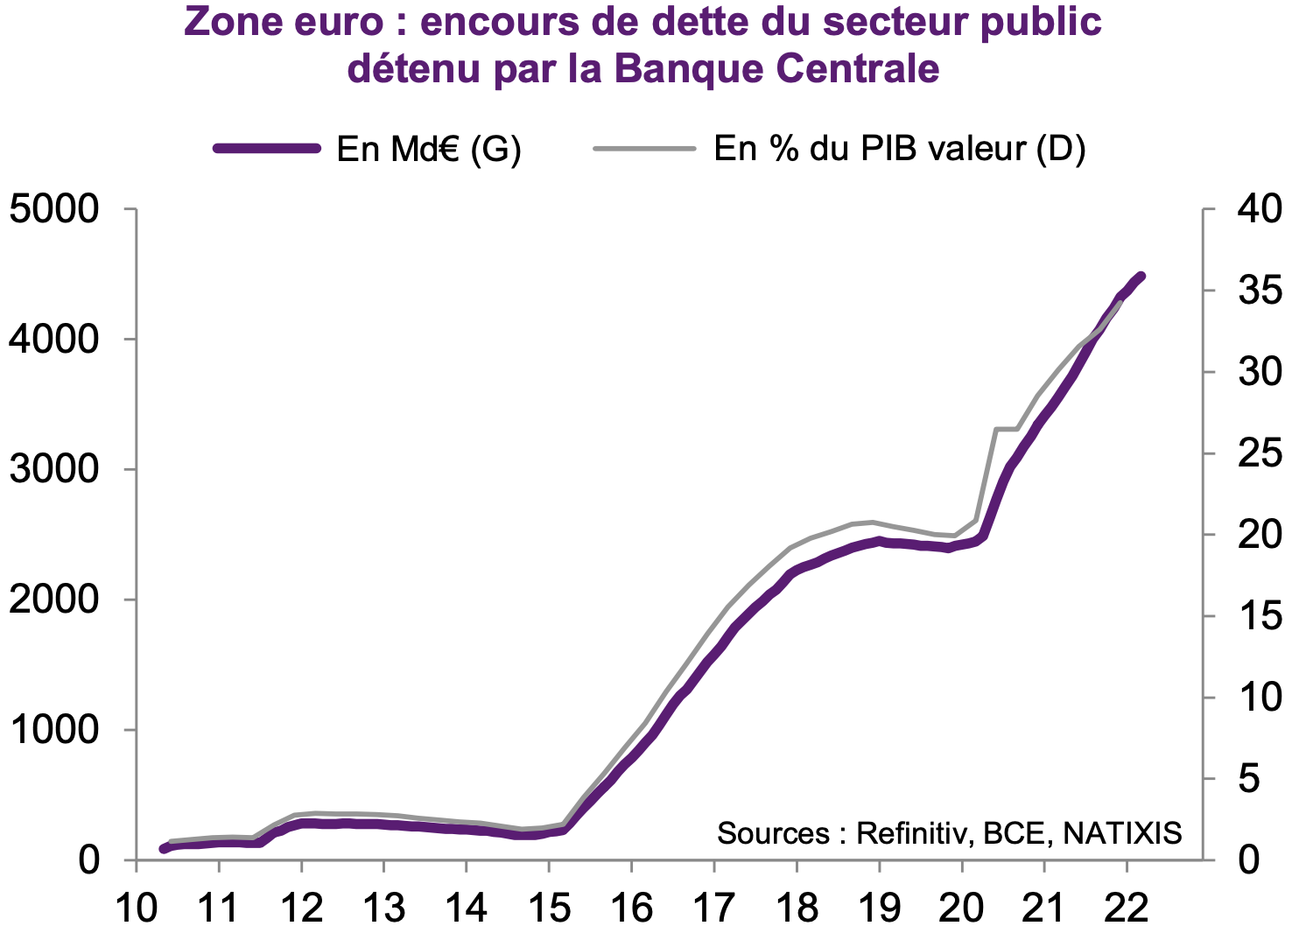
Reaction of the ECB to the Covid-19 crisis
Public debt owned by the ECB
ECB bought an exceptional securities purchase program of 1850 B €= monetisation of public debt, to contain the cost of government debt and guarantee the solvency of government budgets
The Pandemic Emergency Purchase Program (PEPP)
Source : Natixis, 2022
Notes:
https://ec.europa.eu/eurostat/web/government-finance-statistics/excessive-deficit-procedure

Slide 33
From 2021 onwards, surge of inflation in Europe..
Main causes
Increase of the demand for goods following the pandemic
Persistent disruptions to supply chains
Impact of the war in Ukraine on commodity prices (energy, food)
Combined effect of the energy transition on commodity prices
Consequences
ECB stopped Q.E.
ECB raised its key rates (first time since 2011) from 2022 (approx 0%) to Sept 2023 (approx 4.25)
Have started decreasing since end 2023- 2025: 2,9% June 2025=2%
Inflation is back!
Notes:
https://www.ecb.europa.eu/stats/policy_and_exchange_rates/key_ecb_interest_rates/html/index.en.html

Slide 34
To conclude…
Since 2008, Europe has had to face several crises that threatened its very existence (current account balances crisis, sovereign debt crisis, Covid crisis, Inflation crisis), the ECB has played a key role in saving the €
Yet, the ECB cannot solve the problem of structural heterogeneity of the EU, which has worsened since the creation of the €

Slide 35
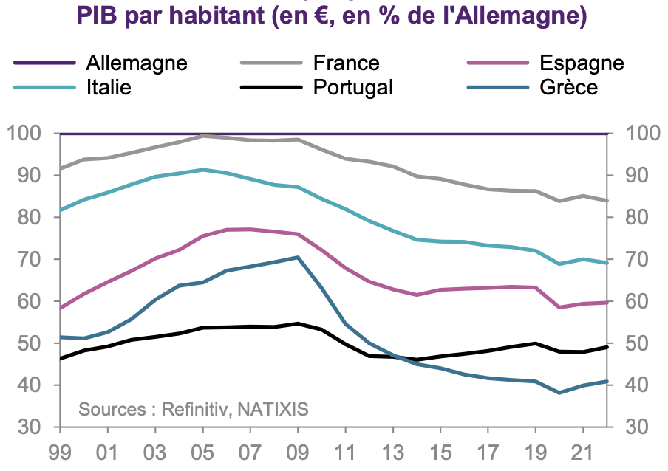
To conclude…
GDP per capita for Southern European countries in % of GDP per capita of Germany
Exchange rate overvalued for France/Italy/Spain/Portugal/Greece
The case of Sweden:
Is it time for Sweden to join? Arguments for and against
https://cepr.org/voxeu/columns/it-may-be-time-sweden-join-euro
https://theconversation.com/could-global-tensions-finally-see-sweden-warming-towards-the-euro-276906
Notes:
https://cepr.org/voxeu/columns/it-may-be-time-sweden-join-euro
https://theconversation.com/could-global-tensions-finally-see-sweden-warming-towards-the-euro-276906

Slide 36

To conclude…
This divergence could fuel a negative perception of the EU by these countries/ Euroskepticism unless…
Germany (which has been struggling economically in the past two years -0,3% 2023; -0,1% 2024; 0,2% 2025 and questioning its economic model based on exports) coordinates with the rest of the EU and agrees to loosen the budget rules in the EU
There is a collective response to the geopolitical and economic threats from the US… along with a common budget and common fiscal policies, which would mean a federation of states
Ex of Next Generation EU (2020) : common debt of 750 B € owned by the 27 member states to finance national programs through subsidies and loans
40 B€ for France to finance green transition, competitiveness and innovation, social and territorial cohesion
It’s now more a political question than an economic one!
Notes:
https://www.lemonde.fr/livres/article/2012/02/07/zone-euro-eclatement-ou-federation-de-michel-aglietta_1639971_3260.html

Slide 37
Quiz Part 1 Slides 1 to 19
How can we explain the French people’s NO-vote to the Constitutional Treaty in 2005? (2)
Give two other events that show some reluctance of the French towards the EU (1)
When was the Euro introduced, for how many countries? (3 + 13)
Give 3 striking figures that characterize the EU (5)
Explain the Mundell –Fleming impossible trinity? (12)
Give at least three advantages that the € has brought (14)
What major instrument of economic policy France- as well as other EU countries – lost in the process? (12)
Interest rates and the Euro: what do you remember? (14-18-19)

