Slide 1
Outline
I Overview of the French history
1) From 467 to the Renaissance era
2) Lyon in the Renaissance (XVIth century)
3) XVIIth and XVIIIth century France
4) XIXth century
5) XXth century
II The Welfare State ‘à la française’
1) Origins: colbertism and state intervention (XVII and XVIIIth century)
2) 1800-1945
3) Post-War reconstruction and the ‘Thirty Glorious Years’ (1945-1975)
4) From the 1980’s: globalization and neoliberalism
Permanent features defining the economy, but also cycles and changes

Slide 2
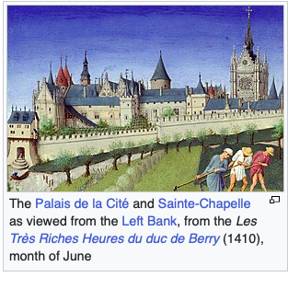
From 1025 to 2025!
1) From 467 to the Renaissance
Collapse of Roman Empire (467)
unlinked The French (Franks) economy from Europe, decline of trade, society based on self-sufficient manor (limited international trade of silk, papyrus and silver carried out by foreigners)
Carolingians (800-887):
improvements of agriculture production, but Arab raids and Viking invasions leading to a decrease of urban activity, retreat into agricultural settlements, isolated military, church and royal centers
High Middle ages (1000-1300)
dvpt of urban life (Paris most important city in Europe, La Sorbonne 1150 one of the 1st Uni in Europe)- feudalism; trade starts to flourish

Slide 3
From 1025 to 2025!
1) From 467 to the Renaissance
1335-1450:
Bad harvests, famines, plagues and wars, population dropped from 17M to 12M in 130 years
Renaissance (XVth and XVIth century)
Dynamic demographic growth, dvpts of agriculture and industry. Most populated country of Europe until 1795, 3rd in the world after China and India.

Slide 4
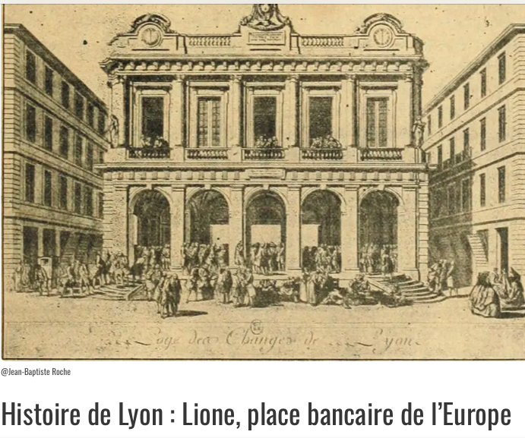
From 1025 to 2025!
2) Lyon in the Renaissance era
(XVIth century)
Introduction of printing (Paris and Lyon), dvpt of mineral mining in Northeast France, glasswork and silk (Lyon and Tours), wool
Lyon in the Renaissance era
Center of France’s banking and international trade markets (fairs four times a year to export cloth and fabrics, imports of Italian, Dutch and English goods). Also imports of exotic goods such as alum, glass, wools, spices and dyes. Lyon contained houses of most of Europe’s banking families (Fugger and Medici), mostly from Firenze and Genoa
Importance of textile industry
Commercial and financial crossroads, “l’égale ou presque de Florence, de Rome, de Gênes, d’Anvers, de Valladolid ; supérieure à Amsterdam, Augsbourg, Nuremberg et Genève”, Richard Gascon
“Lyon l’italienne, Lyon la magnifique.” (Michel Morineau)
Elite at that time: merchant-bankers, mostly located in Vieux-Lyon, quartier Temple du change, grant loans to the King of France himself
1st Stock Exchange in France, where the exchange rate of European currencies is set
Golden age of Italian bankers ended in 1555, when Henry II fails to repay his debt
Trade routes between Lyon-Paris-Marseille-Rouen
Notes:
Alun: material used to dye cloth

Slide 5
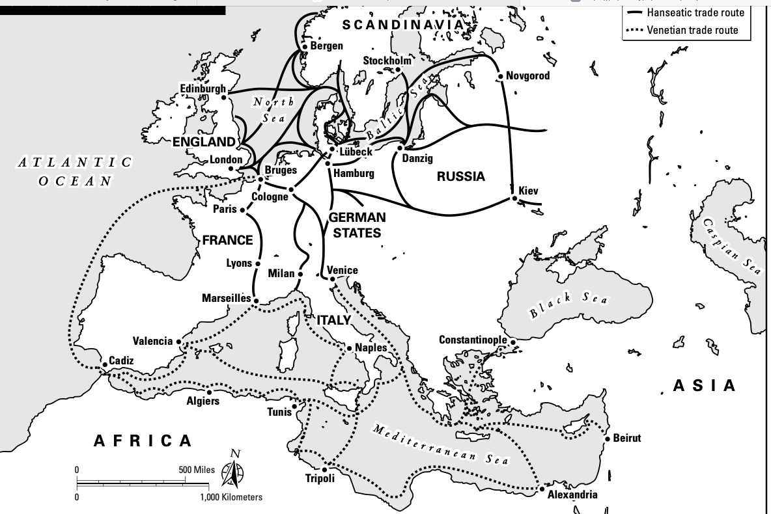
From 1025 to 2025!
2) Lyon in the Renaissance era
(XVIth century)
Trade routes between Lyon-Paris-Marseille-Rouen

Slide 6
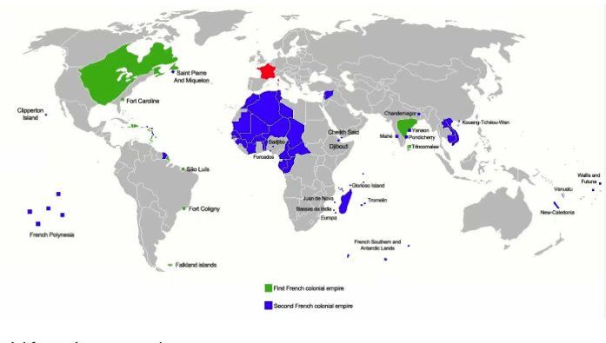
From 1025 to 2025!
2) Lyon in the Renaissance era
(XVIth century)
Beginning of colonial expansion in the Americas and Caribbeans
Exploration of the New World (Jacques Cartier in Canada)
Under Francis I (1515-1547) and Henry II (1547-1559) , trade balance in favour of France with England, and Spain, balanced with the Netherlands, but large deficit with Italy (silks).
Then competition with English, Dutch and Flemish maritime activity led to the displacement of major markets to the NorthWest, leading to the decline of Lyon
Source of map: https://histoire-itinerante.fr/cartotheque/premier-second-empire-colonial-francais/

Slide 7
From 1025 to 2025!
3) XVIIth and XVIIIth century
XVIIth Louis XIV- Colbert (1665-1683) and the mercantile system
Protectionism and state-sponsored manufacturing; massive investment in luxury goods and court life as well as the mediatization of these products made France the country of good taste;
Creation of a centralized, fortified state supported by very high tariffs
But revocation of the Edict of Nantes led to more than 200 000 Huguenot refugees (highly educated artisans and business owners) to flee+ expensive wars led by the King. Most French people ended up poorer
XVIIIth slave trade
‘Négriers’ were merchants who specialized in funding and directing cargoes of black captives to the Caribbean colonies (Saint-Domingue, Guadeloupe, Martinique)– coffee, sugar, cotton, tobacco and..slaves in Africa (from Nantes)- expansion of international trade via French East India Company for example
= 25% French national income in 1789

Slide 8
From 1025 to 2025!
4) XIXth century
French Revolution and XIXth
Revolution= massive upheaval of the economy
IN 1815, overwhelmingly a land of peasant farms, with some handicraft industry; urban centers had little industry. GDP per capita lower than Britain and the Netherlands
Pace of industrialization slower than Britain, Germany, the US and Japan. Tightly held family businesses, which emphasized traditionalism and paternalism. A strong banking system, Paris center of luxury (grands magasins) , but few large industries and giant corporations.
Advent of railways= positive impact, stimulus for metallurgy, coal and engineering
End of XIXth-early XXth: birth of French colonial empire- tariff-exemption zone between France, Algeria, Indochina, Caribbean colonies, Gabon, Tunisia, Madagascar. Preferential system with French West Africa, New Caledonia and Saint-Pierre et Miquelon
1913: the Empire absorbed 13% of French exports and 9,4% of its imports, larger than trade with Germany+Belgium+Luxembourg

Slide 9
From 1025 to 2025!
5) XXth century
XXth
Economic challenges due to WWI and WWII
Post-economic recovery (‘les Trente Glorieuses’)1945-1970
Nationalization of key industries, construction of comprehensive infrastructures, growth of the Welfare State and integration in the E.U.
70’s:
Oil-crises, rising unemployment, stagflation
80’s
Third wave of globalization- liberalization

Slide 10
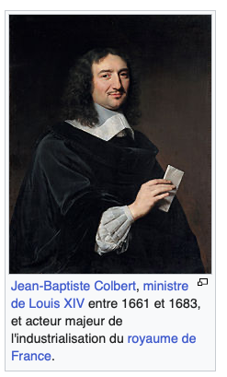
The Welfare State ‘à la française’: compatible with market capitalism in the XX1st century?
Origins: Colbertism and state intervention (XVII, XVIIIth century)
Finance Minister of Louis XIV (1643-1715)
Competing with Dutch maritime hegemony, attempt to conquer markets for
the prestige of the King
Aim:
Creating a unified national market capable of resisting competition ➔
Protectionist policy
Means:
Reduction of the load of internal duties, tolls on routes;
attempt to raise quality of French products to tap the luxury markets (by importing highly qualified foreign workers), hence strengthening of manufacturing standards, imposed universal rules and inspections
put all manufacturers (guilds, free trade, priviledged manufacturers) in direct competition, stamping of products to promote French quality, and stimulate innovation.
Source: Wikipiedia

Slide 11
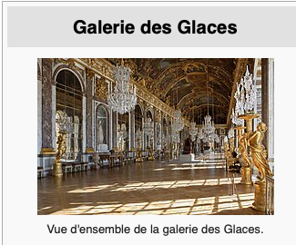
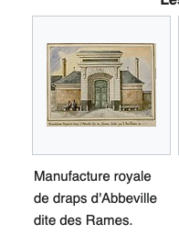
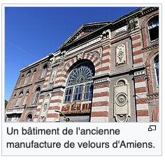
The Welfare State ‘à la française’: compatible with market capitalism in the XX1st century?
Origins: Colbertism and state intervention (XVII, XVIIIth century)
Manufacture of Saint-Gobain, glass industry to decorate Versailles, military material for the King’s Army.
Colbertism has come to designate the control of the Central State over economic activities: price setting, norms and regulations
French version of Mercantilism
Ex: production of sheet – Netherlands,
England, Abbeville (Somme)
Source:The Market Economy and the French State: Myths and Legends around Colbertism by Philippe Minard

Slide 12
The Welfare State ‘à la française’: compatible with market capitalism in the XX1st century?
Origins: Colbertism and state intervention (XVII, XVIIIth century)
In short:
Accumulation of gold
Developing the national industry by importing foreign technologies
Surplus in the trade balance by limiting imports (using tariffs- ex forbade the import of lace) and subsidizing exports, for a country that sells abroad and buys domestic
Formation of trading companies to obtain monopolies for French commerce abroad + formation of a colonial empire
This model has been prevalent in France until the 1980’s
France is integrated in EU and international competition, and in global supply chains after 1970’s.
XX1st century: Very different context altogether: Trade surplus is not something that always has a positive connotation (ex Germany); global supply chain

Slide 13
The Welfare State ‘à la française’: compatible with market capitalism in the XX1st century?
2) 1800-1945:
State-led industrialization, through the development of infrastructure projects (railroads, canals), urban planning (Hausmann in Paris) and founding of national industries (steel, coal, etc)
Not a take-off (like Britain) but a slow process
1803 Franc Germinal
1800 Banque de France
XIXth capitalism based on small family businesses, mostly self-funded
France still mostly rural, and strong territorial segmentation (Brittany and Limousin large population few industries, North and Lorraine densely populated with industries)
Series of crises and recovery periods
Impact of the 1929 crisis, hit later and less strongly, and takes longer to recover

Slide 14
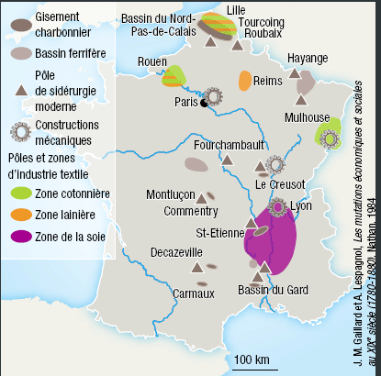
The Welfare State ‘à la française’: compatible with market capitalism in the XX1st century?
Source: Alternatives économiques
https://www.alternatives-economiques.fr/regions-industrielles-france-1800-1880-0105201260336.html

Slide 15
The Welfare State ‘à la française’: compatible with market capitalism in the XX1st century?
3) Post-War reconstruction and the ‘Thirty Glorious Years’ (1945-1975)
the CNR program (Conseil National de la Résistance), Nationalization of the economy
and the ‘Glorious thirty’ (1945-1975)- Wirtschaft swunder/miraculo economico
Why?
A willingness to be independent in a background of Cold War (De Gaulle): priority given to economic sovereignty (dvpt of nuclear energy) and national defense
The context of reconstruction
Marshall Plan (1948-51) France 2nd recipient after GB and Monnet Plan (1945)
1950-75: Growth rate= 5% (average Europe 4.6%)
National context :
Baby boom- consensus of ALL political parties to join forces in a government from left ot right
Creation of the E.N.A (Ecole Nationale d’Administration), very qualified ‘hauts-fonctionnaires’ to lead national policies
International context: Cold War, Bretton-Woods and stability of exchange rates
A wave of nationalizations (sometimes punitive one like Renault) in banking and credit industry (Banque de France, SG, Crédit Lyonnais, BNP), industrial firms (Renault, SNECMA), transport companies (Air France, SNCF), energy utilities (EDF, GDF)
‘dirigism’ and large-scale (indicative) planning
Social Welfare development: La Sécurité Sociale 1945. + creation the SMIG (minimum wage) 1952
Notes:
SMIG: Salaire Minimum Interprofessionnel Garanti (SMIG), has become SMIC (C for ‘croissance’= growth)

Slide 16


The Welfare State ‘à la française’: compatible with market capitalism in the XX1st century?
3) Post-War reconstruction and the ‘Thirty Glorious Years’ (1945-1975)
‘high-tech colbertism’ (Elie Cohen) :French national champions in energy (EDF, Areva), transport (SNCF) and defense (Safran). The State traditionally supports – or sometimes directly controls large industries like aerospace (Airbus) and automative sector (Renault, Stellantis) or airline company like Air France, hence the idea of state capitalism, ‘capitalisme administré’
// ‘americani. ‘ ‘Americanization of society’,
Mass consumption
Enlarged middle class
mass consumerism
Notes:
Stellantis (2021) = merger of PSA, Fiat and Chrysler

Slide 17
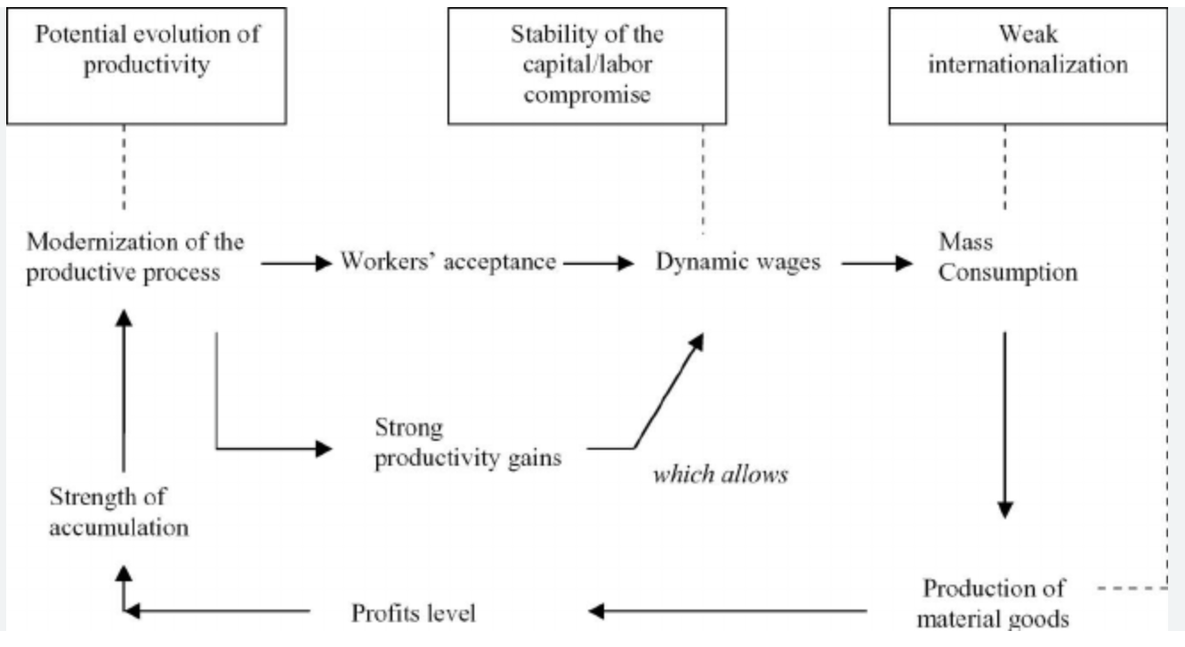
The Welfare State ‘à la française’: compatible with market capitalism in the XX1st century?
3) Post-War reconstruction and the ‘Thirty Glorious Years’ (1945-1975)
The Virtuous Circle of Fordist Growth (Source : Boyer (2004a).
Effective until the 1970’s- then in crisis:
International competition, no more productivity gains, oil shocks

Slide 18
The Welfare State ‘à la française’: compatible with market capitalism in the XX1st century?
4) From the 80’s: globalisation and neoliberalism (M. Thatcher, R. Reagan) to today
1981: François Mitterand, Socialists and communists in power, new wave of nationalizations-
6 Million public jobs, public companies= 40% global industrial production, 90% of cash deposits in public banks
1983: shift in policy to a more market-oriented approach, back to austerity policy
Anglo-saxon capitalism (free competition; flexibility of job market, development of financial markets) seems better suited to this global context
+ reinforced integration in the E.U.
Still, France remains a country with free health system and free education , high taxes (see next slide), very codified labour laws, and of economic patriotism.
Focus on contemporary France
‘les intermittents du spectacle’ and ‘l’exception culturelle française’ (culture is not a commodity)
Other examples
1988 ‘Je suis français, j’achète français’
1996: ‘Nos emplettes sont nos emplois’ (https://www.lefigaro.fr/societes/2016/11/02/20005-20161102ARTFIG00002-nos-emplettes-sont-toujours-nos-emplois.php)
2006 : law that deters foreign companies from buying French companies (ex Arcelor-Mittal)
2005: list of strategic activities (detection material, chemical weapons production, private security)

Slide 19
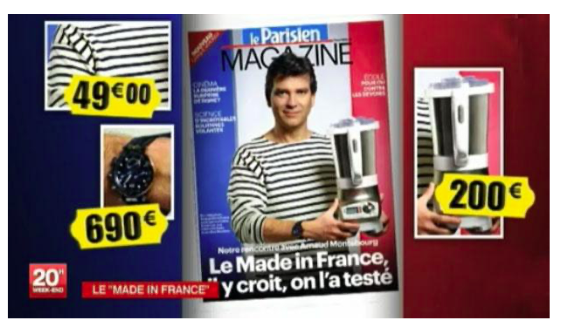
The Welfare State ‘à la française’: compatible with market capitalism in the XX1st century?
4) From the 80’s: globalisation and neoliberalism (M. Thatcher, R. Reagan) to today
Source: https://www.ina.fr/ina-eclaire-actu/2012-lorsque-arnaud-montebourg-pronait-le-made-in-france

Slide 20
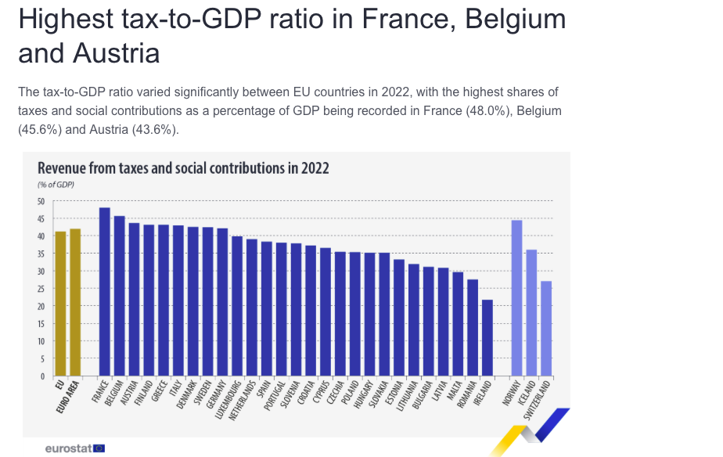
The Welfare State ‘à la française’: compatible with market capitalism in the XX1st century?
Weight of Taxation in the EU
Source : INSEE

Slide 21
The Welfare State ‘à la française’: compatible with market capitalism in the XX1st century?
4) From the 80’s: globalisation and neoliberalism (M. Thatcher, R. Reagan) to today
Things are changing though.. Take-over of Alstom by General Electric
2014: GE suggests buying Alstom for 13 Billion $, the board agrees, but the Ministre du redressement productif Arnaud Montebourg rejects the offer, to protect the national firm from foreign appetite. 2014, E.Macron (minister of economy in a socialist government) agrees and the firm is bought for 13,5 B $
Still, French people agree that the French State should still play a part in reducing inequalities- trust in social protection (See European value survey) and yet a growing reluctance to pay (more) taxes ➔ ambivalent relationship
2022: tariff shield on energy prices, the ‘whatever-it-takes approach’ (https://www.intereconomics.eu/contents/year/2023/number/1/article/exiting-the-energy-crisis-lessons-learned-from-the-energy-price-cap-policy-in-france.html)
A few key figures :
Hourly wage 2022: 43 €/hour ( 31.8€ EU)
Social contributions for companies 10% of GDP in value. (8% EU)
Tax on production 3,5% of GDP (0,5% Germany)
13,2% of GDP to civil servants’ wages (EU average 11%, Germany 7,4%)

Slide 22
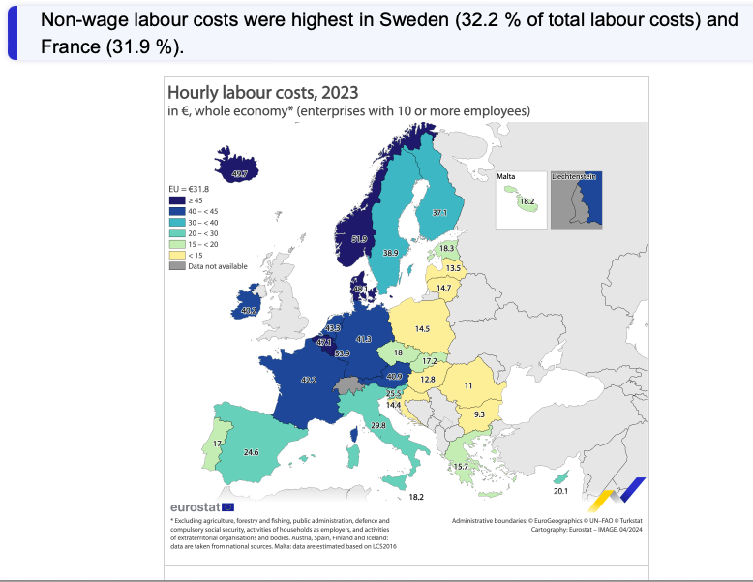
The Welfare State ‘à la française’: compatible with market capitalism in the XX1st century?
Source: Eurostat

Slide 23
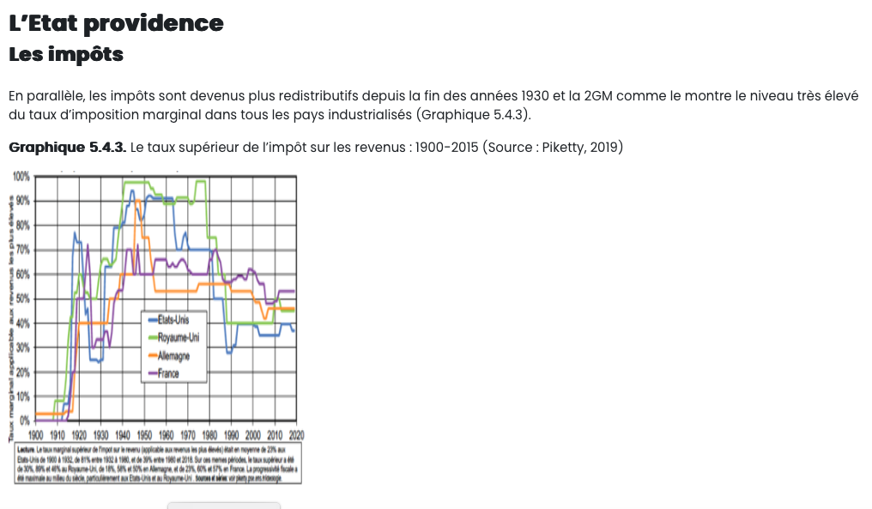
The Welfare State ‘à la française’: compatible with market capitalism in the XX1st century?
Definition of marginal tax rate:
Tax that applies to the highest tranche of your income, percentage of tax applied to each additional $ or € within a specific bracket, rather than on your total income
Source: Thomas Piketty
2019
Conclusion: The French model definitely has its good sides (cf better resistance to economic crises, tighter control on finance)
But also its negative sides (including the French obsession with regulation, very much criticized by The Economist for example)
Strongly criticized as outdated and rigid (end 90’s early 2000’s).. Until 2008 crisis when France’s weaknesses (ex high savings in non-risky placement) have become a strength.
Same with Covid-19 crisis
Still, the model HAS TO be reformed (cf huge amount of debt) if it wants to remain an essential part of the European model
Notes:
In the 1940’s: taxation rate in GB (95%!), in the US 80%, Germany 60%, France 50%
In the 1980’s _____________GB (75%, ) in the US 70%, 65% France, 55% in Germany
In 2020 France 55%, GB and Germany 45%, US less than 40%

