Slide 1

France in Economic Globalization
Objectives of the class
-
Give you an insight into the current global economic situation, as well as an overview of French economic history
Using this knowledge of macro-economic issues as a business student
Focus on ECONOMIC globalization
MMIC program
Module: economics
Course: Economic Globalization
Laurence Collaud
Notes:
As a business student: someone who works in logistics/supply chain, needs to understand how inflation of raw materials will affect turnover, someone working in finance needs to understand the basics of a financial crisis

Slide 2
Outline of the 6 sessions
Session 1 Tuesday March 10th : General intro, introduction to key economic concepts, quick overview of French economic situation in 2026
Session 2 Friday, March 27th: The historical context- The role of the French state in French capitalism
Students’ Presentation: French people’s attitude to globalization, an ambivalent relationship? (mariana, maive, Epainette)
Session 3 Monday, March 30th: France within the EU
Students’ presentation : France and the Euro, benefits and drawbacks (Evelina, Jack, Godfield)
Session 4 Monday, April 20th: France’s major industries and globalization
Students’ presentation: French trade balance and current account balance (Pablo, Lisa, Evelina)
Session 5 Tuesday, April 28th : France’s key trade partners and the role of French multinationals
Students’ presentation: The role of the French government in attracting Global investment Monique, Lucy)
Session 6 May 5th : French Multinational companies
Students’ group presentation: different French MNC (Fadoua, Kaitlien, Rachel) s +EXAM
Requirement for presentations: send me the PPT at least 48 hours before your presentation

Slide 3
Working method- Assessment
On Moodle : https://moodle.univ-lyon1.fr/course/view.php?id=7571
PPT presentation
You need to learn the content, and prepare questions on what has been studied if necessary.
Additional resources: articles +access to IUT library-+ scholarvox and Europress: https://portaildoc.univ-lyon1.fr/les-collections/bibliotheque-en-ligne
Assessment:
Group Presentation (50%) and final written exam (50%)
Instructions for the presentations on Moodle
Notes:
Case-study approach

Slide 4



Class 1 General Introduction
2003
Sept 2024
April 2024

Slide 5
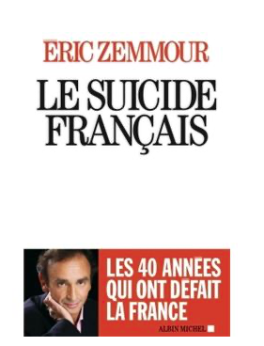

Strong pessimism and nostalgia
Class 1 General Introduction
The French ‘unhappiness paradox’
2014
Sept 2004
https://www.sciencespo.fr/research/cogito/home/measuring-french-pessimism/?lang=en
https://www.spectator.co.uk/article/why-the-french-are-so-pessimistic/
https://www.france24.com/en/20200109-french-connections-why-are-the-french-so-pessimistic-france-glass-half-empty

Slide 6
Class 1 General Introduction
.. Ever since La France Nouvelle L.A. Prévost-Paradole)- 1878 and Le Défi américain (JM Servan-Schreber 1967)
Once the biggest, most populated and powerful country in the West (XIVth century, ‘The China of Europe’)
Dynamic demographics, until 1914
An old country, compared to Germany, Italy unified in the XIXth century https://en.wikipedia.org/wiki/Territorial_evolution_of_France
The European trade routes not at the heart of its territory
The choice of looking inland rather than towards the sea
Even in the XVIIth ‘a rich and varied rural territory, lagging behind from a technical perspective, with a considerable but dormant wealth’ (Pierre Goubert). Low productivity for agriculture.
Sensitive issue of French Revolution: ‘La République n’a pas besoin de marchands’ (Saint-Just)
Share of France in Global Trade
1875: 12,7% 1913: 7,6% 1939: 4% 2025: 3,5 to 4%
// ‘Glücklich wie God in Frankreich’
The shock of the defeat in 1940: seen as a punition for the degradation of the situation
IN fact more ‘a French pace’
… and an opportunity for the French to ..complain and debate about the all-too-powerful state, about the decision to behead the King, a battlefield between liberals and interventionists (within the Right-wing Party)
Source: Vive la France quand même Pascal Gauchon et Jean-marc Huissoud Rapport Anteios 2010
Notes:
The inferiority complex towards Germany and the US

Slide 7
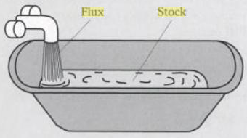
Class 1 Introduction to the key economic concepts
Reminder of the difference between stock and flow
Flow: quantity measured by time unit
Stock: quantity measured at a point in time
Stock or flow… Public debt? GDP per year? Exports per year? Number of unemployed people? Current account deficit per year?
Notes:
Public debt? stock
GDP per year? flow
Exports per year? flow
Number of unemployed? stock
Current account deficit par year? flow

Slide 8
GDP
- Definition
Gross domestic product (GDP) is the standard measure of the value added created through the production of goods and services in a country during a certain period. (oecd.org)= all the output produced within the borders of a country
- What does it include? (rules fixed by the U.N.)
Includes non market production such as education and defence services provided by the government
- What does it NOT include? (rules fixed by the U.N.)
Doesn’t register how the wealth is distributed (same for GDP per capita- check Gini Coefficient)
Does not include negative externalities (like pollution)
Does not include unpaid and domestic work
Does not include the sale of illegal goods (depending on countries)
Figures to be used with caution: a car accident will increase GDP…
Note: Difference between nominal and real
Class 1 Introduction to the key economic concepts
Notes:
What does it include?
Consumption (1), investment, government spending and exports
Non –market production like education: difficult to assess the added value of a teacher…?!
Not domestic work (although it represents on average 1.5 times the amount of time spent at work)
Traffic jams and car accidents increase GDP…
Real vs nominal:
Nominal value/real value: nominal value expressed in currency units whereas real value takes inflation into account
Real value= nominal value – inflation Examples of wages and interest rates for a loan or a return on investment

Slide 9
How to express GDP
Can be given in nominal value or per capita, usually expressed in % of growth BUT
When comparing the GDP over time, or between different countries, it becomes more complex:
As the value of money changes over time, you cannot use nominal/current prices, you need to use a price index, it’s called deflating the current price data
Example:
The EU’s GDP was 16.6 % higher in 2022 compared with 2012 (10 years earlier) in real terms, while over the same period GDP in current prices grew by 39 %. This means that less than half of the growth observed in current prices was due to real economic growth and the rest was simply due to inflation (rising prices).
Source: https://ec.europa.eu/eurostat/statistics-explained/index.php?title=Beginners:GDP_-_Comparing_GDP:_growth_rate_and_per_capita#:~:text=Thus%2C%20by%20dividing%20the%20value,the%20EU%20was%20449%20million.
Class 1 Introduction to the key economic concepts

Slide 10
How to express GDP
➔ Similar problems when comparing different economies, because price levels differ in different countries (you won’t be able to buy the same things with the same amount of money in France and Germany for ex); so you need a price level index to adjust GDP to improve comparison; the value of GDP is converted using the purchasing power parity (PPP), a special exchange rate that takes price level difference into account; so data are measured in an artifical currency called Purchasing Power standard (PPS)
Example:
In 2022, Germany’s GDP was € 3.9 trillion while France’s was € 2.6 trillion. When we divide the GDP by the population, this gives a GDP per capita of € 46.2 thousand in Germany compared with € 38.6 thousand per inhabitant in France.
By convention, one euro is equal to one PPS
However, because price levels are different in different economies, the conversion to PPS leads to a GDP of PPS of around 3.5 trillion in Germany and of PPS 2.4 trillion in France; as can be seen, both of these numbers are smaller than the numbers given earlier in euro terms, because prices in Germany and France are, on average, higher than in the EU as a whole.
This means that you can buy less with € 100 in these two Member States than in several other Member States, which have lower price levels.
Finally, we need to take into account the fact that countries have different population sizes
Example:
In 2022, GDP per inhabitant was PPS 41.2 thousand in Germany, around 15 % higher than the PPS 35.8 thousand in France. As such, adjusting GDP per capita for price level differences decreased the gap in GDP per inhabitant between Germany and France in 2022 from 20% in euro terms to 15 % in PPS terms; this reflects the fact that the average price level in France in 2022 was lower than that in Germany.
Source: https://ec.europa.eu/eurostat/statistics-explained/index.php?title=Beginners:GDP_-_Comparing_GDP:_growth_rate_and_per_capita#:~:text=Thus%2C%20by%20dividing%20the%20value,the%20EU%20was%20449%20million.
Class 1 introduction to the key concepts

Slide 11
How to express GDP
To sum it up: https://www.youtube.com/watch?v=FG7fAothhJM
For France ?
check World Bank Group (not Trading Economics)
https://data.worldbank.org/indicator/NY.GDP.MKTP.CD?locations=FR
GDP France 2025?
3.76 Trillion (PPP current international $)
Class 1 introduction to the key concepts

Slide 12
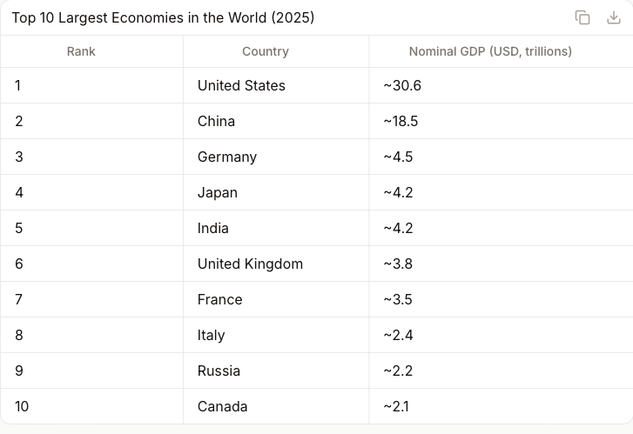
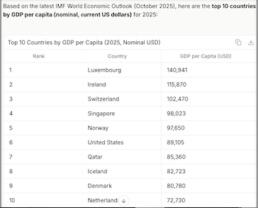
GDP
Class 1 introduction to the key concepts
Top 10 Largest Economies in the World 2025
Top ten GDP per capita
sourced from IMF data 2025
Notes:
Ranking very different if you consider the 10 richest countries in the world (in earnings per capita):

Slide 13
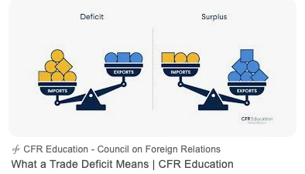
Class 1 introduction to the key concepts
Trade balance (or balance of trade- BOT)
The balance of trade is the account that details the value of exported goods and the value of imported goods over a given period of time. (Insee). In France only goods, elsewhere goods+services
Current account
The current account balance of payments is a record of a country's international transactions with the rest of the world. The current account includes all the transactions (other than those in financial items) that involve economic values and occur between resident and non-resident entities (oecd) (goods, services, income and foreign transfers)
      Balance of payments :https://www.youtube.com/watch?v=owZh5vthZPk
Notes:
Current account:
Example on the positive side:
- Goods: Exports to the rest of the world
- Income: ex I own a pizza place outside the country, generates income
Money transfer: Someone I know outside the country sends me money
Examples on the negative side:
Goods: Imports
Income: A foreigner owns a pizza place in my country and is making profits
Money transfers: I receive money from someone who lives outside the country
Interpretation of trade deficit : not always a bad sign… could indicate that the country may be overly reliant on foreign goods. However, that is not always the case. It could also mean the country is wealthy and has a high level of demand that needs to be satisfied (investopedia: https://www.investopedia.com/terms/b/bot.asp). Means you have to finance your debt on international markets
Trade surplus can be a result of a country having a competitive advantage in the production and export of certain goods, or a country's currency being relatively undervalued, making its exports cheaper for foreign buyers. (cf China, not enough local demand, too much savings). Can reflect of a falling demand, a start a recession… means you LEND money to the others
In itself, not a good indicator of the health of the economy (you need to analyze the context, understand why there is a surplus or a deficit)
+ you can have a deficit in the BOT and surplus in the balance of payments, and vice-versa.

Slide 14
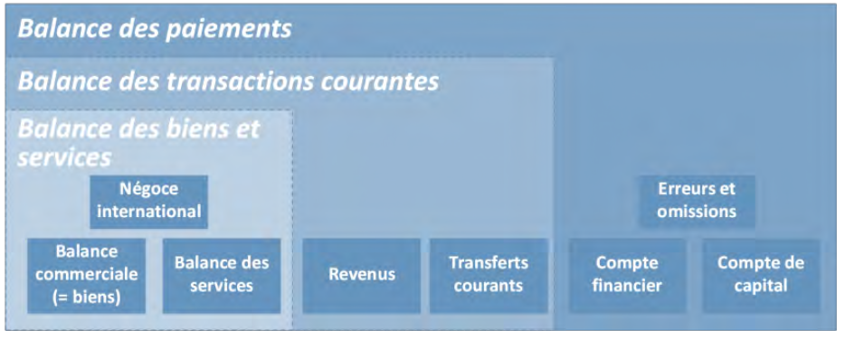
Source : DG Trésor, 2023
Class 1 introduction to the key concepts
Balance of payments= current account+ financial account (direct investment, portfolio investment, financial derivatives, other investment and reserve assets)+ capital account (patents, etc)
Notes:
The balance of payments consists of:
the current account (including the accounts for goods and services trade as well as the primary and secondary income accounts)
the capital account
the financial account (comprising direct investment, portfolio investment, financial derivatives, other investment and reserve assets)
The different accounts within the balance of payments are distinguished according to the nature of the economic resources (e.g. goods, services, income or financial resources) provided and received.
The balance of payments is based on a double-entry accounting system. Each transaction is recorded as consisting of two entries – a credit entry and a debit entry. The sum of the credit entries and the sum of the debit entries are the same. (https://www.ecb.europa.eu/stats/balance_of_payments_and_external/balance_of_payments/html/index.en.html)

Slide 15
Class 1 introduction to the key concepts
Inflation
Definition
Inflation is the loss of purchasing power of the currency that results in an increase general and sustainable prices. (…) . The loss in value of the money is a phenomenon that strikes the national economy as a whole (households, businesses, etc.). (Insee)
Possible causes
Tensions on the market of most goods (following disruptions of the supply chain, sharp and sudden increase of demand for certain types of goods, which exceeds production capacities)
Sharp increase of staple products: energy products, wheat/ corn, raw materials.
Can be imported (ex gas for France)
Tensions on the labour market, in situation of full employment
Exaggerated growth (/GDP) of the money supply
Notes:
Possible causes:
Covid-19 lockdown, demand for IT goods, construction materials, rescue plan
..
The Big Quit in 2020
The rescue plans post-Covid, 1900 B$ in the US

Slide 16
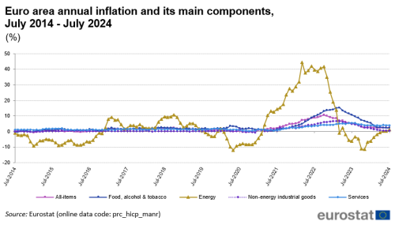
Class 1 introduction to the key concepts

Slide 17
Class 1 introduction to the key concepts
- Why is inflation a problem?
It affects revenues that are not indexed to inflation
Creates a gap between sectors and companies
The wage-price spiral
What can be done to reduce inflation? Risks incurred?
Reduction of the nation’s money supply (Central Banks)
Contractionary policies through the increase of interest rates (key rates)
Control of prices and wages
- Nominal value/ real value
Notes:
- Why
Revenues not indexed: wages, savings in cash
A gap between major actors who can act on prices and others
Wageprice spiral: when inflation is high, workers ask for salary increases, which itself creates inflation
What can be done?
Reduction of money supply by Central banks
Control of prices : practised in the 70’s (following oil shocks, for ex Nixon in the US),now considered largely ineffective
… restrict the access to credit and thus depress supply

