Slide 1
The best tool is just crap if you don’t know when to use it

Slide 2



Generic approach to (biomedical) imaging.
Focus on X-ray tomography, ultrasound and MRI
¹CREATIS; CNRS (UMR 5220); INSERM (U1206); INSA Lyon; Université de Lyon, France
Denis Grenier
M2 Biomécanique
UE Bases expérimentales et de modélisation

Slide 3
Disclaimer
This course is a compilation of my work and of many other sources picked from internet.
I’ve tried to cite these sources but i may have miss a pack them

Slide 4
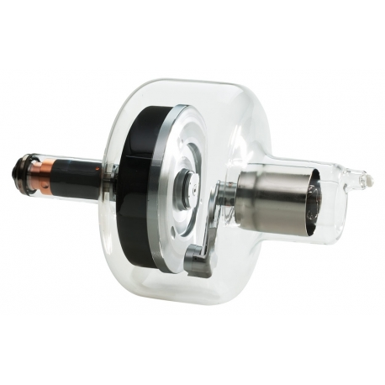
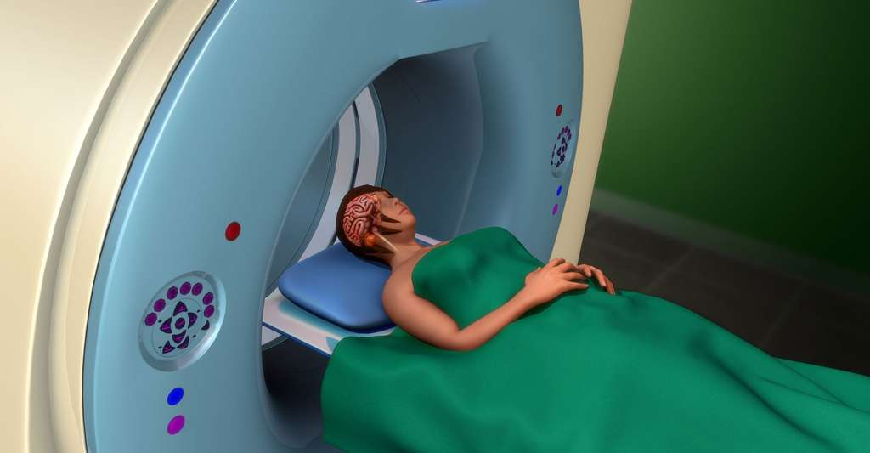
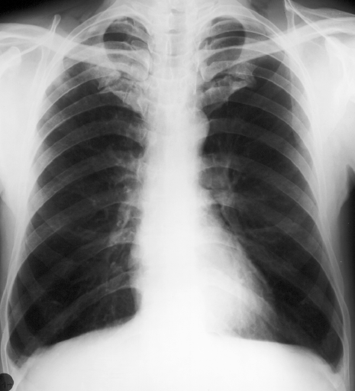
Goals of medical imaging
Explore a biological environment in the least traumatic way possible
Challenges
Understand the anatomy, physiology, mechanics and function of biological tissues
Detect and characterize pathologies
Treat / Care / Repair
Excitation system or markers
Image or signal
Acquisition

Slide 5
Mathematically speaking
the students in this course are
degenerate
If it's any consolation (or not), so am I !
(but less so!)

Slide 6
In mathematics and physics, a system is said to be totally or partially degenerate when its components cannot be uniquely identified.
The degeneracy is lifted as soon as we have enough independent dimensions to uniquely characterize/classify each of its elements.

Slide 7
What information do you have that allows you to uniquely classify each member of this class?
To collect this information, we have a number of sensors at our disposal: what are they?

Slide 8
sight
Vision
senses
Electromagnetic energy
Electroception
ears
Magnétocaption
smell
Touch
our senses
earing
flavor
Mechanical reception
Echolocation
touch
Proprioception
Or, in scientific parlance
balance
gravity
smell
chemoception
taste
Electrical fields
Cutanous receptors
Animals
their senses = ours + …
Thermoception
Magnetic fields
Homeostasys receptor
Cutanous receptors
Polymodale (dolor)
Joint receptors
Visceral receptors

Slide 9
Time
Dimensions associated with the senses
Polarization
Direction
Sight
Tiem
Intensity
Distance
Time
Texture
Colors
Enveloppe
Direction
Intensity
Electrical fields
Direction
earing
Frequency
Delay
Distance
Intensity
Our daily lives are made up of at least
21 dimensions !
Senses
Time
Time
Umami
Sweet
Not all of them orthogonals !
Taste/Smell
Magnetic fields
Salt
Bitter
Intensity ?
Direction
Sour
Time
Time
Gravity
Touch
Direction
Intensity
Texture
Stifness

Slide 10
Two dimensions are said to be orthogonal
when the information they provide is uncorrelated:
A person's height and weight are quite correlated.
A person's volume and weight are highly correlated.
A person's height and musical tastes are not at all correlated.

Slide 11
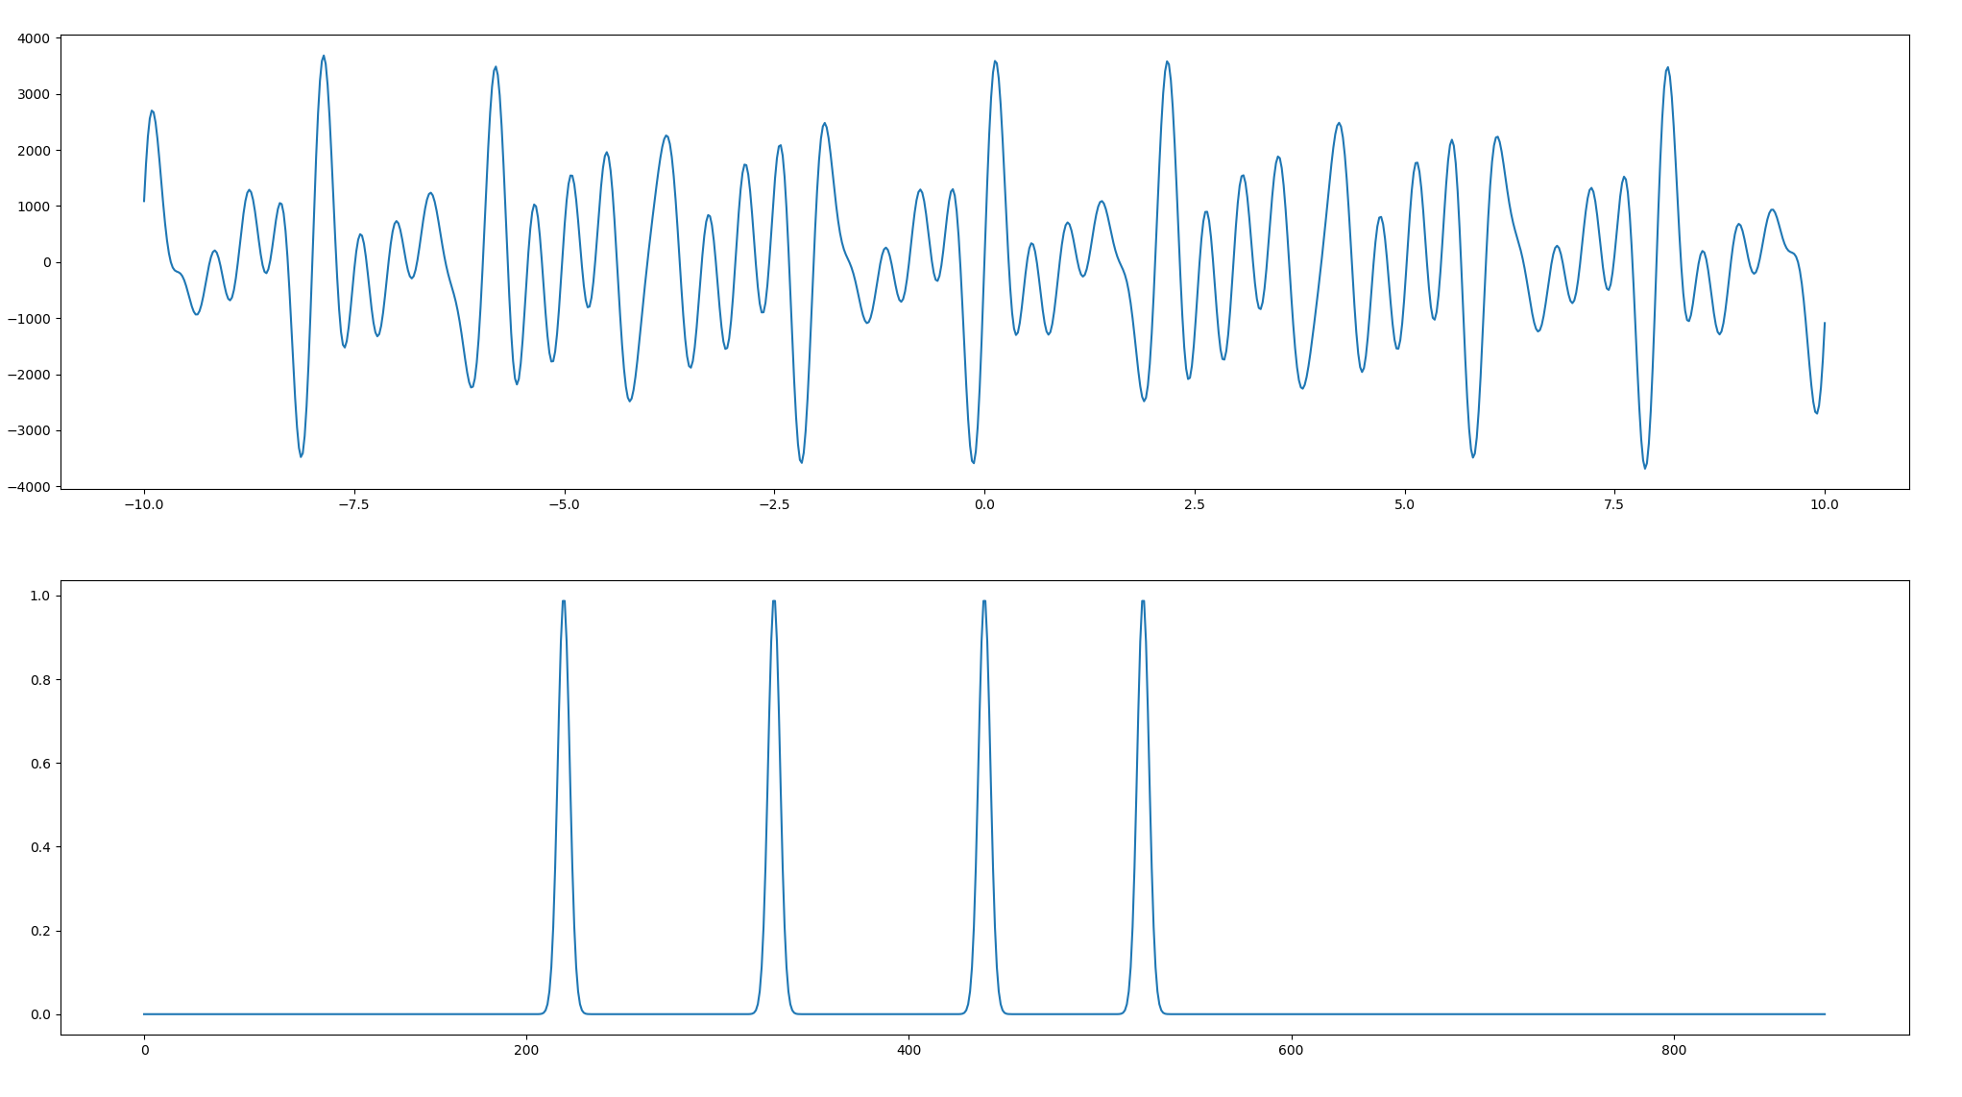
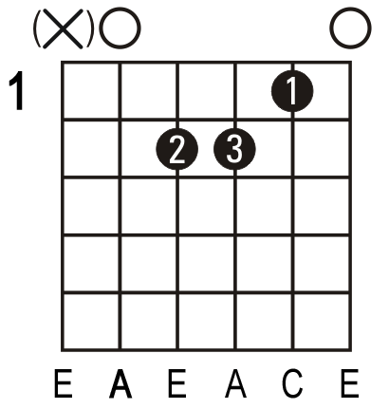

Representation of an information
The human brain can apprehend 1D, 2D, 3D, 3D + color information, above which it quickly becomes too complicated for a brain to process (computers don't have this restriction).
Even simple information can be very difficult for the human brain to grasp if it is studied in an unsuitable representation base (computers don't have/have less of this restriction).
Am
4 different descriptions
of the "same" sound
LAm

Slide 12
All information has a cost,
The title of this course could have been:
What information am I interested in
and
what price am I willing to pay for it?
€ = f(∆info , ∆t )

Slide 13
What are the costs of an information?
€
Collecting a sample
Energy
Instrumentation complexity
accuracy
A change in the subject's state
Subject destruction
Physical/physiological changes
Computing power
Temporal precision
Time
Stress
€
Ethical costs
Statistical costs

Slide 14
What types of imaging do you know?

Slide 15
X-ray Tomography (CT)
Vision
Electromagnetic energy
Electroception
Magnétocaption
Touch
earing
Mechanical reception
Echolocation
Proprioception
Or, in scientific parlance
balance
smell
chemoception
taste
Cutanous receptors
Thermoception
Homeostasys receptor
Cutanous receptors
Polymodale (dolor)
Joint receptors
Visceral receptors

Slide 16
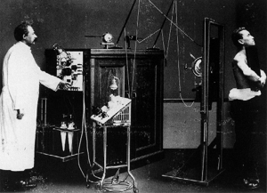
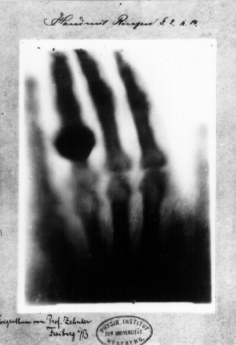
1895 : Röntgen découvre les rayons X
En novembre 1895 à Würzburg (Allemagne), Wilhelm Röntgen (1845-1923) remarque que le verre du tube cathodique qu'il utilise pour ses expériences émet un rayonnement invisible capable d'impressionner une plaque photographique.
1901 : Prix Nobel de physique

Slide 17
Simplified principle
X-ray tomography involves studying the ease with which X-rays can penetrate matter.
In addition to the object to be studied, we therefore need at least..:
an X-ray source
an X-ray detector
Constraint on the sample: it must not be transparent or opaque to X-rays

Slide 18
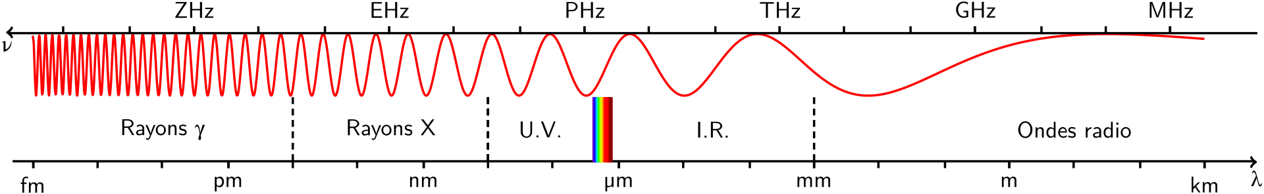
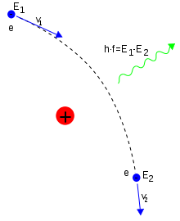
Creation of X-rays consequence of the conservation law:
Conservation of the energy of a particle
The basic principle is to accelerate negatively-charged electrons "stripped" from a white-hot cathode. These electrons are accelerated in a vacuum by a very intense electric field (potential difference) (tens of kV) applied between the cathode and the anode. The atoms of the anode (or rather their charge) will deflect the electrons, causing them to lose their energy through bremsstrahlung.
The higher the voltage, the faster the electrons, the more energetic the X-rays.
The higher the intensity, the greater the number of electrons, the greater the quantity of X-rays.
Most of the X-rays used in tomography are created by Bremsstrahlung (braking radiation in German), which reflects the fact that a charged particle emits electromagnetic radiation when its speed changes in intensity or direction.
How effective is this process?

Slide 19
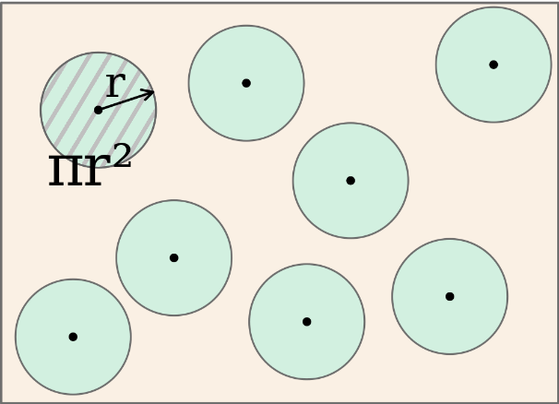
The concept of cross-section
Usually, when we want to describe interactions between particles and/or radiation, we need to use the notion of effective cross-section or absorption coefficient.
The effective cross-section σ of a particle expresses the probability of a particle or radiation passing through a medium without interacting with it.
Depending on the context, this notion can be used in the form of a surface (on a microscopic scale), or as the inverse of a distance in a macroscopic approach: σ[cm²]*(Number of atoms / cm3) = [cm-1].
This notion is also found in the mean free path, which represents the average distance covered by the particle or radiation without interacting with the medium.
And leads also to the attenuation coefficient µ (% of beam loss per unit distance)
Extremely important point: for X-rays, the effective cross-section is a function of a very large number of parameters.
In this list, the physical size of the nucleus is generally of little importance.
The effective cross-section varies according to the particle or radiation being emitted:
energy, charge, wavelength, type of particle, etc.
It also depends on the characteristics of the target:
mass number, atomic number, electronic layers, temperature, ...

Slide 20
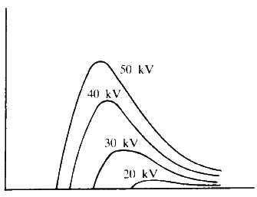
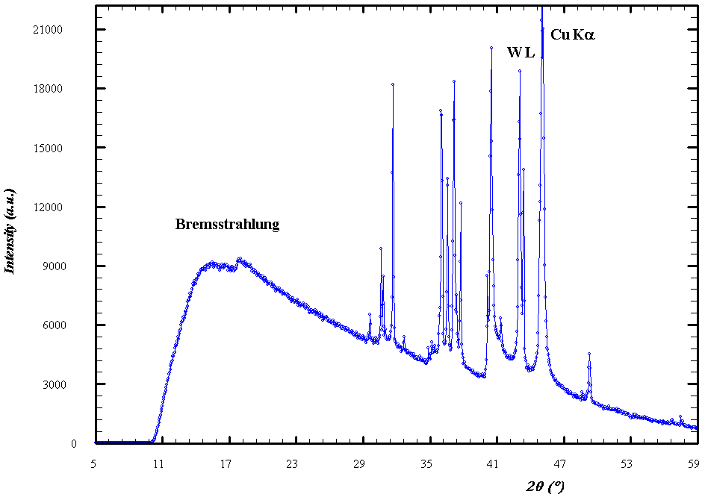
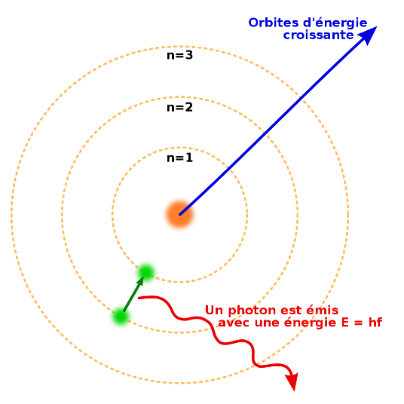
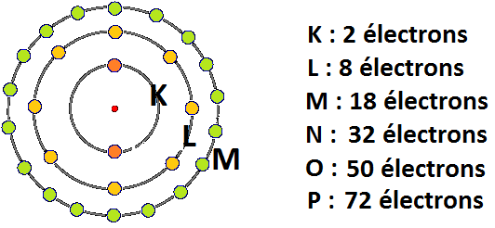
X-ray density according to electron energy (for tungsten)
Intensity of the process (a.u.)
← High energies (wavelength)
During the process, electrons that may have been stripped from atoms cause rearrangements of the electronic layers that produce high-energy X-rays.
← High energies (wavelength)

Slide 21
Let's build an X-ray generator for tomography
We need a source of electron "production"
A cathode, a source of high current (amperage)
A means of accelerating the electrons
An anode with a high potential difference (voltage) to strongly attract electrons from the anode.
A vacuum between the two so that electron acceleration is not hindered by interactions with matter.
A means of slowing electrons very rapidly:
The anode must have a large effective cross-section to "hinder" the passage of electrons as much as possible.

Slide 22
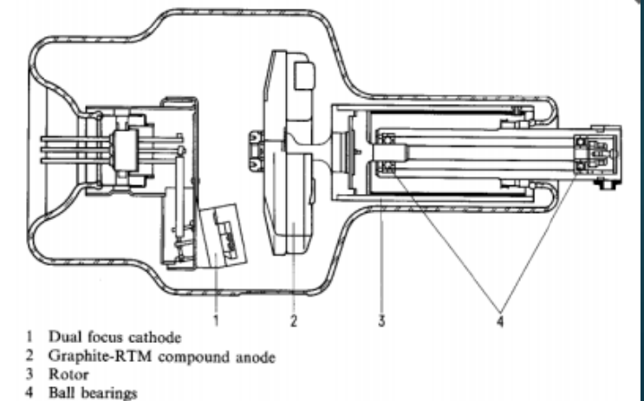
In an X-ray tube, just around 1% of the energy is transformed into X-rays (the rest becomes heat).
The target is often made of tungsten, since a high Z (number of protons in the nucleus) favors bremstrahlung.
=> But as this Bremstrahlung remains a very small minority compared with electron-electron "collisions", most of the energy is lost in the form of heat.
=> Tungsten has a very high melting point (3422°C).

Slide 23
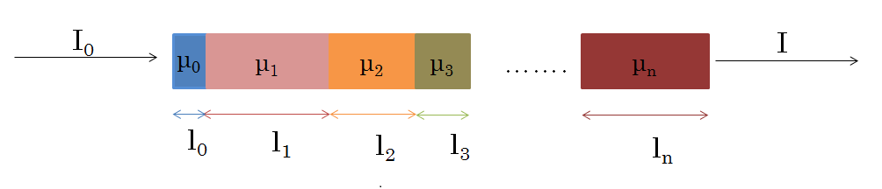
Penetration of X-rays into sample/subject
Beer-Lambert Law
$$I\left(X\right)=I_{0}.e^{−\sum_{i=0}^{n}{μ_{i}}l_{i}}$$
I0 initial intensity of beam
I final intensity
µi attenuation coeff of i^{th} material
li length of i^{th} material

Slide 24
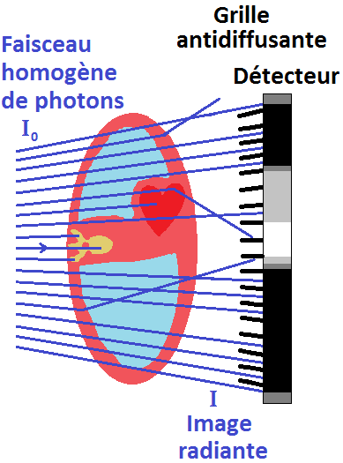
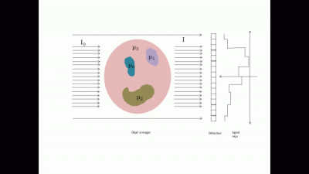
A series of 2D projections can be used to reconstruct a 3D volume using projection reconstruction or filtered back-projection techniques.
Mathematics of inverse problems
$$I\left(λ,X\right)=I_{0}.e^{−\sum_{i=0}^{n}{μ_{i}}l_{i}}$$

Slide 25
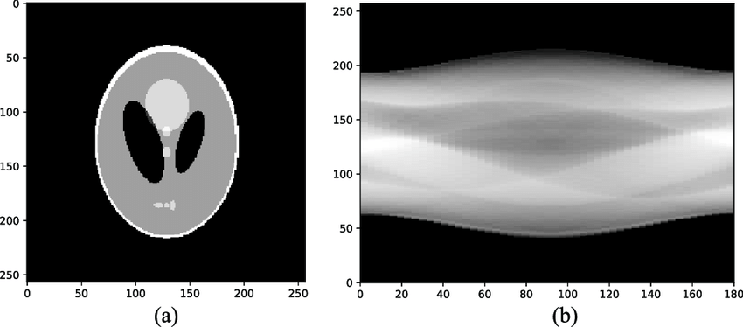
Image
Projection-based reconstruction
Reconstruction
Sinogram
Radon transform
Acquisition

Slide 26
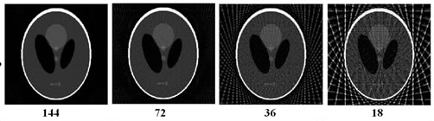
Retroprojection artifacts : less projection
=> less time and less irradiation
=> less quality

Slide 27
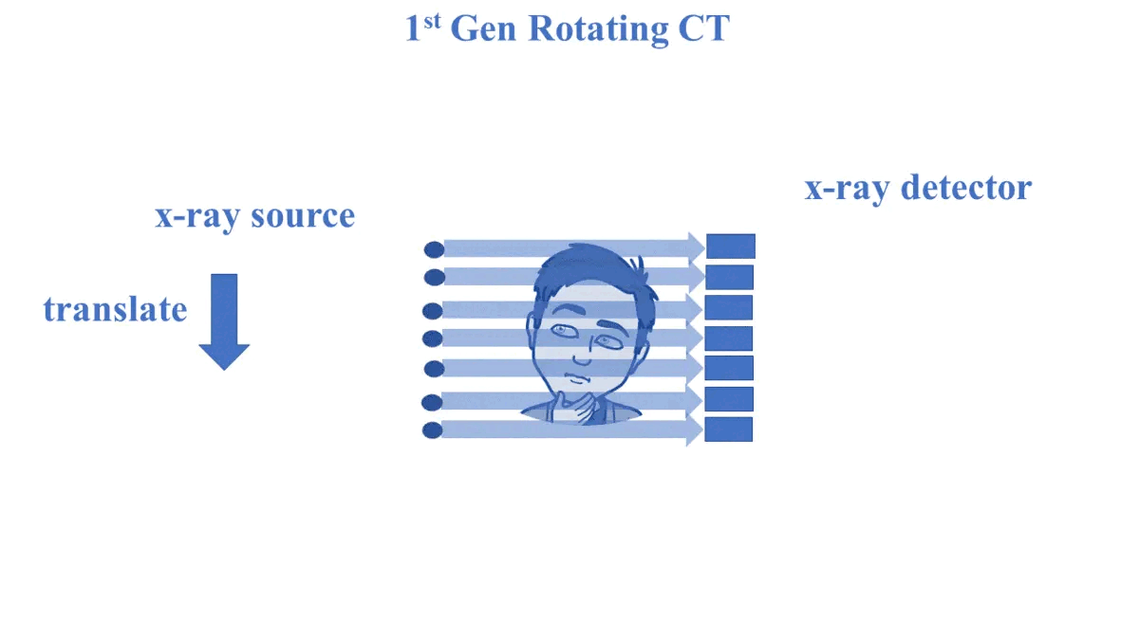
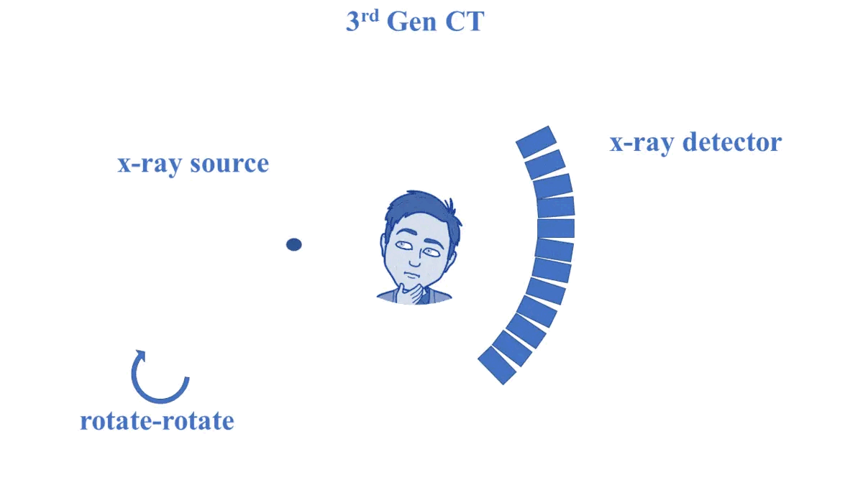
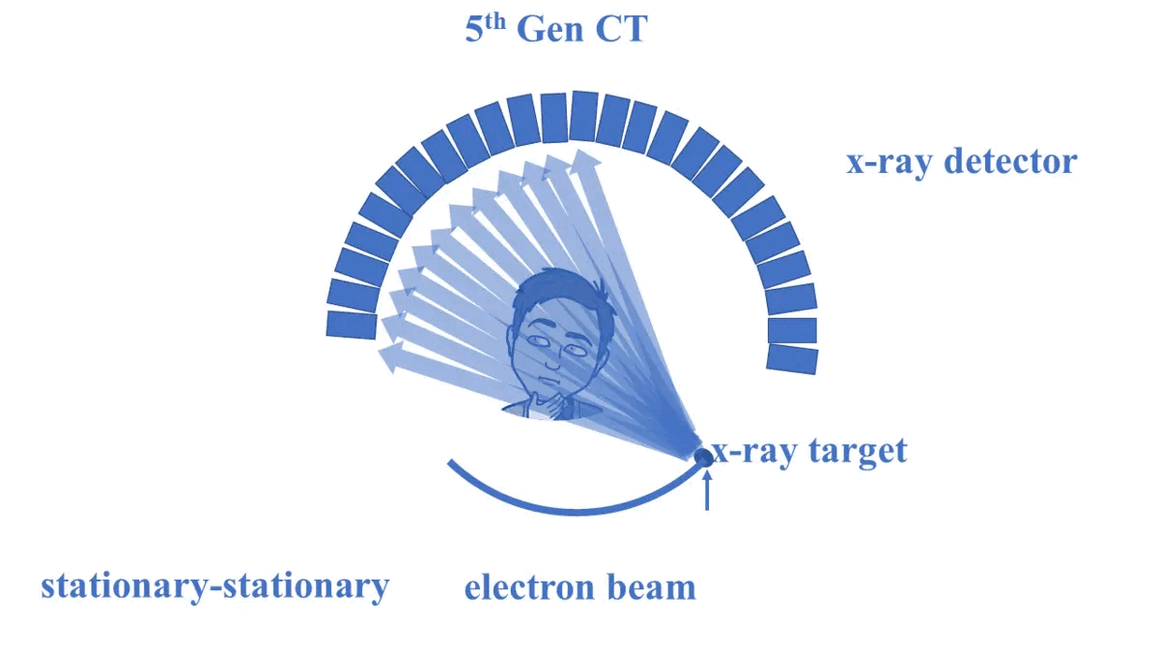
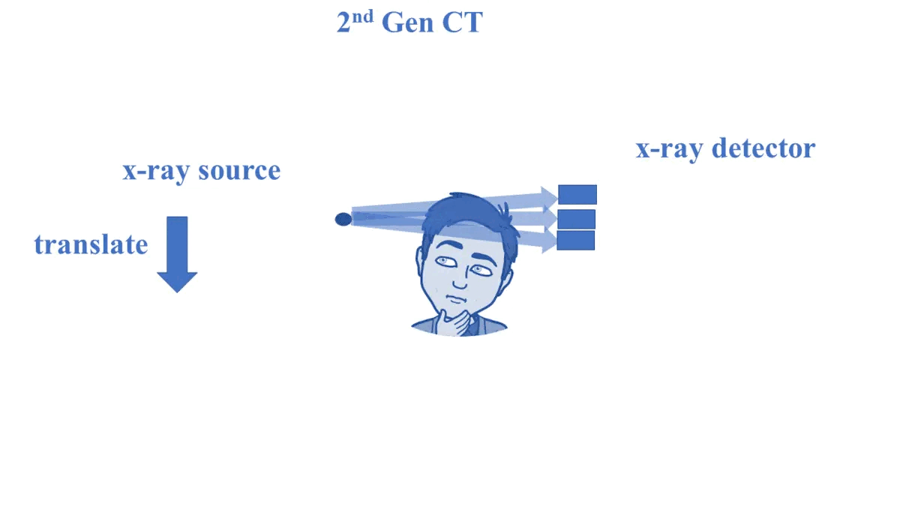
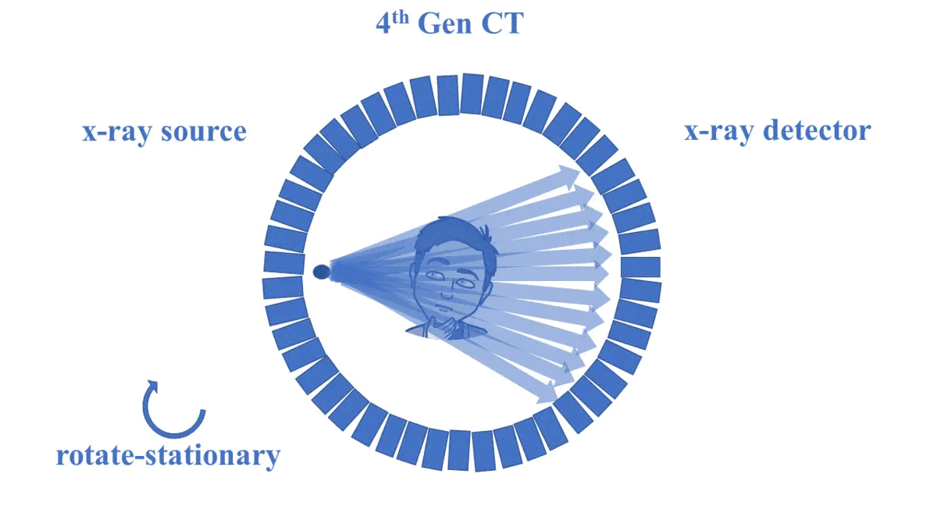

Slide 28
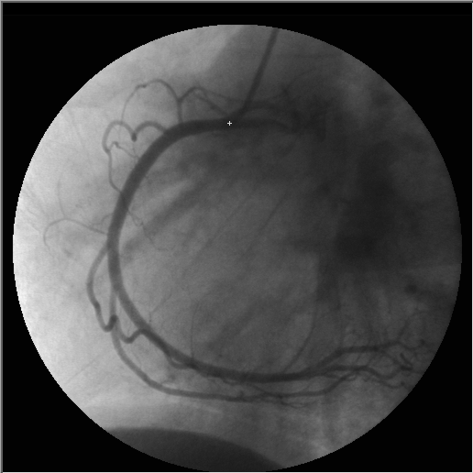
Contrast agent
Angiography
  Contrats agent injection
  Substraction of image with and without contrast agent

Slide 29
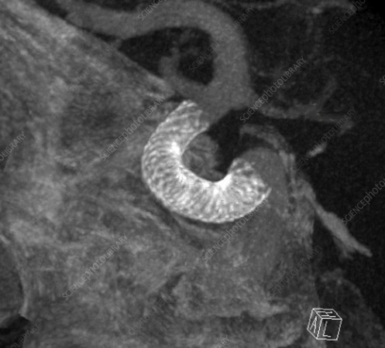
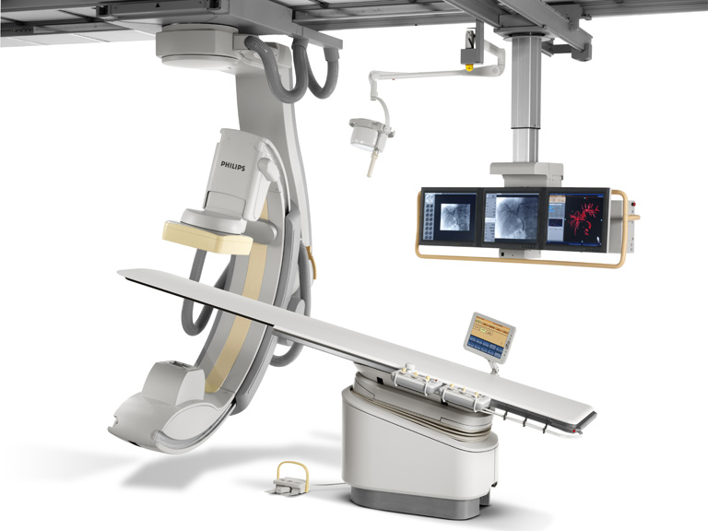
Interventionnal imaging
Used for :
  aortic or coronarian stents positionning
          Thrombosis detection

Slide 30
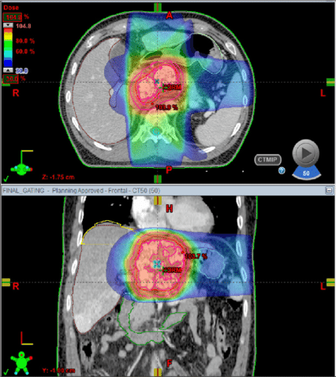
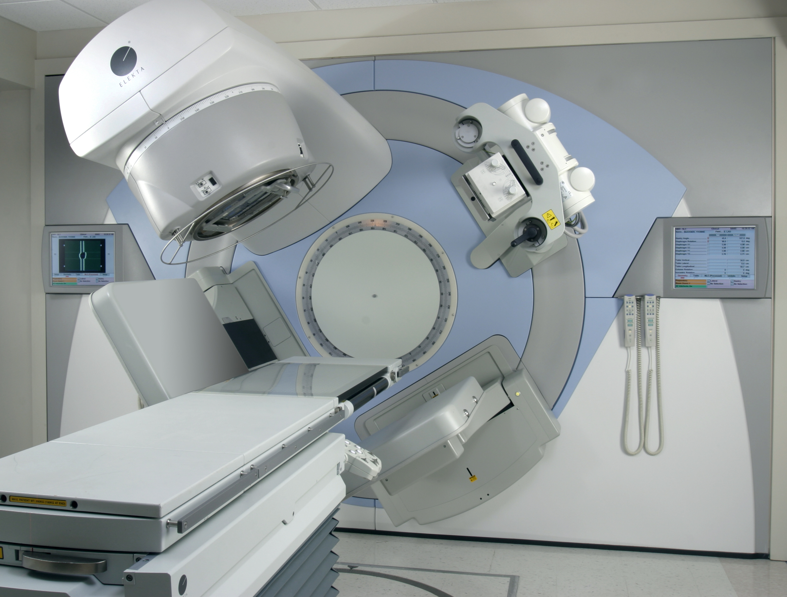
Interventionnal imaging
Positioning for radiothérapy

Slide 31
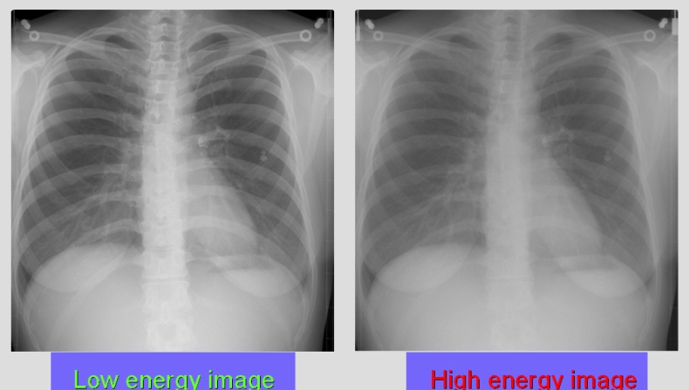
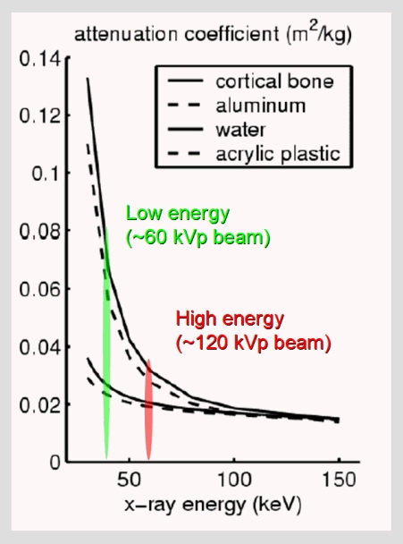
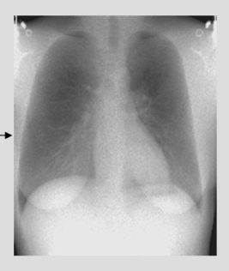
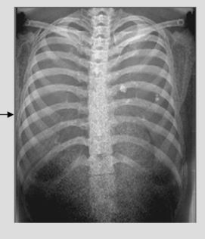
dual energy Scanner
soft tissue
bone

Slide 32
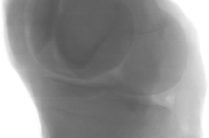
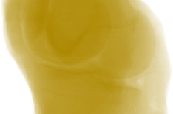
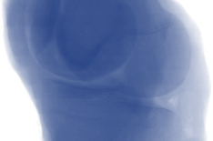
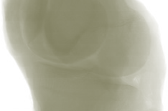
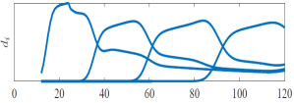
spectral CT
Projections into I energy bins (I=4)
Polychromatic Source
Photon counting detectors

Slide 33
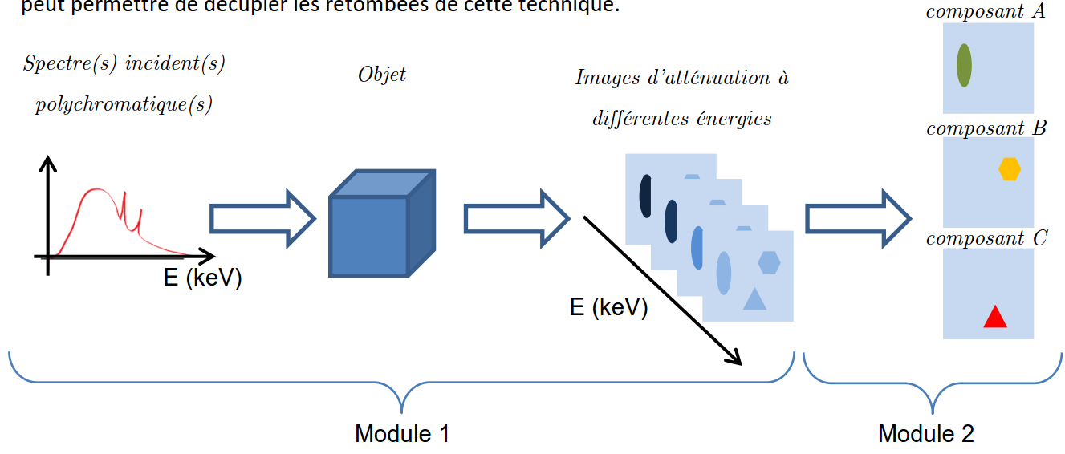
spectral CT

Slide 34
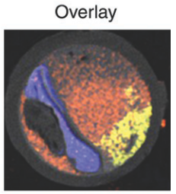
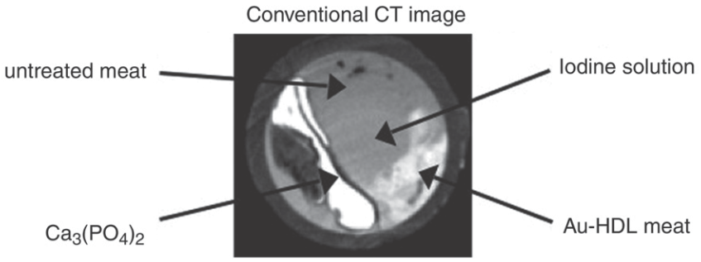
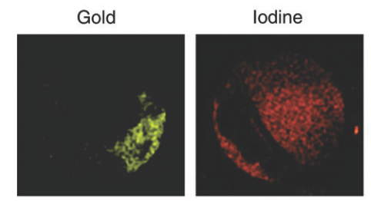
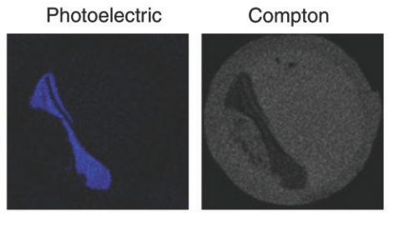
spectral CT
Scanner conventionnel
« Maintenant »
Cormode et al., Radiology, 256 (3), 2010

Slide 35
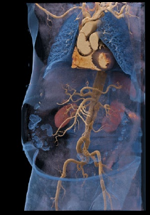
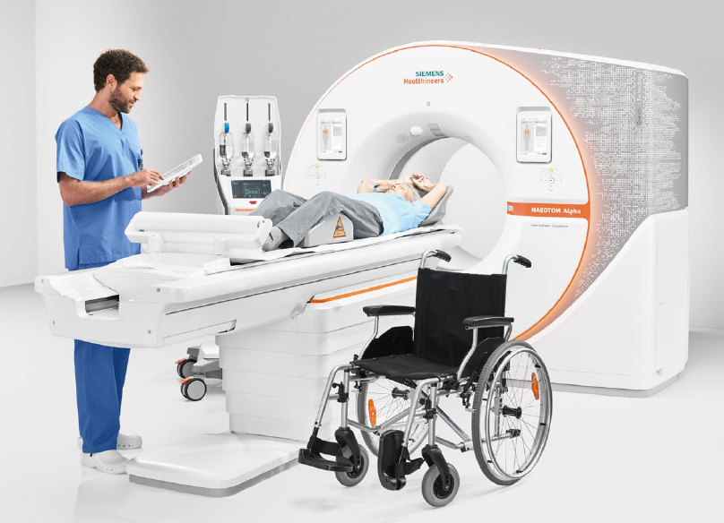
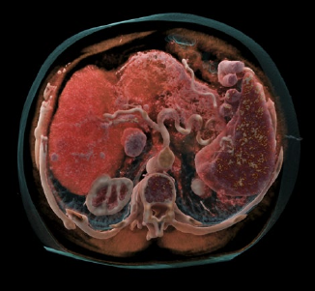
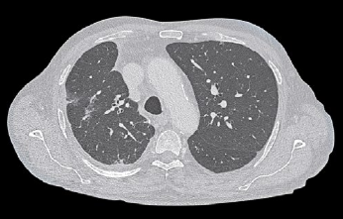
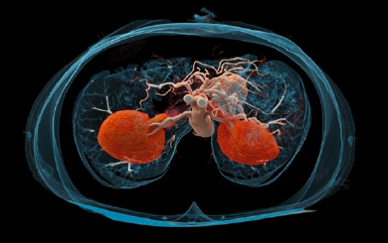
Technical specifications
Slices​: 2 x 144​
MA​: Up to 1.300 mA​
Temporal resolution​: Down to 66 ms​
KV: 90, 120, 140, Sn100, Sn140 kV
Z-coverage​: 144 x 0.4 mm​120 x 0.2 mm (UHR)​
Spatial resolution​: 0.11 mm (in-plane) in UHR mode​
Power​: 2 x 120 kW ​
Max. scan speed: Up to 737 mm/s​
Table load​: Up to 307 kg​

Slide 36
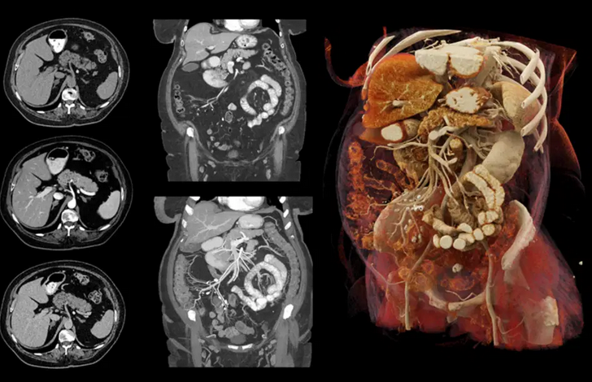






Slide 37

Type | Desktop cone-beam microCT Fully shielded No external shielding required
X-ray source | Sealed Air-cooled Maintenance-free 5 µm spot size (4/8 W) 20 - 90 kVp (45, 55, 70, 90 kVp preset and calibrated)
Detector | 3400 x 1200 elements, 20 µm pitch
Resolution | ‹ 5 µm 10% MTF 1.25 µm - 100 µm nominal isotropic (pixel size)
Image matrix | 512 x 512 to 8192 x 8192 pixels
Max. scan size | 50 x 120 mm (ØxL)
Max. specimen size | 50 x 120 mm (ØxL)
Electrical | 100 - 230 V / 50 - 60 Hz max. 400 W
Dimensions | 78 x 97 x 57 cm (HxWxD)
Weight | 250 kg

Slide 38




Slide 39
Image quality in X-ray tomography
Notion of contrast :
Impact of kV and tube amperage
Scattered radiation
Image grain :
Quantum noise,
acquisition chain noise
Notion of sharpness :
Focus blur
Detector blur
Kinetic blur
Image quality and artifacts dependent technologies and algorithms

Slide 40
X tomography pro’s and con’s
Irradiant
Few different types of information available.
Notion of benefit-risk for its use.
X-rays are frightening
Use in leaded environments
Fast
Very good spatial resolution
Inexpensive
Very mature technique
push button

Slide 41
Evolution margin
X-ray scanning is a highly advanced technique
In terms of spatial resolution, the compromise between resolution and irradiation quantity defines the limits of what can be obtained in vivo.
In terms of richness of information, the scanner is based solely on the notion of absorption (with the possible use of contrast agents). The scope for development in terms of richness of information is also limited.
The most active research is now focused on multi-energy scanners (spectral scanners). This spectral approach provides access to new types of contrast.

Slide 42

https://fr.wikipedia.org/wiki/Sievert

Slide 43
X-ray tomography / X-ray scanner / X-ray radiography
Information on the CT X part was mainly sourced from wikipedia @ :
https://fr.wikipedia.org/wiki/Scanner_spectral_X
https://fr.wikipedia.org/wiki/Radiographie
And courses of Pr L Dusseau @ IES:
http://www.eea.univ-montp2.fr/IMG/pdf/M2_seminar_opto_et_radiations_-_Copie.pdf
Also Dr A Cheifa @ enci:
http://univ.ency-education.com/uploads/1/3/1/0/13102001/radio3an16m-01tube_rayons_x-cheifa.pdf
And https://howradiologyworks.com/ctgeneration

Slide 44
Ultrasound
Vision
Electromagnetic energy
Electroception
Magnétocaption
Touch
earing
Mechanical reception
Echolocation
Proprioception
In ultrasound we are interested in mechanical waves
Or, in scientific parlance
balance
smell
chemoception
taste
Cutanous receptors
Thermoception
Homeostasys receptor
Cutanous receptors
Polymodale (dolor)
Joint receptors
Visceral receptors

Slide 45
basis
Ultrasound is the study of acoustic signals reflected (or sometimes transmitted) as they pass through a material medium.
In addition to the object to be studied, we need to have..:
a vibration source (ultrasonic)
an ultrasonic vibration detector
(Most of the time, transmission and reception will be carried out by the same device).
Constraint on the sample: avoid excessive absorption of acoustic waves

Slide 46


Displacement of mechanical waves in a medium
Transverse waves (shear): the propagation of the wave takes place in the direction perpendicular to the deformation of the medium
Longitudinal waves (compression): the propagation of the wave is in the same direction as the deformation of the medium
Longitudinal waves are faster, propagate farther than transverse waves and/or are less influenced by the mechanical properties of the medium
In standard ultrasound, longitudinal waves will be used

Slide 47
Do not confuse the speed of sound which is the speed of propagation of the sound wave.
and the acoustic velocity, which is the speed of propagation of the material particles that make up the sound wave
The velocity of a longitudinal wave is strongly related to the density and compressibility of the medium:
The less compressible the medium, the higher this speed
Density Mv↑ → V ↓
Compressibility C ↑ → V ↓
Temperature T ↑ → V ↑
lungs: ~600m/s
lipids: ~1410-1470m/s
leaver: ~1535-1580m/s
Muscle: ~1545-1630m/s
bone 2100-4080m/s
air: ~340m/s
water: ~1480m/s
concrete: ~3100m/s
steel: ~5600m/s
Diamons: ~18 000m/s
In echography, a tissue velocity of 1540m/s is generally considered

Slide 48


Wavelength [m]
Wave speed[m][s⁻¹]
$$λ=\frac{c}{υ}=c.T$$
Wave period [s]
Wave frequency[s⁻¹]

Slide 49
Concept of impedance (acoustic)
An impedance is a characteristic of a material with respect to an excitation: how does this material react to the excitation imposed on it?
This quantity accounts for the transformation of a force into a flow rate (of something)
More prosaically, it is the opposite of mobility
In the context of our interest, acoustic impedance accounts for the ease of propagation of a wave in a medium
$$Z_{ac}=\frac{p}{v}\frac{\left[Pa\right]}{\left[m\right]{\left[s\right]}^{−1}}$$
or
$$Z_{ac}=ρ.c\frac{\left[kg\right]}{{\left[m\right]}^{3}}.\left[m\right]{\left[s\right]}^{−1}$$
And so, in our framework, a change in density will imply a change in acoustic impedance

Slide 50

Reflected waves
If 2 media have a different impedance then a wave that passes from one to the other will be partially reflected
In ultrasound, we consider that we are in normal incidence θ1 = θ2 = 0 and we then have:
θ₁
θ₁
If Z1 = Z2 then QR=0 and QT=1=> everything is transmitted
If Z1 and Z2 are very different then QR~1 and QT~0 => almost everything is reflected
Z₁
Z₂
θ₂

Slide 51

Reflected waves
If Z1 = Z2 then QR=0 and QT=1
=> everything is transmitted
If Z1 and Z2 are very different then QR~1 and QT~0
=> almost everything is reflected
https://www.astrolabe-science.fr/echographie-reflexion-et-transmission-dune-onde-ultrasonore/

Slide 52
medium Density c in m/s Z
Air 1.3 343 4,5.10²
Lungs 300 600 1,8.10⁵
Lipids 924 1410-1470 1,33.10⁶
liver 1061 1535-1580 1,6.10⁶
muscle 1068 1545-1631 1,7.10⁶
bones 1913 2100-4080 7,7.10⁶

Slide 53

Signal scattering, weaker and more stable than reflection
If the size of the scatterers is much smaller than λ
Diffusion is omnidirectional
If the size of the scatterers is of the order of λ
diffusion is preferentially done
forward or backward
If the size of the scatterers is much larger than λ
diffusion is preferentially done
towards the emission source

Slide 54

Speckle
All the waves that propagate in the medium and that are diffused by it interfer constructively or destructively to form patterns:
the speckle
It is this speckle that composes the classically studied ultrasound image.
The speckle does not represent the scatterers but is the visualization of the constructive interference of all the waves reflected by (all) the scatterers at the same time

Slide 55
Absorption
There is never a lossless energy transport => sound waves lose energy (in the form of heat) as they travel
The residual intensity of the beam decreases exponentially with the distance traveled as a function of the medium crossed (kmat) and the frequency of the source wave

Slide 56
Reflection + Diffusion + Absorption = Attenuation
For soft tissues, a loss of 0.5 dB/cm/MHz is considered
To give you an idea, on a high-frequency ultrasound machine (15MHz), for an exploration depth of only 4 cm in muscle tissue, the intensity of the ultrasound wave is already attenuated by 60dB
=> 1,000,000
Frequency (MHz) Max depth (cm))
2.5 -> 3.5 > 15
5 10
7.5 5 -> 6
10-12 2-3
SD

Slide 57
I make my ultrasound machine
An excitation part
A reception part
A reconstruction part

Slide 58
Transmit receive
Piezo
Send a sine wave voltage (~150V) modulated at the desired frequency (some MHz) for 1 μs = > ultrasonic pulse.
Stop the stimulation and go into listening mode:
Propagation, reflections, broadcasts
Conversion of reflected ultrasound pressure to voltage
Attenuating material
Coupling Medium
(like a student) The probe spends 99% of the time passively listening !

Slide 59
Focalization

Slide 60
Information reconstruction
Amplification
Time Gain Compensation => modulates the amplitude of the signal according to the material being passed through (e.g. a full bladder hardly attenuates the signal) (adjusted in real time by the user).
Attenuation Compensation => amplifies the signal to account for its exponential decay (again adjusted manually).
Demodulation: We remove the frequency of excitation/reception to keep only an envelope of intensity
Digitization
Filtering

Slide 61
Mode A Ultrasound (Amplitude)(1D)
In mode A, we plot the amplitude of the signal received over time (i.e. distance/depth). We can thus see the reflectivity of the interfaces

Slide 62
Ultrasound mode B (Brightness)(ND)
In B mode, the amplitude of the signal received over time (and therefore distance/depth) is represented as a gray level.
By scanning different lines, you can obtain an image

Slide 63
Time Motion Mode
In single-sensor mode B, the displacement of a line over time is tracked:

Slide 64

Doppler ultrasound
To observe the Doppler effect, it is obviously necessary that the speed of movement of the reflectors is not perpendicular to the direction of the ultrasonic wave

Slide 65

3D imaging by probe arrays

Slide 66
Spatial Resolution
The axial resolution is a function of the duration of the transmission pulse. For standard ultrasound scanners, it is in the order of mm.
The lateral resolution is not as good. It varies with the geometry of the probe, and the focus of the beam (the resolution varies according to the depth)

Slide 67


Elastography
Longitudinal wave velocities used to form images are not very sensitive to small variations in the rigidity of the medium, but these longitudinal waves can be used to create transverse waves, which are much more sensitive.
As the transverse waves created are much slower than the longitudinal ones, we can use the longitudinal waves to observe the transverse waves.
The speed of transverse waves depends on the stiffness of the material through which they pass

Slide 68


Contrast agents
The agents used consist of microbubbles with an average diameter of 3 microns, which are injected into the bloodstream. As the acoustic impedance of these microbubbles (gas) is very different from that of blood (liquid), they act as highly effective ultrasound reflectors, providing the physician with information on the state of vascularization of the area being explored.
Without µ-bubbles
With µ-bubbles

Slide 69


Microimaging
These injected microbubbles also break the spatial resolution barrier imposed by the wavelength of ultrasound waves.
By coupling microbubble injection with ultra-fast image acquisition (500i/s), spatial resolutions of a few tens of micrometers can be achieved.

Slide 70
Pros and Cons
Presence of noise due to piezo and acquisition electronics
The speckle is an "artifact" but creates a texture of the medium => Images with a very particular appearance.
Differences in velocity in tissues can create artifacts
Grey areas.
Multiple reflections.
Low spatial resolution and variable depending on position
Inability to visualize tissues with too much different acoustic impedance on the same device
Real time
Very low cost
Bench to bed Use

Slide 71


Interesting room for evolution
Ultrasound is a young technique
Signal generation is very inexpensive and can cheaply increase the number of transmit/receive elements (3D probes)
Contrast agents begin to be developed
AI should make it possible to recreate a visual approach that is easier to interpret
Approaches using multifrequency and nonlinear responses in development
Active research on new forms of signal generation and acquisition coupled with new types of reconstruction
Elastography
Theragnostic possibilities
<2k€ sur des marketplaces !

Slide 72
Bibliography of the ultrasound part
Here again, Wikipedia has been a major source of information
As well as the ultrasound courses accessible on the internet of:
Sonia Dahdouh Telecom ParisTech - CNRS LTCI - WHIST Lab
Michel Dauzat, DIU, Ultrasound Techniques Database (parts 2 and 3),
Nîmes University Hospital
Corinne Gautier Physics Acoustics Ultrasound Basics
EFCV Department - Lille CHRU Cardiology Hospital

Slide 73
MRI
Vision
Electromagnetic energy
Electroception
Magnétocaption
Touch
earing
Mechanical reception
Echolocation
Proprioception
Or, in scientific parlance
balance
smell
chemoception
taste
Cutanous receptors
Thermoception
Homeostasys receptor
Cutanous receptors
Polymodale (dolor)
Joint receptors
Visceral receptors

Slide 74
Simplified principle
MRI consists of studying the way in which the nuclear magnetization of certain nuclei evolves over time following radiofrequency excitation.
We must have:
An object containing magnetizable nuclei (of non-zero spin)
A very strong magnetic field capable of creating magnetization in the object
A radiofrequency magnetic field generator to "excite" the magnetization of the nuclei
A radiofrequency magnetic field receiver capable of capturing the signal re-emitted by the nuclei by de-exciting
Main constraint on the sample: contain non-zero spin nuclei

Slide 75
The magnetic moment of a particle
Protons, electrons, neutrons are particles that have an angular momentum of spin s.
Immersed in a magnetic field, this spin generates a μ magnetic moment which will orient itself in the direction of the magnetic field and which will "rotate" around the field B0 at a rotation speed ω0 as a function of the strength of the field: ω0 = γ B0
γ is called the gyromagnetic ratio of the nucleus under consideration
The number of nuclei whose magnetic moment μ will actually orient itself according to the field is statistically very (very) small because the thermal energy is generally sufficient to continuously disturb it, the macroscopic magnetization M of the sample is:
$$M=\frac{S\left(S+1\right)γ^{2}ℏ^{2}}{3k_{B}}.N.B_{0}.\frac{1}{T}=CsteN.B_{0}.\frac{1}{T}$$
=>Under standard MRI conditions, less than 5ppm* of the nuclei align with the magnetic field
*ppm = part per million
=> MRI is a very insensitive imaging method

Slide 76
Why doesn't this big magnetic field stuck me into the magnet?
In MRI, we are interested in the magnetic moment of the nuclei. Whereas the attraction generated by "classical" magnets is due to the magnetic moment of the electrons of certain metals and rare earths.
Magnetization (responsible for attraction) is inversely proportional to the square of the mass m of the particle or nucleus under consideration.
There is a factor of 4000 between the mass of a nucleon and that of an electron.
The attraction is therefore 16 million times weaker.
=> the sum of the hydrogen nuclei present in the body of an 80 kg person is less attracted to the MRI magnet than a single metal dust of a few µg
$$M=\frac{S\left(S+1\right)γ^{2}ℏ^{2}}{3k_{B}}.N.B_{0}.\frac{1}{T}withγ=\frac{q}{2m}$$

Slide 77

Which nuclei does it work for?
All those of spins not zero, but
Element | Symbol | Natural Abundance
Hydrogen | ¹H | 99.985%
 | ²H | 0.015%
Carbon | ¹³C | 1.11%
Nitrogen | ¹⁴N | 99.63%
 | ¹⁵N | 0.37%
Sodium | ²³Na | 100%
Phosphorus | ³¹P | 100%
Potassium | ³⁹K | 93.1%
Calcium | ⁴³Ca | 0.145%
Element | Biological Abundance*
Hydrogen (H) | 62%
Sodium (Na) | 0.037%
Phosphorus (P) | 0.22%
Carbon (C) | 12%
Oxygen (O) | 24%
Calcium (Ca) | 0.22%

Slide 78
How to detect an NMR signal?
Imagine a macroscopic magnetization M rotating on itself around the field B0 to ω0 of several tens of MHz.
We are not even able to see if it is running.
By moving it from its vertical equilibrium position, we can observe its return to the vertical
B₀
B₀
M
ω₀
ω₀
M

Slide 79
Move it from balance, how?
Softness and subtlety
Use a low-amplitude, sinusoidal magnetic field, perpendicular to B0, which will add a continuous torque force
Resonant Excitement
(principle of the swing)
Force Brute
Superimpose a magnetic field so intense that the magnetization will start to rotate around it
Versus

Slide 80

Excitation/Sensing
The dynamo principle is used, a variation in the magnetic field creates a current in a coil (reception) and the opposite principle is used for transmission
Thus, with a resonant excitation of a few μT, the magnetizations present in a static magnet of several Tesla can be tilted.
A well-adapted resonator is then able to recover the re-emitted NMR signal of a few mV at most

Slide 81
Principle of THE machine
So, to make NMR, you need a sample, a magnetic field, an RF amp for the transmission, an antenna and an acquisition amplification chain for reception
Why is it so expensive?
The culpit is B0!

Slide 82
(I don't know if I've already told you) but NMR is a technique that is not very sensitive because the magnetization is very weak. But this magnetization increases with the intensity of B0
=> We want B0 to be as intense as possible.
If B0 is not homogeneous, the MACROSCOPIC signal is destroyed too quickly to be exploitable (c.f. course on the Fourier transform)
In addition, B0 must be very homogeneous in space AND in time (a few ppm or a few tenths of a ppm depending on the use)
A superconducting magnet with a large diameter is therefore used
(And that's expensive !)

Slide 83
B₀ +/- ΔB₀
ΔB₀/B₀ in ppm (parts per million) in the volume of interest
ex.: 40 cm diameter sphere
Volume of interest
!! ΔB₀/B₀ : 1 ppm @ 3T
Δφ (Hz) => 128 Hz
2π (rad) dephasing in 8 ms
The required DB0/B0 depends on the applications
Standard Imaging~ 1 ppm @ 1,5 T
EchoPlanar ~ 0,25 ppm
Spectroscopy ~ 0,1 ppm

Slide 84
Notion of shims, specification of uniformity (homogeneity)
In itself, a supraconductor magnet has a homogeneity of the order of a hundred ppm
During the installation on site, small metal masses will be added to it judiciously placed to homogenize the field even more. These masses are calculated according to the magnetic characteristics of the magnet and the building
And finally, to have an even more homogeneous field during each manipulation (for each subject), we also have electromagnets in the magnet that will allow us to add fields that are variable according to space but static according to time which, by adding to B0, will be able to make it even more homogeneous (<0.1ppm):
These electromagnets are called shim coils
They make it possible to add magnetic fields of linear variation, quadratic and sometimes higher orders

Slide 85

Reconstruction of the information
In MRI, as in almost all modalities, the signal is acquired over time.
But in addition, in the case of NMR, the signal is composed of a (continuous) sum of sinusoidal signal
=> the Fourier Transform (FT) of the acquired signal is the most telling basis for representation to visually represent the signal

Slide 86



Slide 87
The Fourier Transform is the most classical/simple way to scrutinize the frequencies present in a time signal.
The Fourier Transform of a thin line is a wide line and vice versa
(property at the origin of the famous Heisenberg inequalities)
Information about the details of a signal is encoded in the high frequencies (and its outline in the low frequencies)

Slide 88



And spectroscopy is invented!
Most of the time molecules have a neutral electronic charge (fortunately because free radicals are bad)
But despite this, under the action of magnetic fields, molecular electron clouds will react to the magnetic field they are subjected to and will create shielding phenomena around the nuclei. This "chemical shift" phenomenon makes it possible to characterize molecules by their spectral signature

Slide 89
And now the imaging!
Spectroscopy and TF allow us to visualize a quantity of resonant nucleus at a given intrinsic frequency .
To do imaging, we could do the same if we had a way to impose a resonance frequency according to the position

Slide 90


IRM : gradients
Spatial encoding (3 directions)
B(x, y, z) = B0 + x Gx + y Gy + z Gz
z
x
y
B₀
Voxel size
t
r ~1/(G.t)
G
Time
Gradient amplitude
Duration
dt

Slide 91

THE k-space
The k space is “just” the spatial frequency representation space of a spatial representation
k-space (complexe)
Usual space (real)

Slide 92


Slide 93



Slide 94


Slide 95

MRI sequence
Over time, we will acquire the area of the k space that interests us in order to be able to transform it into an image via TF (1D, 2D, 3D)

Slide 96





Selecting a slice

Slide 97

Scanning of the k-space by phase gradient

Slide 98

Scanning of the k space by reading gradient

Slide 99

Scanning of the k space by read gradient + phase

Slide 100

Various types of k space scans

Slide 101
Great Trinity of MRI
ACQ time
The S/N ratio increases with the root of the signal accumulation number
Signal to noise ratio
Spatial resolution
The S/N ratio increases as the volume of the voxel increases
If I need 10 minutes to get an SNR of 10, I'll need 40 minutes to get 20
If the SNR of a voxel of 1x1x1mm is 20, that of a voxel of 0.79x0.79x0.79 is only 10

Slide 102
Now we can make images like the CT: a lot of signal => a lot of protons
MRI course has ended?
Actually no, it's now that it's starting to be interesting:
MRI benefits from dozens and dozens of ways to contrast images, that is, offers us the means to access an impressive variety of dimensions (orthogonal or not).

Slide 103


Signal Refocusing Concept

Slide 104
An MRI/NMR experiment consists of creating a signal in the transverse (observable) plane
modulate it over time by a mechanism
Which we choose to favor the development of a given type of interaction
we then observe the effect that this interaction will have had on the observed signal

Slide 105


The classics: T1, T2, proton density (ρ)
T1 the faster the signal of a voxel has lost its energy, the brighter it appears
T₂ The more out of phase the signal of a voxel has become, the darker it appears
ρ (proton density) the more nuclei, the brighter it is

Slide 106

TE Echo Time and TR Repetition Time
As said above, the signal is acquired after a time of TE evolution.
As the signal decreases quite quickly, it is not easy to acquire the k-space in one shot. In general, acquisitions are repeated to cover this space or improve the S/N ratio. This repetition time is called TR

Slide 107
T1 Contrast
Long TR: If we wait a long time between two repetitions, all the nuclei have time to lose their energy and will be available for the next excitation => they will have the same response regardless of their T1=> no contrast in T1
Short TR: If the time between two repetitions is short, the nuclei of short T1 will have lost their energy and will be excitable again while those of long T1 will still not be excitable => contrast in T1

Slide 108
T2 Contrast
Short TE: If the signal is acquired shortly after its creation, it does not have time to dephase and therefore the phase loss processes in T2 do not have time to operate => no contrast in T2
Long TE: If we let the signal evolve longer after its creation, it will be even weaker for the shortest T2 and remain intense for the longest T2 => contrast in T2

Slide 109


Slide 110









And also
Susceptibility: visualizes variations in χ, macro and microscopic magnetic impedance (indirectly detects iron deposits)
Diffusion: the more the nuclei have moved, the darker the voxel, we can even see the direction => tractography
Perfusion, velocity, angiography: calculation of macroscopic movements
Elastography Calculation of the hardness of a material
fMRI detects neuronal activations through oxygenation difference
Spectroscopic imaging (visualizes metabolites)
Detection of nuclear dipole interaction
Detection of chemical water grease mismatches
Deformation detection
Dynamic MRI (films the movements of an organ in repetitive motion)
MRI of tissues at short T2 (such as scanX but without irradiation)
MRI MT, ihMT study of interactions between different populations of nuclei
MRI CEST indirect study of the consumption of certain molecules (as for PET)….

Slide 111


MRI, magnet: safety
B0
dBo
dr
Gradient de champ => force F~ M Bo dBo/dr
F with Bo^{1 à 3}

Slide 112
Pros and Cons
Manuy many, and many different types of information accessible
Expensive
Bulky
Dangerous if metal is nearby (even filings in the eyes)
Not very sensitive (have I already said it?)
Non-ionizing(but it can get hot in some cases)
Quite slow as an imaging method (although) (from 10h to 50ms per acquisition)
Less suitable for hard tissues
Works "only" for non-zero spin nuclei
True 3D
Good spatial resolution (preclinical > 20μm clinical > 500μm)
Visually Intuitive Images
Quite noisy

Slide 113




Slide 114
Room for improvement
Young technique
Number of technological breakthroughs per decade impressive
Research towards the hyperpolarization of nuclei
Research in post-Fourier reconstruction very active
Superconductor research very active (also thanks to related areas such as transport)
the race to the very high fields slowed down because the ratio Amount of information/€ is not good
And in addition, very high field => microwave effect

Slide 115
Sources:
Wikipedia,
https://mriquestions.com/index.html
http://www.mri-q.com
Site Pr Hornack
Cours Pr H Saint Jalmes (LTSI Rennes)

Slide 116
The best tool is just crap if you don’t know when to use it

Slide 117


