Slide 1

Introduction to Arduino

Slide 2
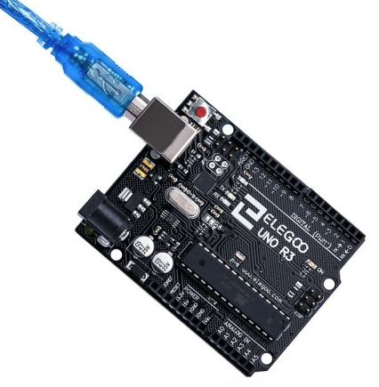
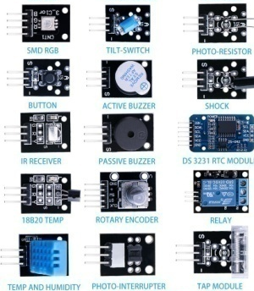
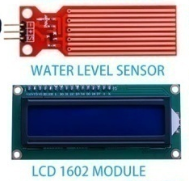
How can we adress instrumentation design ?
Low cost electronic devices
  Based on Arduino motherboards
Full set of sensors
Full set of actuators
Easy to program
  Enhanced simulation tools : Tinkercad
  Arduino IDE (Integrated Development Environment)

Slide 3
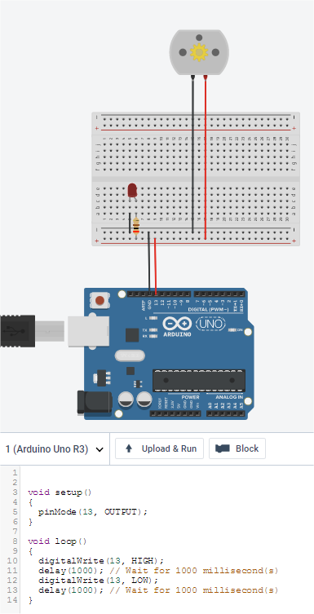

Is this difficult ?
Definition of the specifications
Basic knowledge on electronics, computer science
Useful simulation software for non-specialists
Available numerical libraries to implement sensors and actuators
  → easy programming for beginners
https://www.tinkercad.com

Slide 4
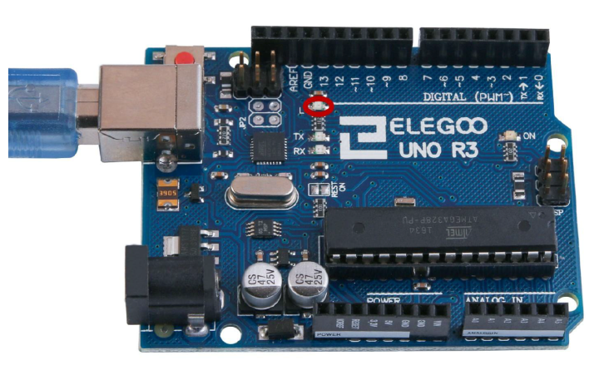
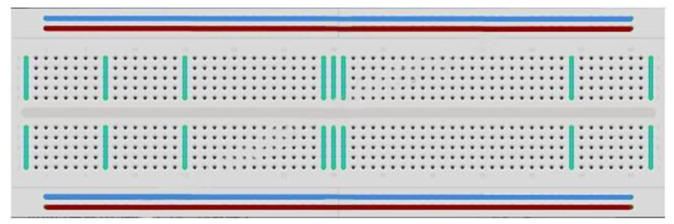
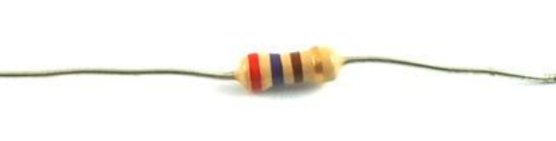
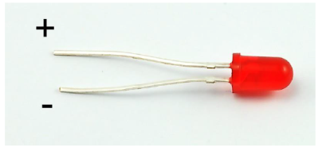
Available devices
Arduino motherboard
Breadboard
Basic components: Resistor, LED (Light Emitting Diode), and more

Slide 5
Breadboard
All pins in the same column are connected together
All pins along the red line are connected together
All pins along the blue line are connected together

Slide 6
First electrical circuit,
Arduino used as power supply
1 LED
1 resistor 220 Ω
2 cables
Connect Arduino to USB port => power supply
5V
GND

Slide 7
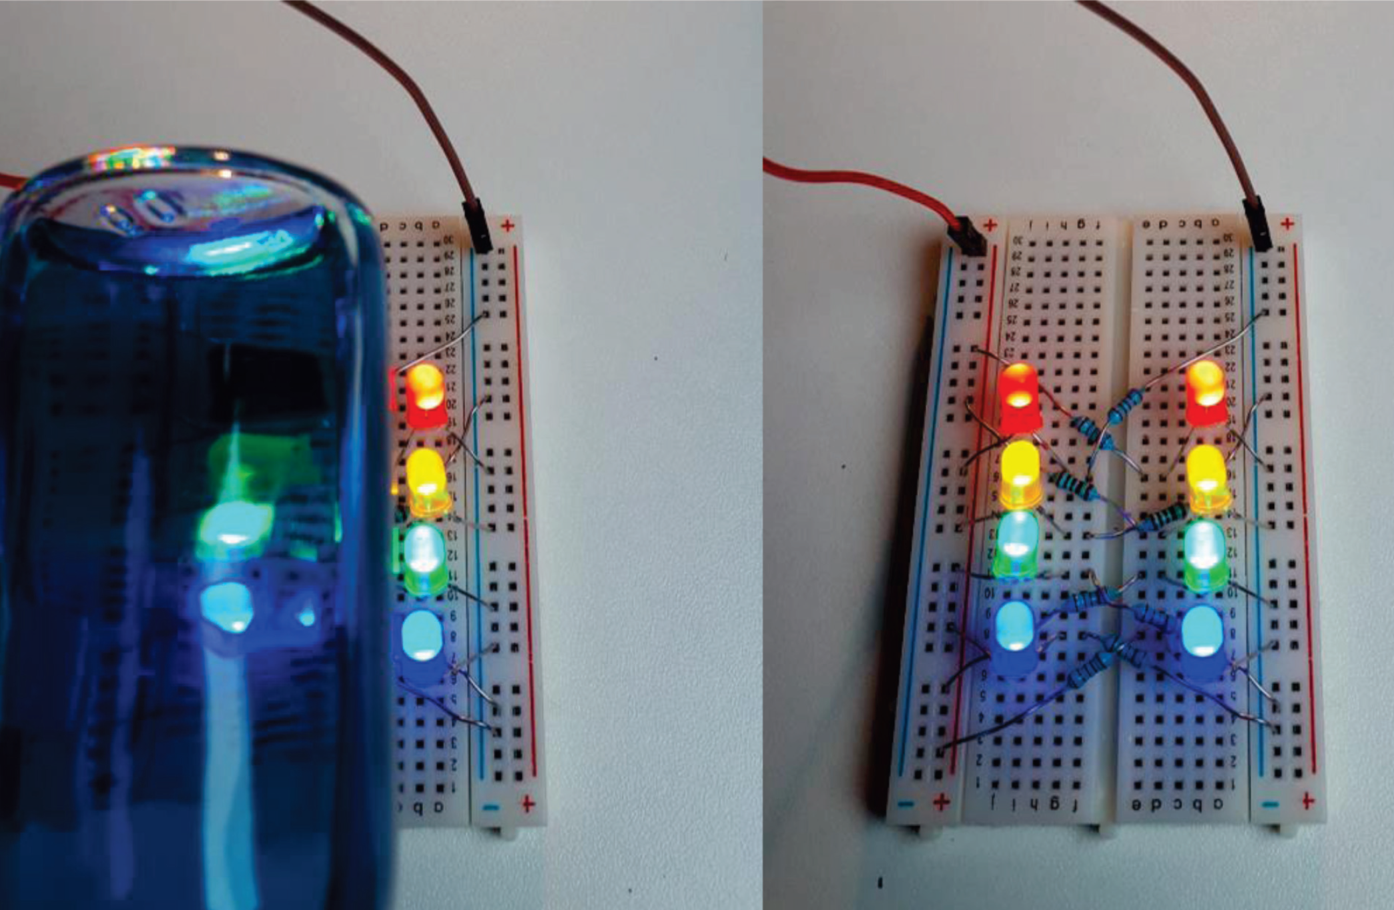
Callenge 0 : create a circuit with four LED
4 LED (red, yellow, green, blue)
4 resistor 220 Ω
several cables
Connect Arduino to USB port => power supply

Slide 8
Arduino motherboard : Outputs (actuators)
Digital and analog outputs (you can choose voltage 0V or 5V)
Reference voltage : 5V and GND (0V)

Slide 9
https://www.arduino.cc/en/main/software
Install the software arduino-1.8.8-windows.exe

Slide 10
Connect Arduino to computer
Select board type
Arduino and USB port => Communication

Slide 11
Connect Arduino to computer
Check connexion

Slide 12
Challenge 1 : LED blinking
digitalWrite
GND
void setup(){
pinMode(13,OUTPUT);
}
void loop(){
digitalWrite(13, HIGH);
delay(1000);
digitalWrite(13, LOW);
delay(1000);
}
Pin 13

Slide 13
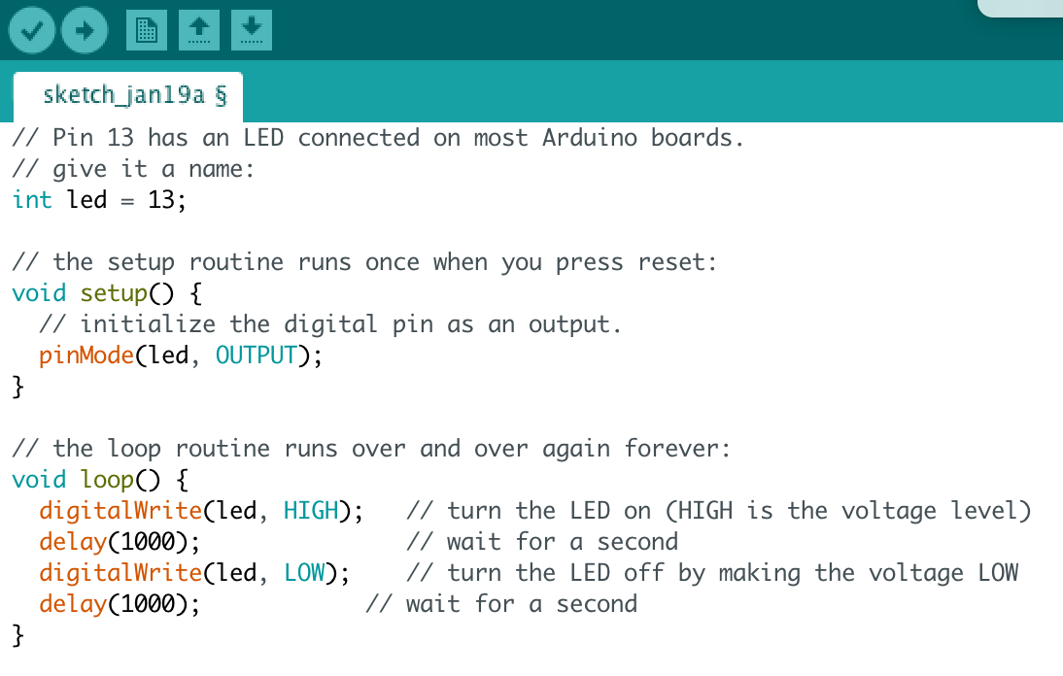
Variable declaration
Initialization
Main program
(loop)

Slide 14
2 – send the compiled program to Arduino board
1 – Compilation

Slide 15
Digital output

Slide 16
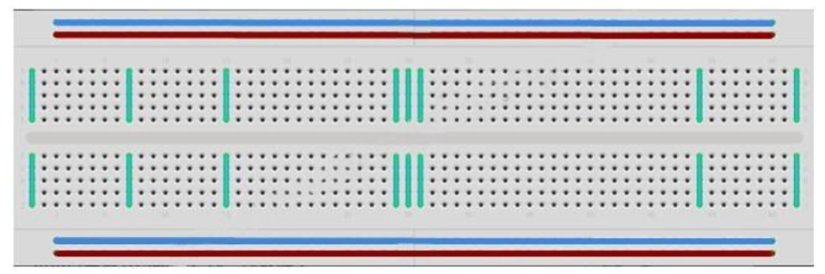
Challenge 1 : LED blinking
    Wire the real circuit on the breadboard, copy the program in Arduino IDE and upload in the device memory
  Run the program using the Arduino motherboard
  Modify blinking delay
R=220 Ω

Slide 17
Challenge 1 : LED blinking
digitalWrite
GND
void setup(){
pinMode(13,OUTPUT);
}
void loop(){
digitalWrite(13, HIGH);
delay(1000);
digitalWrite(13, LOW);
delay(1000);
}
Pin 13
Step 2 : Connect the red wire to pin12 instead of pin 13, and modify the code in order to blink the LED

Slide 18
Challenge 1 : LED blinking
Introduction of variable
int PinLED=13;
void setup(){
pinMode(PinLED,OUTPUT);
}
void loop(){
digitalWrite(PinLED, HIGH);
delay(1000);
digitalWrite(PinLED, LOW);
delay(1000);
}
Step 2 : Connect the red wire to pin12 instead of pin 13, and modify the code in order to blink the LED

Slide 19
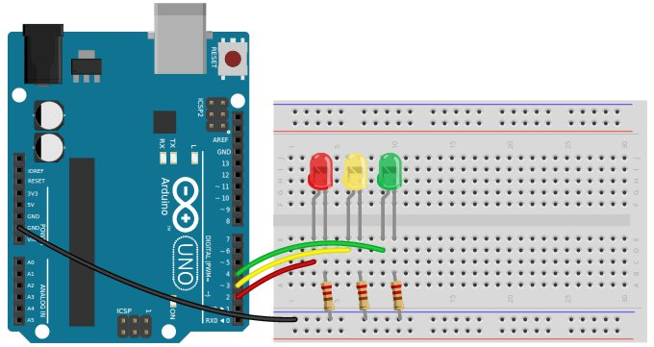
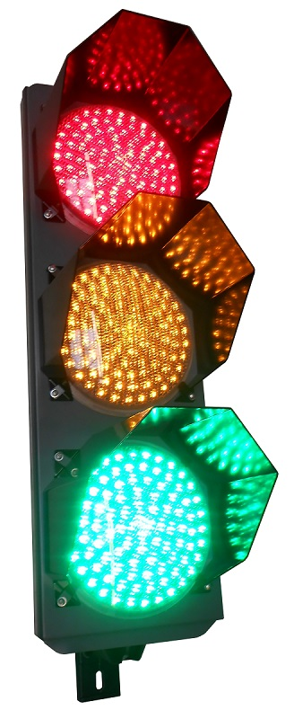
Challenge 2 : build a traffic ligth

Slide 20
Analog output

Slide 21
Change LED intensity
analogWrite (PWM only on pin 3, 5, 6, 9, 10, 11)
int PinLED=13;
int intensite=255;
void setup(){
pinMode(PinLED,OUTPUT);
}
void loop(){
analoglWrite(PinLED, intensite);
delay(1000);
analogWrite(PinLED, 0);
delay(1000);
}
Step 2 : change the intensity value

Slide 22
LED intensity, change using a loop
int PinLED=11;
int intensity=255;
//----------------------------------------------------------
void setup(){
pinMode(PinLED,OUTPUT);
}
//----------------------------------------------------------
void loop(){
for (intensity=0; intensity<255; intensity=intensity+1) {
analogWrite(PinLED, intensity);
delay(10);
}
for (intensity=255; intensity>0; intensity=intensity-1) {
analogWrite(PinLED, intensity);
delay(10);
}
}

Slide 23
Digital input

Slide 24
Digital input
What happend with this circuit ?
Challenge : I would like to see the red LED ON during 5 seconds if I press the button

Slide 25
Digital input
int PinLED=5;
int PinTestBouton=2;
void setup(){
pinMode(PinLED,OUTPUT);
pinMode(PinTestBouton, INPUT);
}
void loop(){
if (digitalRead(PinTestBouton)==HIGH){
digitalWrite(PinLED, HIGH);
delay(5000);
digitalWrite(PinLED, LOW);
}
}

Slide 26
Write on serial monitor
int PinLED=11;
void setup(){
pinMode(PinLED,OUTPUT);
Serial.begin(9600);
}
void loop(){
digitalWrite(PinLED, HIGH);
Serial.print(“Car stop");
delay(1000);
digitalWrite(PinLED, LOW);
Serial.println(“Go");
delay(1000);
}
GND
11

Slide 27
Send command from serial monitor
int PinLED = 11;
String ChaineSaisie;
//------------------------------------------------------------
void setup() {
pinMode(PinLED, OUTPUT);
Serial.begin(9600);
}
//------------------------------------------------------------
void loop() {
// check if something has been sent from serial monitor
if (Serial.available()) { ChaineSaisie = Serial.readString(); }
else
{ ChaineSaisie = ""; }
if (ChaineSaisie == "LEDON") { digitalWrite(PinLED, HIGH); }
if (ChaineSaisie == "LEDOFF") { digitalWrite(PinLED, LOW); }
delay(100);
}

Slide 28
Other functions
Set up functions
pinMode (pin number, OUTPUT or INPUT); //sets one pin direction
pinMode (9, OUTPUT);
pinMode (PinLED, OUTPUT);
Serial.begin(9600); // initializes the serial communication
SERIAL PRINT
Serial.print(”character string"); // prints a text in the serial window
Serial.print(sensorValue); // prints the data sensorValue in the serial window
DELAY
delay(time_period); //waits during time_period ms

Slide 29
OUTPUT > WRITE
digitalWrite (pin number, HIGH or LOW); //sets the digital level of the specified pin
digitalWrite (9, LOW);
analogWrite(pin number, value between 0 and 255 ); //sets the analog voltage of the specified pin (3, 5, 6, 9, 10, 11)
analogWrite (9, 128); //mean voltage delivered at pin 9 is 2,5V

Slide 30
Analog input

Slide 31
Arduino motherboard : Analog inputs (sensors)
Digital Inputs (switch, button, contact)
Digital levels:
5V : “HIGH” or “1”
0V : “LOW” or “0”
Analog input :
From 0 to 5 V
Reference voltage : 5V and GND (0V)
Analog Inputs (thermistor, photocell, humidity sensor, …. )

Slide 32
pinMode (pin number, OUTPUT or INPUT); //sets one pin direction
pinMode (9, INPUT);
pinMode (A0, INPUT);
INPUT : READ
digitalRead (pin number); // returns the digital level of the specified pin
SensorValue=digitalRead(6);
analogRead (pin number); // returns the numerical value (0-1023) proportional to the analog voltage of the specified pin (between A0 to A5)
SensorValueA=analogRead(A0);

Slide 33
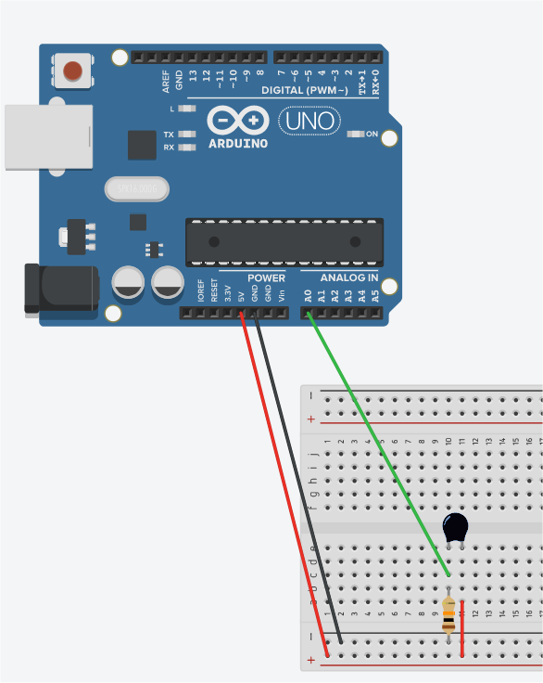
Build a thermometer
Use a thermistor
Measure a value and print it on serial monitor
Convert R to T

Slide 34
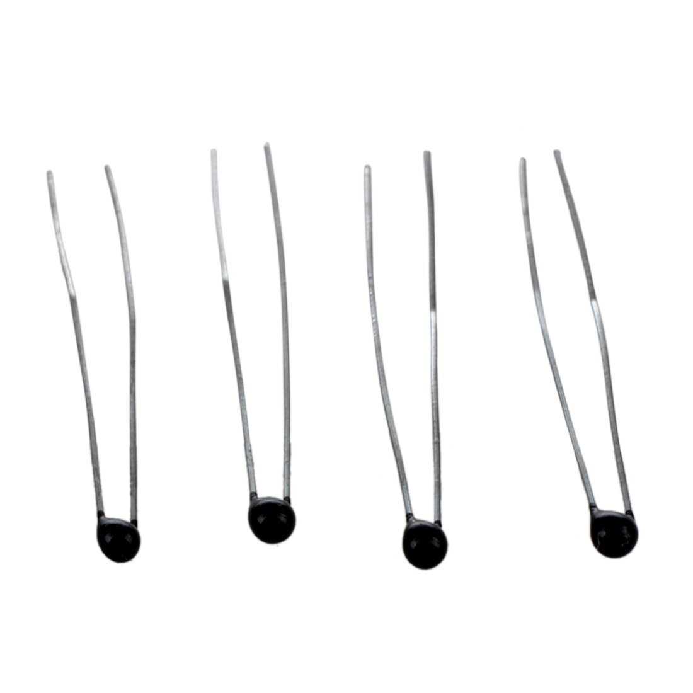
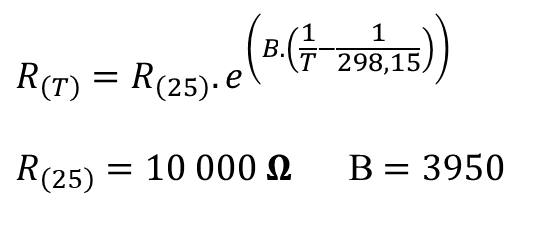
Build a thermometer
Sensor : thermistor
Electrical circuit
5V
Thermistor
A0
input
$$R_{\left(T\right)}=R_{\left(25\right)}.e^{\left(B.\left(\frac{1}{T}−\frac{1}{298,15}\right)\right)}$$
$R_{\left(25\right)}=10 000 Ω$ B $=3950$
10 kΩ
GND

Slide 35
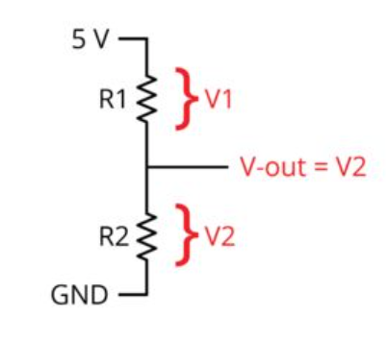
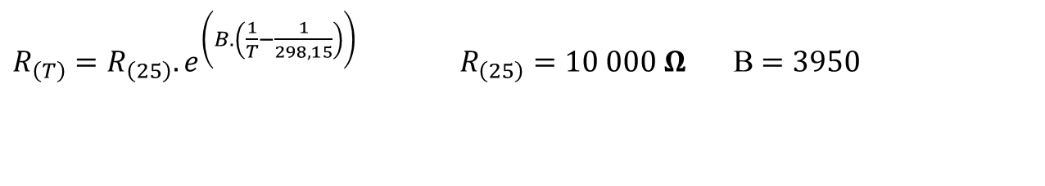

Build a thermometer
5V
Thermistor
A0
input
10 kΩ
$$R_{1}=R_{2}(\frac{5 V}{V_{out}}−1)$$
GND
$R_{\left(T\right)}=R_{\left(25\right)}.e^{\left(B.\left(\frac{1}{T}−\frac{1}{298,15}\right)\right)} R_{\left(25\right)}=10 000 Ω$ B $=3950$

Slide 36
Build a thermometer
5V
void setup() {
pinMode(A0, INPUT);
Serial.begin(9600);
}
void loop() {
Serial.println(analogRead(A0));
delay(200);
}
Thermistor
A0
input
10 kΩ
GND

Slide 37


Build a thermometer
Tension V_{out}
0
5V
Valeur lue S_{out}
valeur sous forme
d’un nombre entier
0
1023
$$R_{1}=R_{2}(\frac{5 V}{V_{out}}−1)$$
$$R_{1}=R_{2}\left(\frac{1023}{S_{out}}−1\right)$$

Slide 38
Build a thermometer
float TensionLue;
float ResistanceCapteur;
float Temperature;
float R2 = 10000;
void setup() {
pinMode(A0, INPUT);
Serial.begin(9600);
}
void loop() {
TensionLue = analogRead(A0)* 5.0 / 1023;
ResistanceCapteur = R2 * (5 / TensionLue - 1);
Temperature = 1 / ((log(ResistanceCapteur / 10000)) / 3950 + 1 / 298.15);
Serial.println(Temperature- 273.15);
delay(200);
}

Slide 39
Build a thermometer
float ResistanceCapteur;
float Temperature;
float R2=10000;
void setup() {
pinMode(A0, INPUT);
Serial.begin(9600);
}
void loop() {
ResistanceCapteur = R2*(1023.0/analogRead(A0) – 1);
Temperature=1/((log(ResistanceCapteur /10000))/3950+1/298.15);
Serial.println(Temperature-273.15 );
delay(200);
}

Slide 40
Challenge 3 : build a colored thermometer
  What is the temperature today?
  Heat the thermistor with your fingers and observe the measured temperature in the serial window
  Switch on blue LED if T=<23°C
  Switch on green LED if 23<T<28°C
  Switch on red LED if T>=28°C

Slide 41
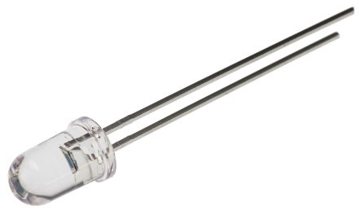
Build a lightmeter
5V
void setup() {
pinMode(A0, INPUT);
Serial.begin(9600);
}
void loop() {
Serial.println(analogRead(A0));
delay(200);
}
Photodiode
A0
inut
10 kΩ
GND

Slide 42

Challenge 4 : Automatic light control
  Automatic Light Control turns the lights on whenever the sensor senses dark conditions.

