Slide 1

Build a colorimeter

Slide 2
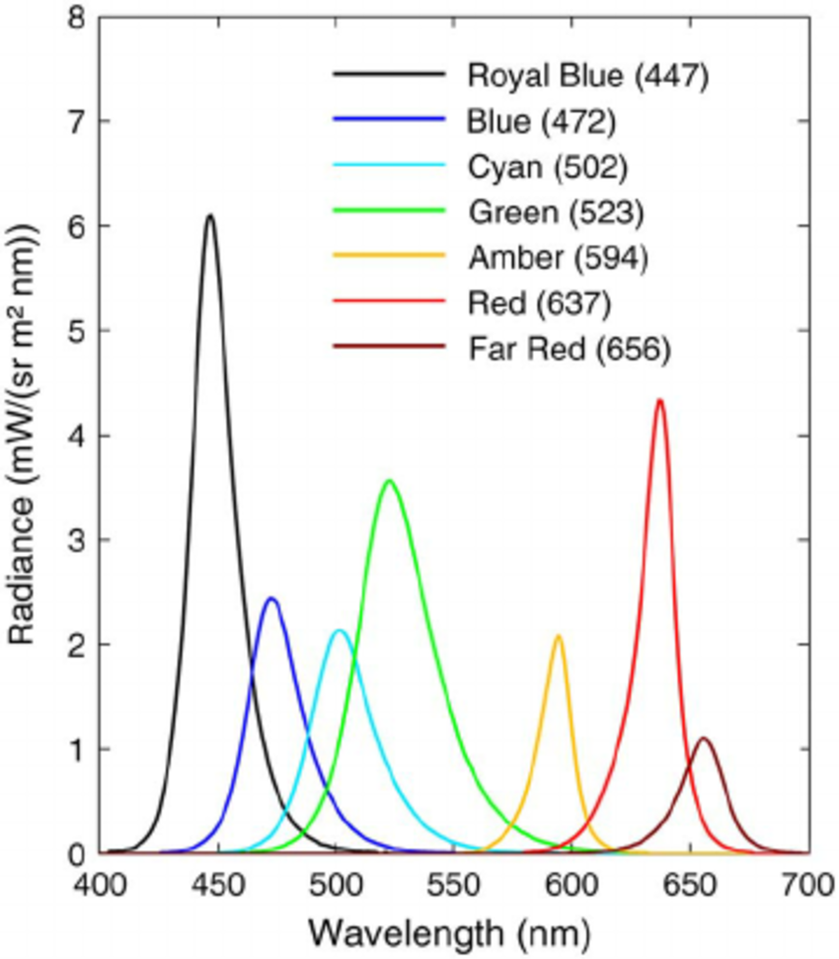
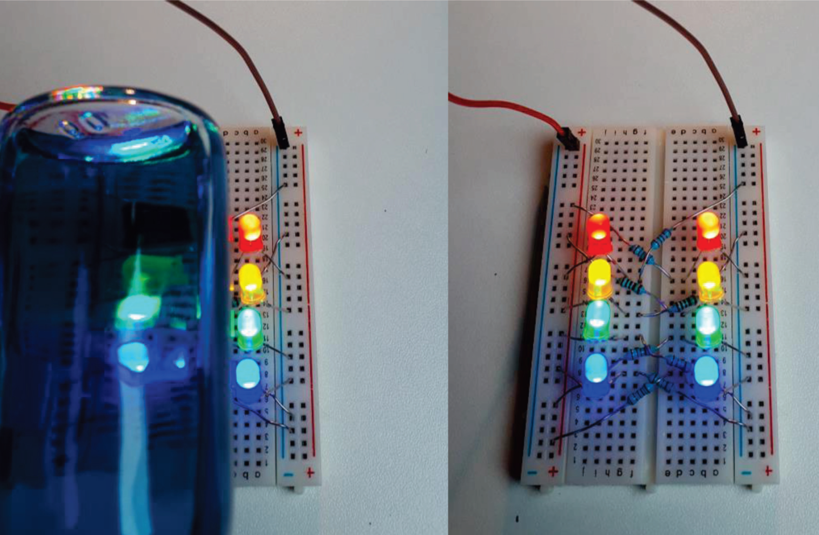
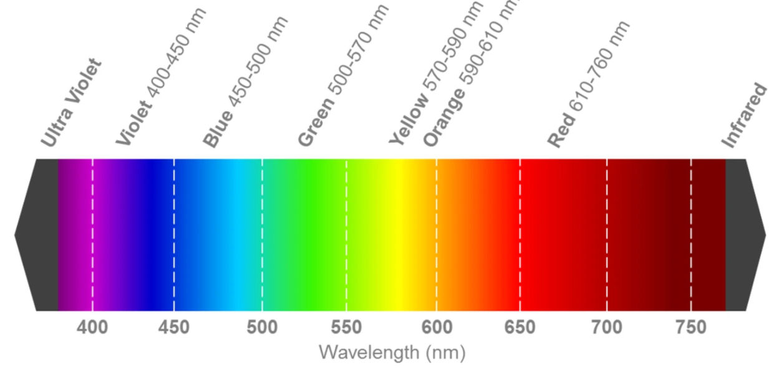
Spectra
LED Emission

Slide 3
Light absorption

Slide 4
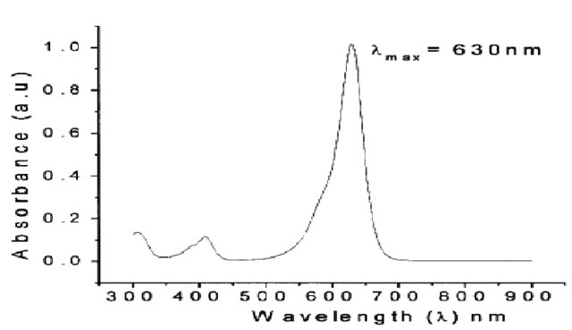
Light absorption
Erioglaucine Absorption
λ_{max} = 630 nm

Slide 5
Spectra
LED Emission
Erioglaucine Absorption
λ_{max} = 630 nm

Slide 6
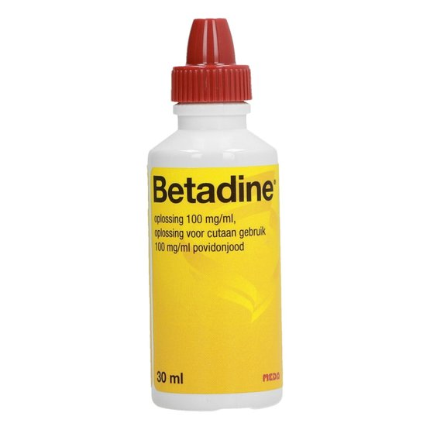
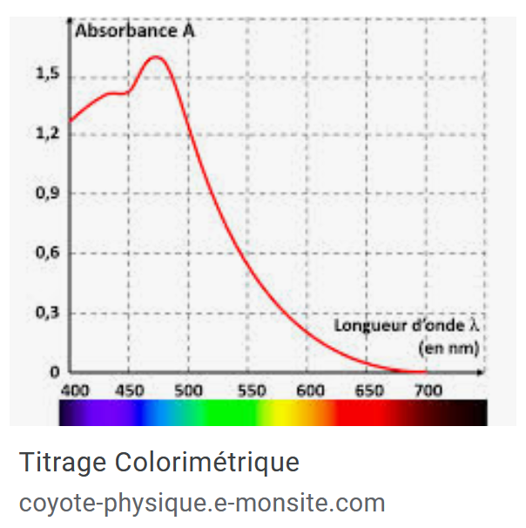

Slide 7
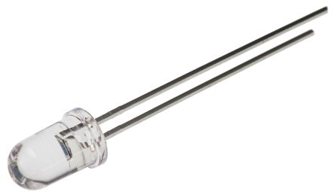
A simple lightmeter
void setup() {
pinMode(A0, INPUT);
Serial.begin(9600);
}
void loop() {
Serial.println(analogRead(A0));
delay(200);
}
5V
Photodiode
Grande patte
A0
input
Resistor 10 kΩ
GND

Slide 8
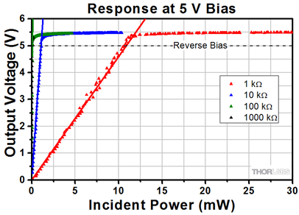
Photodiode
Signal proportional to light intensity
5V
Photodiode
A0
input
Resistor
1-1000 kΩ
GND
Notes:
https://www.thorlabs.com/newgrouppage9.cfm?objectgroup_id=1285

Slide 9
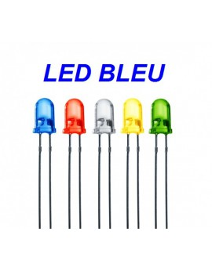
Can we imagine to build a colorimeter ?
5V
5V
Photodiode
LED
A0
input
R1
Resistor 1-1000 kΩ
GND
GND

Slide 10
Can we imagine to build a colorimeter ?
5V
Pin 8
Photodiode
LED
A0
input
R1
Resistor 1-1000 kΩ
GND
GND

Slide 11

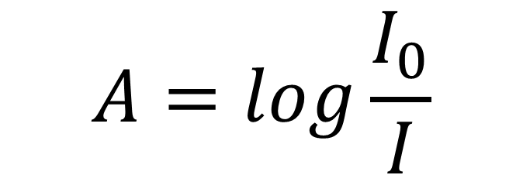
How do we really mesure Absorbance (I and I₀₎ ?
$$A=log\frac{I_{0}}{I}$$
Capteur
I₀
I
Notes:
https://www.thorlabs.com/newgrouppage9.cfm?objectgroup_id=1285

Slide 12

How do we really mesure Absorbance (I and I₀₎ !
$$A=log\frac{I_{0}}{I}$$
Notes:
https://www.thorlabs.com/newgrouppage9.cfm?objectgroup_id=1285

Slide 13
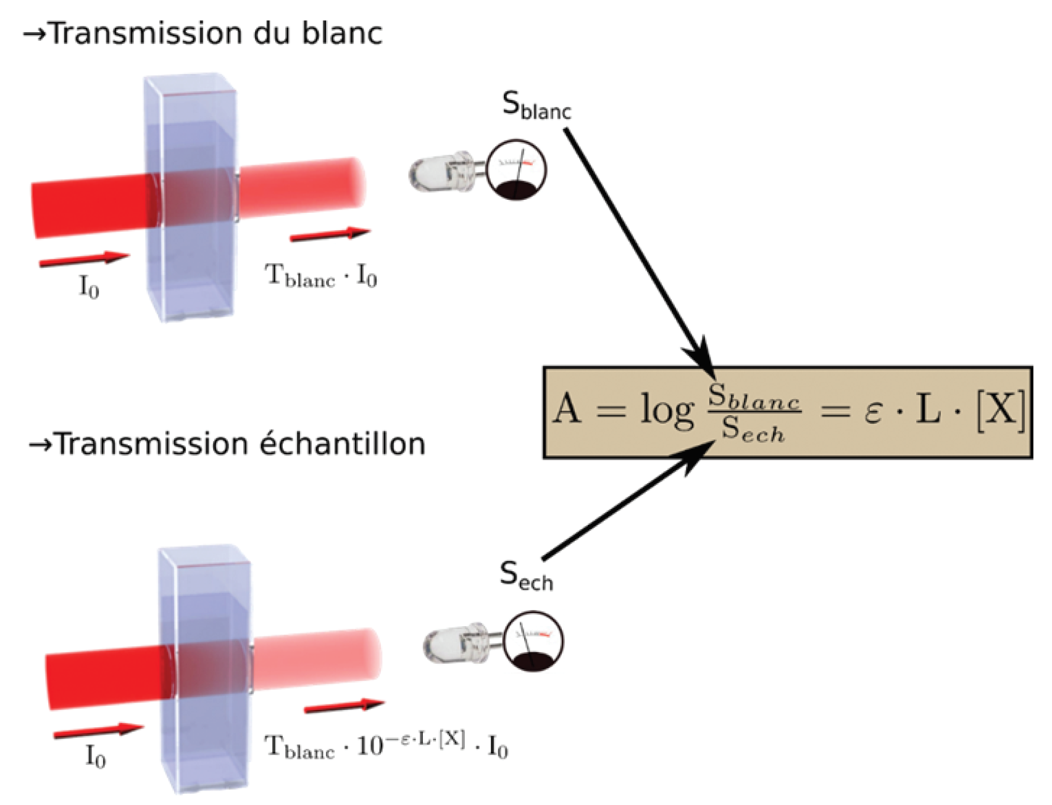
Absorbance measurement in dark conditions
Blank
Sample (échantillon)

Slide 14

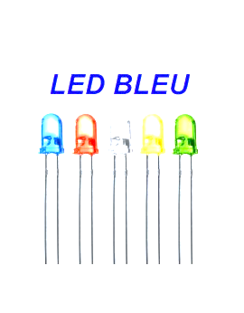
Without cover : light modulation
1 - LED ON
S_{blank}+S_{sun}
3 - S_{sample}+S_{sun2}
4 - S_{sun2}
2 - LED OFF
S_{sun}

Slide 15
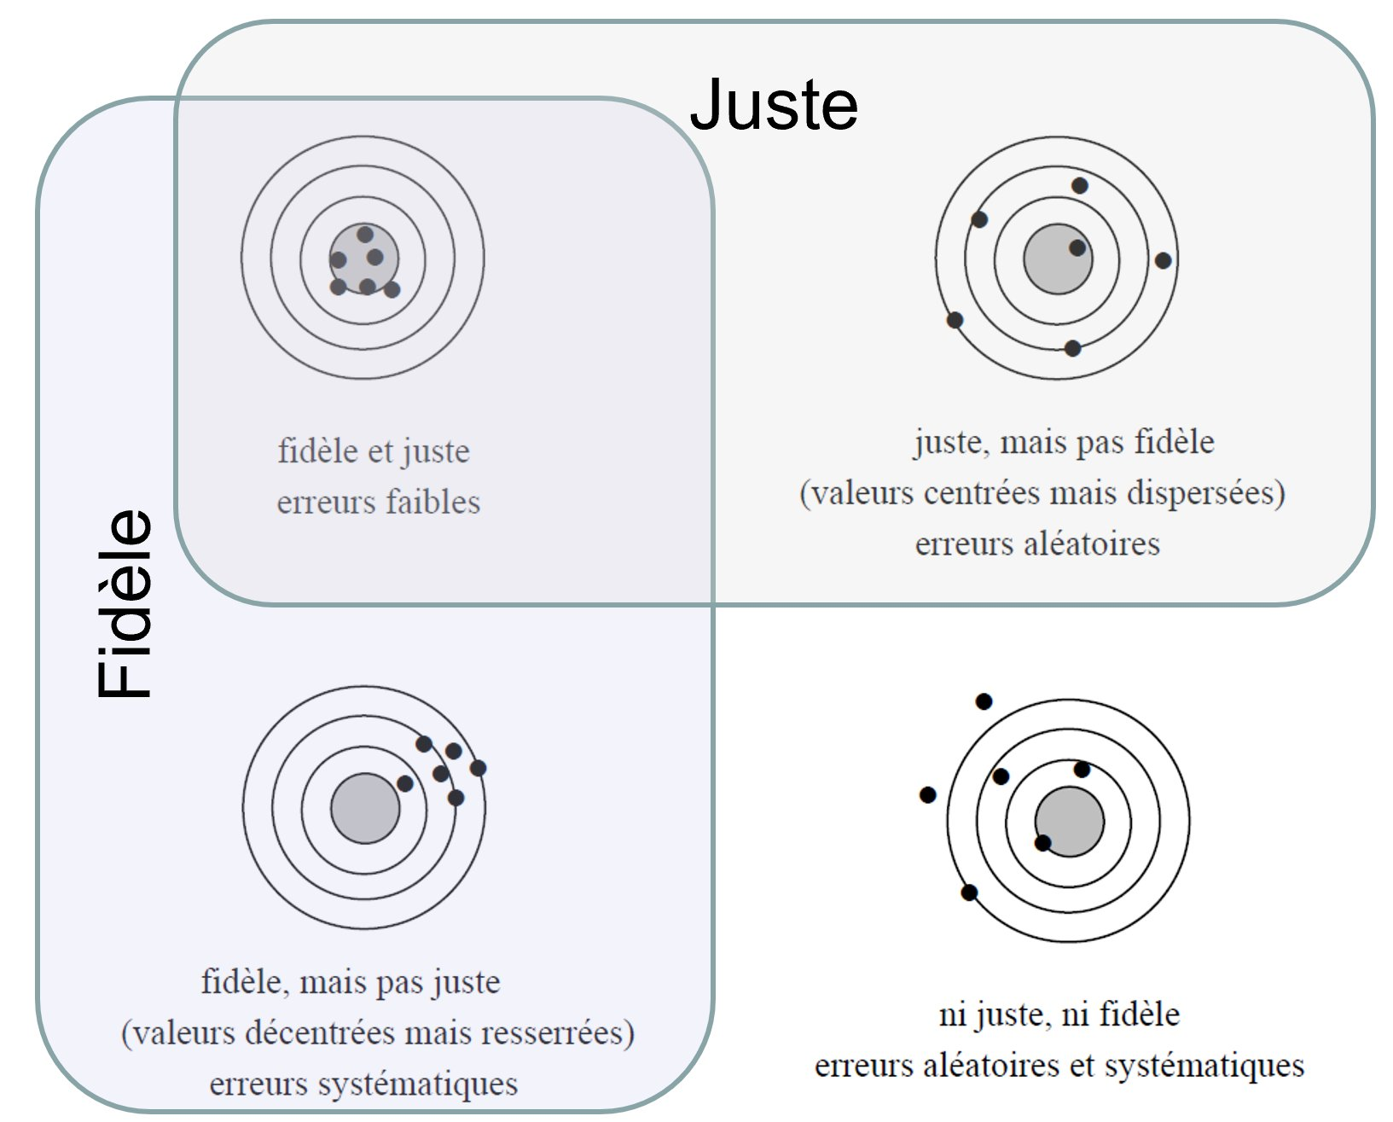
Quality of measurement
trueness
precision

Slide 16
Quality of measurement
Accuracy = trueness and precision

Slide 17
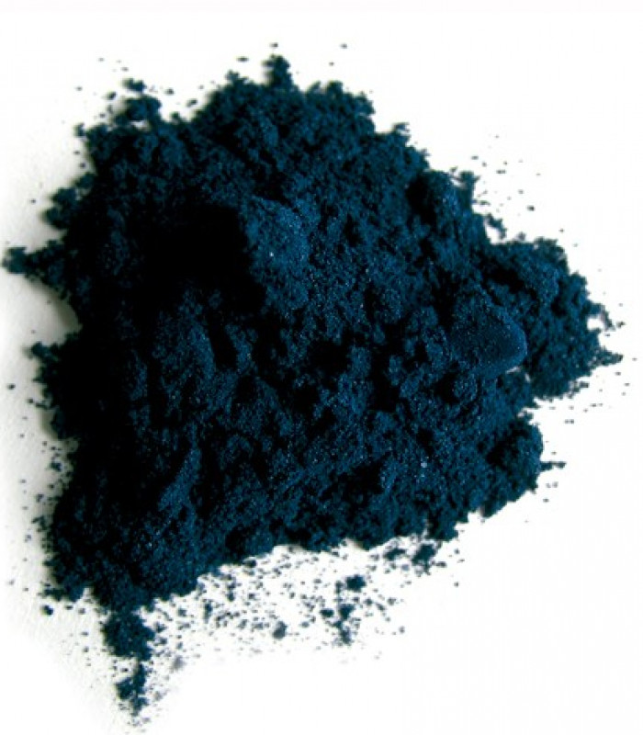
Validation of calibration
Concentration
Signal
5 repeated mesurement on 5 concentration levels
I₁
I

Slide 18
Validation of calibration (NF 90-210)
For each line
Slope, intercept
Recalculated concentrations
(close to 2, 4, 6, 8, 10)
Absolute Biais
Calc.Conc – Expected.Conc
Relative Biais

Slide 19
Validation of calibration (NF 90-210)
Relative Biais %
Concentration (mg/L)

Slide 20
One instrument : three wavelengths

