Slide 1
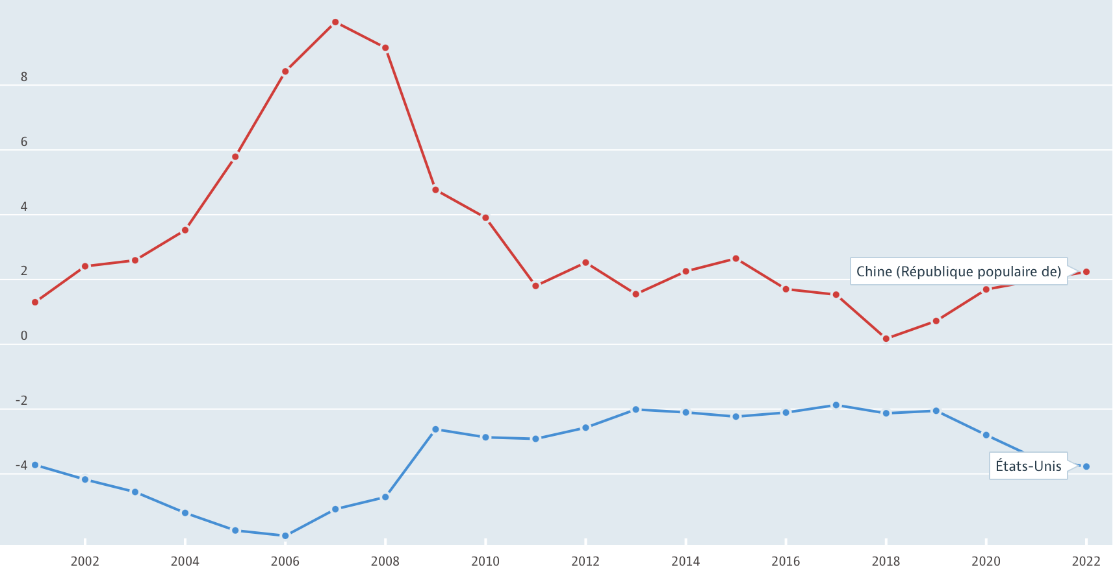
China’s ‘steroid growth’
Evolution of Current account balances from 2001 to 2022 (%of GDP)
Source: OECD 2023
Four periods: 2001-2008/ 2008-2012/ 2012-2020/ Post-2020
Notes:
Interesting to compare both graphs…
In 2007, Chinese surplus: 10% of GDP (US deficit 5%), in 2018, Chinese surplus only 0,2% (US deficit: 2,1%); in 2022, 2,2% Chinese surplus, US deificit 3,8%
We can identify 3 periods:
2001 to 2008
2008-2012
2012-2020
Since 2020

Slide 2
China’s steroid growth’
From 1990’s to 2008: The birth of a specific kind of capitalism
Distinctive feature: significant state involvement
‘the factory of the world’
2001 joined; WTO Model based on exports, largely subsidized by the Central state
Money came from Chinese households (high savings at state banks, artificially low cost of K)
Wage suppression, suppression of labor rights
Interest rates control on banks deposits (kept very low, 1.6% while the real return on K was 22%), while companies enjoyed a low cost of K, great beneficiary: Chinese gvt that has maintained a depreciated , hence more competitive exchange rate (also helped to contain inflation)
Targeted subsidies: ex steel industry 2009; China overtakes the US as biggest car market in the world+fiscal advantages, softer loans and priority access to infrastructure and land for exporting firms (mostly state-owned)
➔ unusually low consumption/GDP ratio (only 35% in 2008, compared with about 50% in market economies), contrast with Japan and Korea, vast increase of savings+ practice of ‘evergreening’ firms
Notes:
Den XiaoPing (1978), from a ‘back-water economy into the world’s most connected component’, GDP per capita X 50, a billion people out of poverty, competing to become the world’s leader in cutting-edge technology (Meeting Globalization’ s challenges 2019, Chapter 4 article by Keyu Jin)
Large volumes of resources from low-productivity agriculture to high-productivity manufacturing sectors, economies of scale.
) ‘In sum, through financial repression, households were in part subsidizing corporate borrowing and in part subsidizing an undervalued real exchange rate’, household disposable income declined steadily between 1992 and 2007

Slide 3
China’s steroid growth’
2) The impact of the 2008 crisis
Table 1. China’s annual GDP growth rates
Year | 2005 | 2006 | 2007 | 2008 | 2009 | 2010
China | 11.30 | 12.70 | 14.20 | 9.60 | 9.22 | 10.33
Source: IMF World Economic Outlook.
Table 2. China’s net FDI in $ billions.
Year | 2005 | 2006 | 2007 | 2008 | 2009 | 2010
China | 105.90 | 102.92 | 143.06 | 121.68 | 70.32 | 124.93
Source: World Bank World Development Index
Notes:
Not so much affcted by the financial crisis ( China’s trade market does not trade derivatives- although Chinese State banks had assets in Lehman Brother’s) but by the
fall of global demand (Exports represented 30% of China’s GDP)
Decrease of FDI
Starting in October 2007, the stock market in China crashed, wiping out more than two-thirds of its market value [10].
A similar story applies to the real estate market. A bubble started to grow with China’s booming economy, since most of the people believe that investing in property, such as real estate, is safer than putting money in the banks. The impacts of these developments on the Chinese economy were relatively small compared with the trade channel, however.

Slide 4
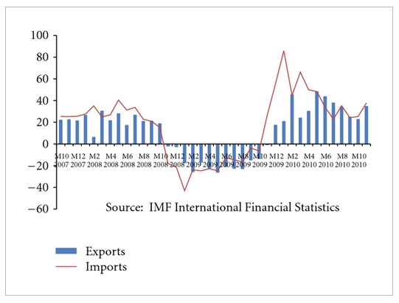
Quick recovery in 2009 thanks to - strong stimulus package in 2008 (586B$) to finance real estate and infrastructure - Low interest rates
2) The impact of the 2008 crisis
But.. Rural China still poor and high level of savings, consumption only 35% of GDP (compared to around 50% in market economies )
Notes:
A quick recovery, thanks to
The fact that People’s bank of China lowered its interest rate
A strong fiscal position, that enabled a strong stimulus package ($586 billion ) to finance real estate and infrastructures
This combination of stimulus package and lower interest rates helped pickup in growth by the second quarter of 2009 (https://www.imf.org/external/pubs/ft/fandd/2010/06/yueh.htm) China’s continued growth will depend on the success of the massive fiscal stimulus, focused largely on infrastructure. Infrastructure spending builds on a large-scale transportation project in the 11th Five Year Plan, which began in 2006. The existing plan allowed the spending to be quickly implemented and provided jobs on roads and rail for some of the millions of workers laid off from export-oriented factories
But the social part of the stimulus, representing less than 5 percent of the package, was judged insufficient to stimulate private consumption. It failed to address China’s high level of household saving—a major cause of low domestic demand. To discourage precautionary saving, China added $125 billion in spending on health care later in 2009—covering 200 million uninsured citizens as a step toward achieving universal coverage by 2020—and about $400 million toward pensions for rural workers.
Nevertheless, consumption as a share of GDP remained constant in 2009. A 10.5 percent increase in urban incomes helped fuel consumer spending, but that increase was from a low base. Consumption accounts for only 35 percent of GDP in China, compared with 50 percent or more in most market economies. And the majority of the rural population remains poor. As a result, despite a 16 percent increase in retail sales, consumption contributed only about 4 percentage points of China’s growth in 2009.

Slide 5
China’s ’steroid growth’
3) 2009-2020: an attempt to change the model
An upgrading of industrial production
Investment in R&D, education, new technologies (E.V, aeronautics, AI, IT)
b) Development of services
c) An attempt to increase the household consumption, so that growth should rely less on exports and investment in infrastructures
A rapid increase of wages (especially minimum wages): between 2005 and 2012, average minimum wage multiplied by 3…(nominal value)
…in a country that has become one of the most inequal in the world
Notes:
Faced with increasing inequalities within the country (social, geographical), the Chinese Communist Party has been trying to tackle the issue

Slide 6
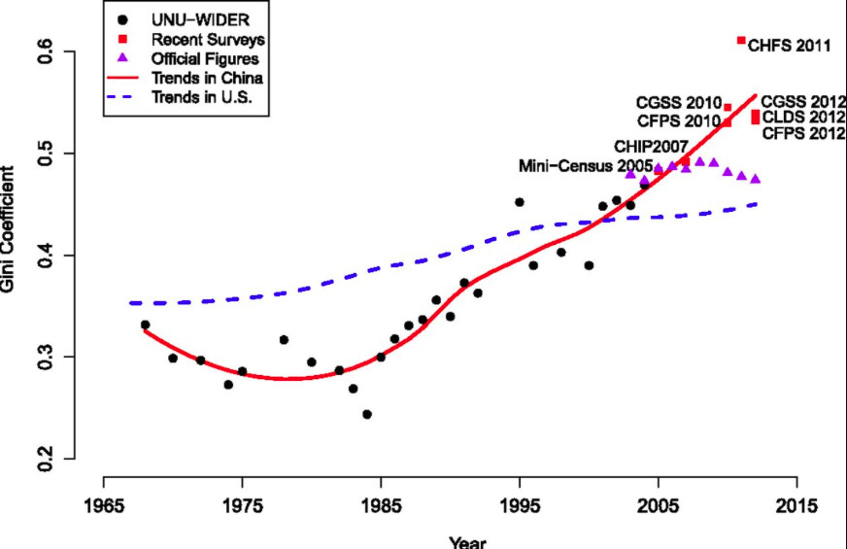
China’s ’steroid growth’
3) 2009-2020: an attempt to change the model
Regional differences (government favouring urban and coastal areas)
GDP per capita in Pekin&Shangai= Portugal
In Ganzu= Namibia
Trends in Gini coefficient of family income in China and the United States. Gini coefficients from UNU-WIDER and CHIP 2007 are based on household disposable income per capita. Gini coefficients of family income in the United States from 1967 to 2012 are provided by the US Census Bureau (19). Trends in both countries were fitted using LOESS. The official figures in China were not included in fitting the LOESS curve.
Notes:
In 2010, Gini coefficient 0,6 (0= equal society, 1 = inequal), much higher than in the past, much higher than in other BRICS. Surpassed the US in 2010, where income inequality is traditionally the highest
Mostly explained by GEOGRAPHICAL divide
our results reveal that China’s income inequality has grown rapidly in the last three decades, to a very high level around 2010. The rapid rise in income inequality can be partly attributed to long-standing government development policies that effectively favor urban residents over rural residents and favor coastal, more developed regions over inland, less developed regions (13, 25, 32).
(https://www.pnas.org/doi/full/10.1073/pnas.1403158111#:~:text=By%20now%2C%20China's%20income%20inequality,or%20higher%20standards%20of%20living.)
GDP per capita in Pekin and Shangai= same as Portugal
In Ganzu= same as Namibia

Slide 7
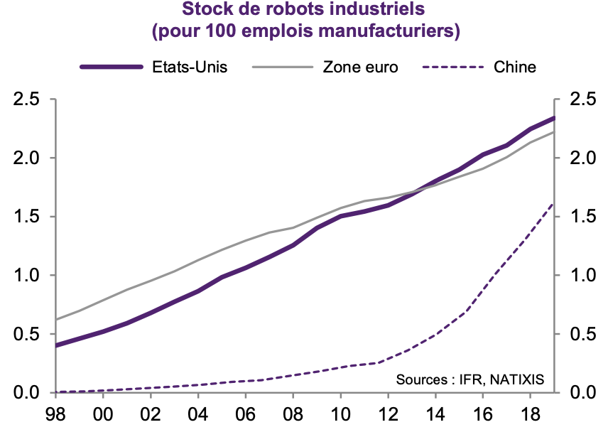
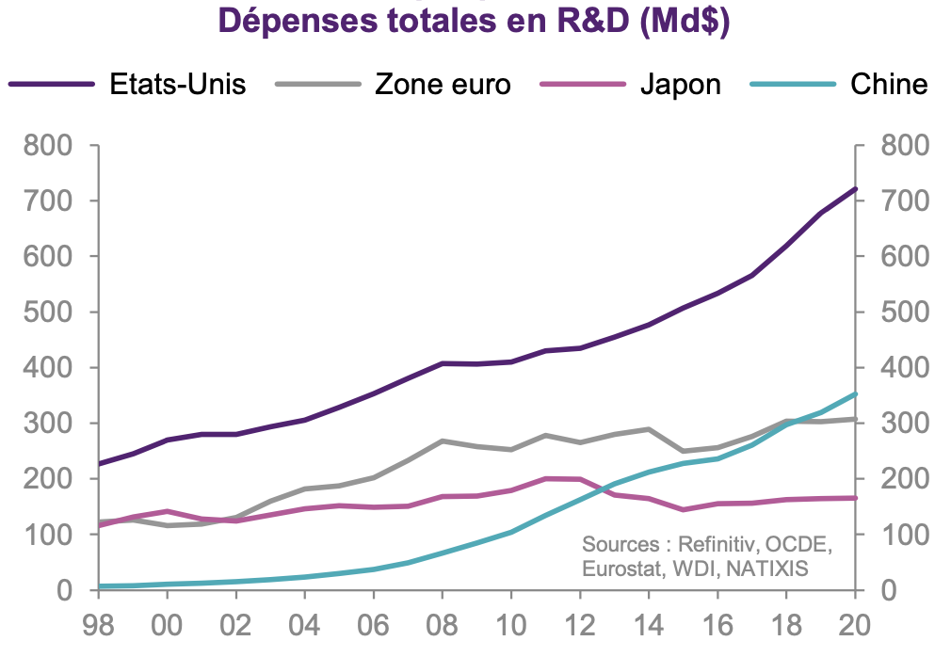
3) 2009-2020: an attempt to change the model
Stock of industrial robots for 100 manufacturing jobs
Total spending in R&D
The Chinese economy has transformed a lot through automation and investment in R&D
Yet,
it is still struggling in sectors that are key such as semi-conductors (cf protectionist measures from the US)
The rise of wages leads to a decline in traditional cost-competitive industries (textile, electronics, white goods, furniture, etc )now produced in other emerging countries in Asia – still the State keeps investing in zombie companies

Slide 8
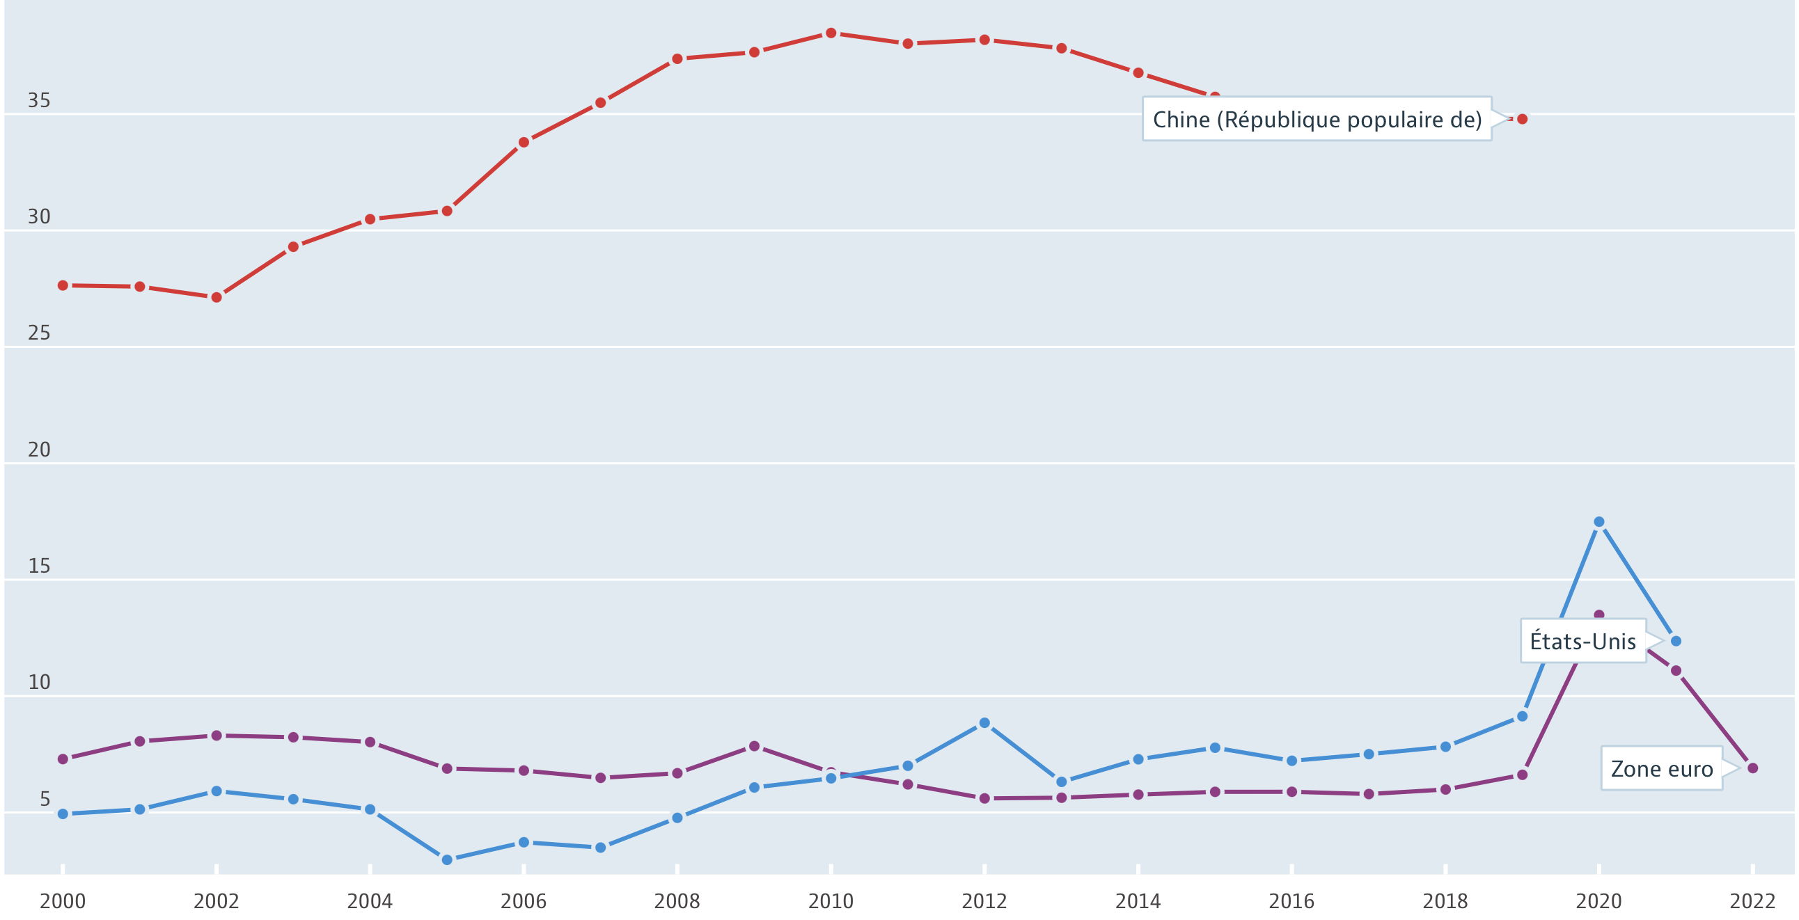
China’s ’steroid growth’
3) 2009-2020: an attempt to change the model
Chinese households’ savings, in % of disposable income (source OECD 2023)
Reasons for high savings
The legacy of Confucianism
Lack of trust in banks
Absence of social net
All the more worrying as China has an aging population
Notes:
Cf confucius… saving characterizes traditional mentalities in China; the rate of savings has started to decrease in 2013 but still vey high. Household Consumption= less than 40% in China, 55% in France, 68% in the US) in spite of increasing wages…
Reasons: growing inqualities, lack of trust in banks, and mostly the absence of a social net (unemployment benefits, pension system, health insurance). All the more worrying as China has an aging population (cf one-child policy)

Slide 9
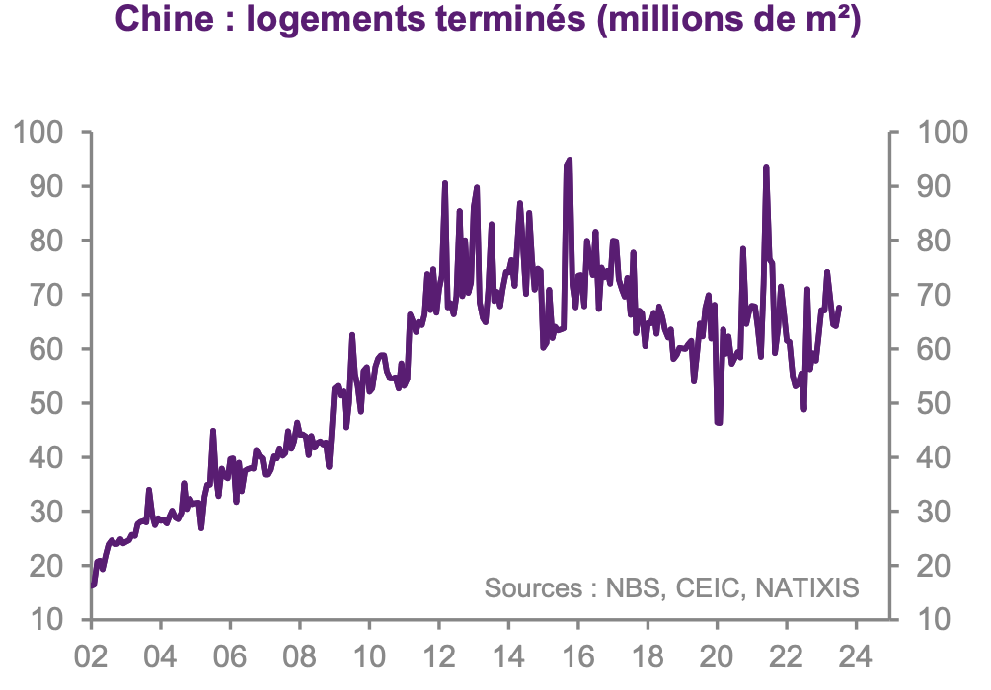
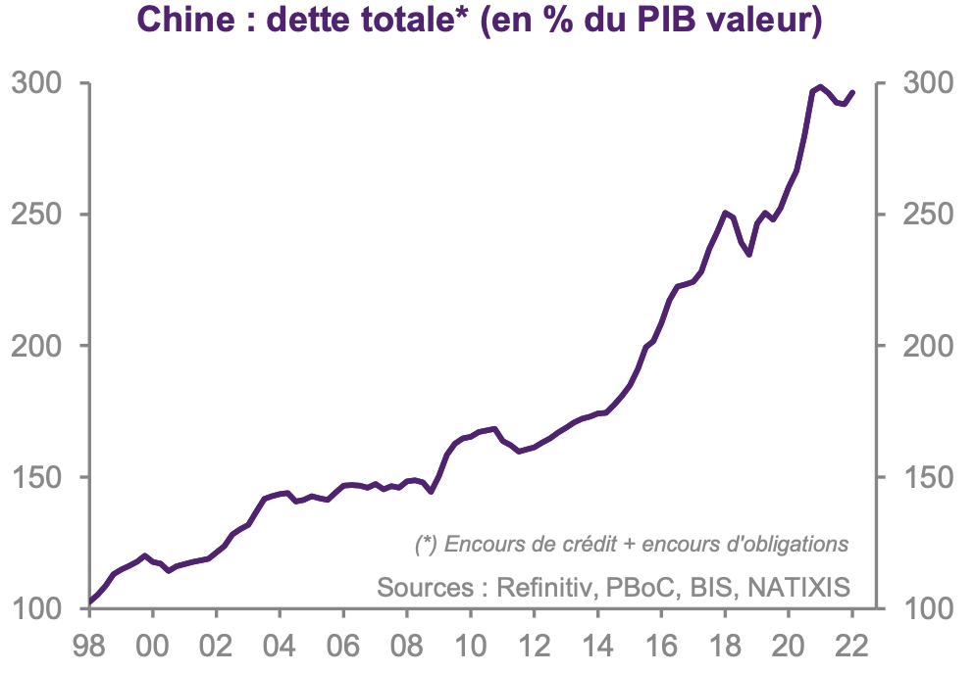
3) 2009-2020: an attempt to change the model
To tackle the issue of decreasing growth…
Massive Investment in construction of infrastructures and real estate
➔ a massive private and public debt
Number of houses built
Chinese debt in percentage of GDP
Government wants to avoid growing unemployment and social unrest
Notes:
Investment in construction often non-productive or with a low profitability, but the Chinese gvt want to avoid growing unemployment and the social trouble; Also individuals who cannot invest in K (cf regulation by the gvt) have to invest in cnstruction as well.
Also a poilitcal issue (Chinese gvt cannot afford to face social unrest..) so, vicious circle!

Slide 10
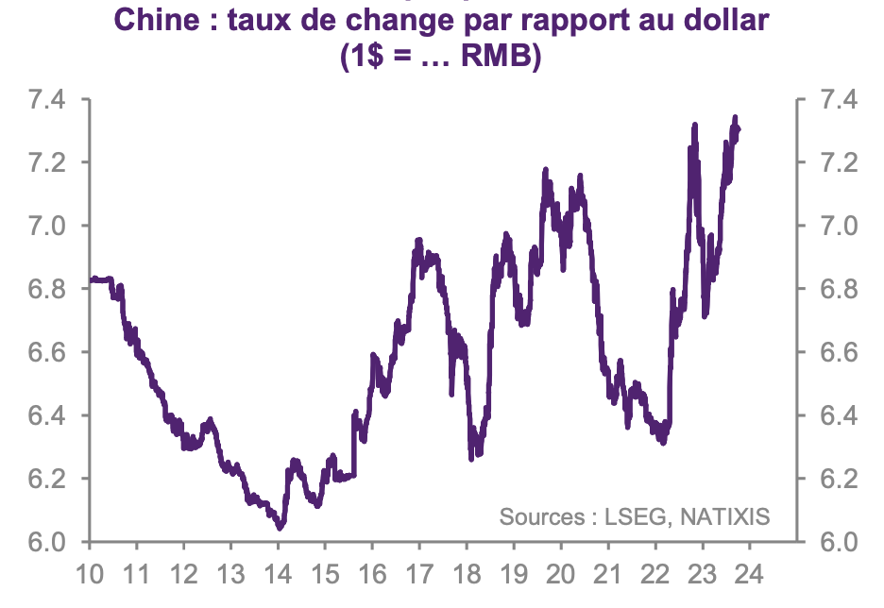
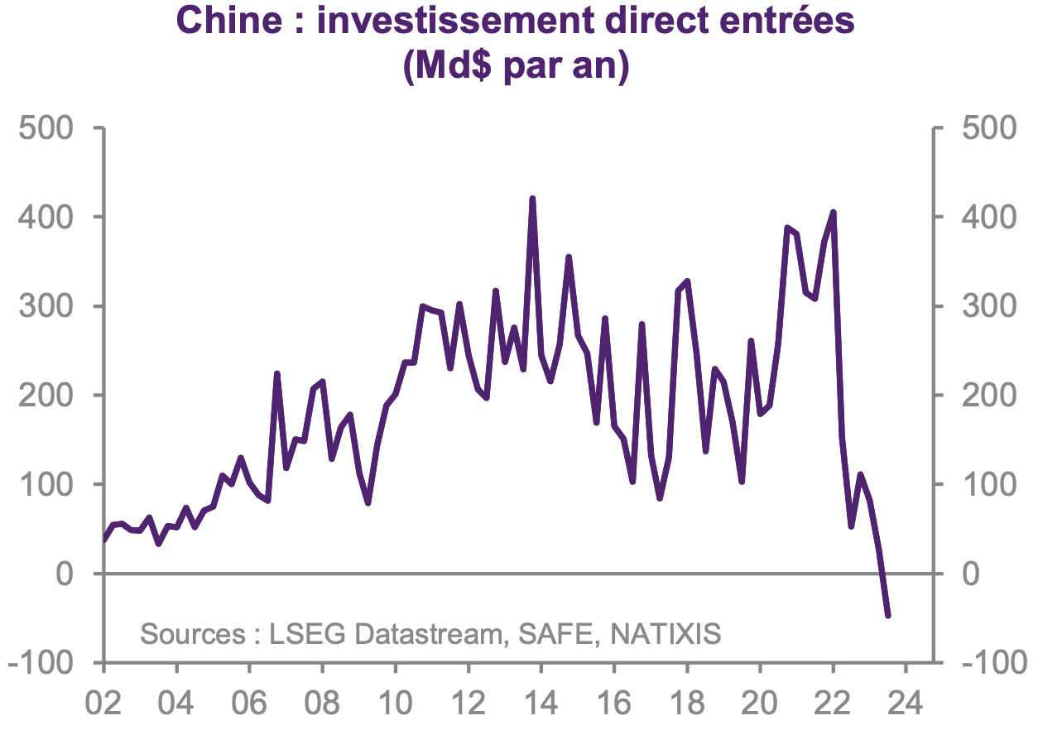
4) Since 2022: the temptation to turn (again) to a strategy based on exports, through an improvement of the competitiveness and a decrease of the exchange rate (and subsidies)
Exchange rate of the RMB / $
Foreign Direct Investment in China
Expansionary monetary policy (a lot of loans, to ailing companies), low renminbi to improve competitiveness of exports
Drop of FDI for geopolitical reasons, trade war with the US and Europe
Protectionist measures, ex Huawai, restriction on the sale of semi-conductors to China, sanctions and more tariffs for E.V
Notes:
In 2023, American imports of Chinese products represent only 13,4% of their imports (used to be 20% in 2018)
1) Expansionary monetary policy (a lot of loans, even to ailing companies), contrary to Europe and the US, by supporting construction, fighting against deflation and improve its competitiveness for exports (low RMB)
2) Since 2022, drop of FDI for geopolitical reasons, the relations between China and its Western partners has deteriorated a lot (more protectionism and sanctions against China- unfair competition denounced more and more openly: 'trade war' between the US and China
- forbidding the use of Huawai equipment
- American sanctions against people (vice-President of the Aseembly of people of China)
- The ban for companies wanting to invest in Chinese military companies
The limits put on selling semi-conductors to China
- The sanction against Chinese companies who have sold weapons to Russia
Heading toward more and more tariffs on Chinese products (E.V)
https://www.bis.doc.gov/index.php/policy-guidance/advanced-computing-and-semiconductor-manufacturing-items-controls-to-prc

Slide 11
4) Since 2022: recent developments
Shift towards green tech: EV, batteries, solar panels
Declining and Aging population (cf one-child policy)
Lack of skilled labour
Environmental depredation
Property crisis
Too much precautionary savings
Excess capacity of industries
https://www.youtube.com/watch?v=P8GSY4WNM-0
1) ‘China: why the country’s economy has hit a wall – and what it plans to do about it’
Published: March 19, 2024
2) ‘China’s youth unemployment problem has become a crisis we can no longer ignore’
(Oct 2023)
3) ‘China needs a new growth model to shift from exports and investment to domestic demand, and this will require a more generous social safety net so consumers can spend more with less precautionary savings’
➔… garbage time of history???
Notes:
https://theconversation.com/china-why-the-countrys-economy-has-hit-a-wall-and-what-it-plans-to-do-about-it-225623
2) https://theconversation.com/chinas-youth-unemployment-problem-has-become-a-crisis-we-can-no-longer-ignore-213751
3) (https://www.reuters.com/markets/imf-fiscal-chief-us-china-must-rein-debt-face-different-challenges-2023-10-11/#:~:text=2%2C%20shows%20that%20the%20U.S.,global%20total%20and%20China%2020%25.)

