Slide 1
Economic Globalization
Objectives of the class
-
Give you an insight into the current global economic situation, as well as an overview of recent economic history
Give you the tools to analyze future developments
Using this knowledge of macro-economic issues as a business student
Focus on ECONOMIC globalization
MMIC program
Module: ENVIRONMENT
Course: Economic Globalization
Laurence Collaud
Notes:
Current eco situation: inflation rate? Debt to GDP ratio?
Recent eco history: 3rd wave- what were the first two?
Future eco dvpt: reading the press
As a business student: someone who works in logistics/supply chain, needs to understand how inflation of raw materials will affect turnover, someone working in finance needs to understand the basics of a financial crisis

Slide 2
Outline of the 9 sessions
Session 1 Monday, September 23rd : General intro + a few key concepts
Session 2 Monday, September 30th: Mind map with major concepts per country
Session 3 Monday, October 7th Students’ presentation : Should we worry about the current deficit in the US?
Session 4 Thursday, October 17th Students’ presentation: China’s steroid growth?
Session 5 Thursday, October 24th Students’ presentation: Are MNCs superpowerful?
Session 6 Tuesday, November 5th Students’ presentation: Germany, the sick man of Europe again?
Session 7 Tuesday, November 12th Students’ presentation: Has Spain or Italy taken advantage of the Euro?
Session 8 Tuesday, November 21st Students’ presentation: Global governance, towards the end of multilateralism?
Session 9: Monday, December 2nd EXAM
Requirement for presentations: send me the PPT at least 48 hours before your presentation
Notes:
Case-study approach

Slide 3
Working method- Assessment
On Moodle :
PPT presentation, sometimes to be studied before the class.
You need to learn the content, and prepare questions on what has been studied if necessary.
Additional resources: articles +access to IUT library-+ scholarvox and Europress: https://portaildoc.univ-lyon1.fr/les-collections/bibliotheque-en-ligne
Assessment:
Group/indiv Presentation (40%) and final written exam (60%)
Instructions for the presentations on Moodle
Notes:
Case-study approach

Slide 4
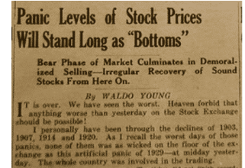
Class 1 Introduction
O
Oct 1929
August 2024
Sept 2008
Notes:
August 2024 (US sees clouds..)
‘Current crisis is greatest challenge’ Sept 2008
‘panic levels of stock prices’ (Oct 1929)
The Great lockdown April 2020
All these crises… Globalization= a political agenda for neoliberal policies, serving the interests of the ruling class (F. Lebaron dans Le savant, le politique et la mondialisation), the result of a long-time process, the ultimate stage of a progress that started with the Great discoveries of the XVIth century, mercantilism, the Industrial revolutions (XIXth), colonization, the emergence of MNC / international finance, both for Marxists and classic economists like Ricardo.
Interesting parallel between the birth of agriculture (in the Neolithic period) and the 3rd wave of globalization: the search for a decrease of transaction costs (chap 1 page 16)
Cf Adam Smith, homo economicus

Slide 5
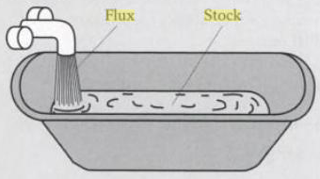
Class 1 Introduction
Reminder of the difference between stock and flow
Flow: quantity measured by time unit
Stock: quantity measured at a point in time
Stock or flow… Public debt? GDP per year? Exports per year? Number of unemployed people? Current account deficit per year?
Notes:
Public debt? stock
GDP per year? flow
Exports per year? flow
Number of unemployed? stock
Current account deficit par year? flow

Slide 6
GDP
- Definition
Gross domestic product (GDP) is the standard measure of the value added created through the production of goods and services in a country during a certain period. (oecd.org)= all the output produced within the borders of a country
- What does it include? (rules fixed by the U.N.)
Includes non market production such as education and defence services provided by the government
Doesn’t register how the wealth is distributed (same for GDP per capita- check Gini Coefficient)
Does not include negative externalities (like pollution)
Does not include unpaid and domestic work
Does not include the sale of illegal goods (depending on countries)
Note: Difference between nominal and real
Class 1 introduction to the key concepts
Notes:
What does it include?
Consumption (1), investment, government spending and exports
Non –market production like education: difficult to assess the added value of a teacher…?!
Not domestic work (although it represents on average 1.5 times the amount of time spent at work
Different approaches for calculation:
● The production approach sums the “value-added” at each stage of production, where value-added is defined as total sales less the value of intermediate inputs into the production process. For example, flour would be an intermediate input and bread the final product; or an architect’s services would be an intermediate input and the building the final product.
● The expenditure approach adds up the value of purchases made by final users—for example, the consumption of food, televisions, and medical services by households; the investments in machinery by companies; and the purchases of goods and services by the government and foreigners.
● The income approach sums the incomes generated by production—for example, the compensation employees receive and the operating surplus of companies (roughly sales less costs).
Traffic jams and car accidents increase GDP…
Real vs nominal:
Nominal value/real value: nominal value expressed in currency units whereas real value takes inflation into account
Real value= nominal value – inflation Examples of wages and interest rates for a loan or a return on investment

Slide 7
GDP
Different approaches for calculation:
Production approach
expenditure approach
income approach
Given in nominal value or per capita, usually expressed in % of growth
For France 2023: 2370 B€ (= 2644 Billion$)- 0,8% (GDP growth with 5% inflation)
Other indicators used:
Human Development index- HDI- (takes into account literacy, life expectancy, school enrollment, etc)https://hdr.undp.org/data-center/human-development-index - /indicies/HDI
Gross National Happiness Index https://www.imf.org/en/Publications/fandd/issues/2024/03/Picture-this-looking-beyond-GDP
Class 1 introduction to the key concepts
Notes:
Non –market production like education: difficult to assess the added value of a teacher…?!
Different approaches for calculation:
● The production approach sums the “value-added” at each stage of production, where value-added is defined as total sales less the value of intermediate inputs into the production process. For example, flour would be an intermediate input and bread the final product; or an architect’s services would be an intermediate input and the building the final product.
● The expenditure approach adds up the value of purchases made by final users—for example, the consumption of food, televisions, and medical services by households; the investments in machinery by companies; and the purchases of goods and services by the government and foreigners.
● The income approach sums the incomes generated by production—for example, the compensation employees receive and the operating surplus of companies (roughly sales less costs).
Traffic jams and car accidents increase GDP…
IN 2023

Slide 8
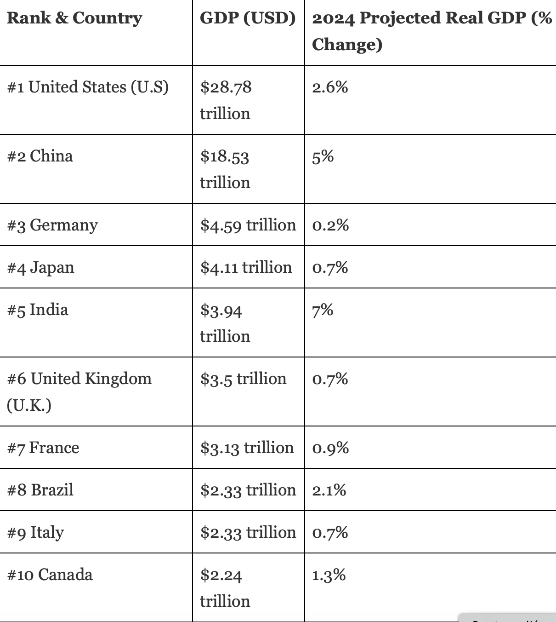
GDP
Class 1 introduction to the key concepts
Top 10 Largest Economies in the World 2024
Top ten GDP per capita
sourced from IMF data (as of September 11, 2024)
Country | Continent | GDP-PPP per capita (in USD)
#1 Luxembourg | Europe | 143,740
#2 Macao SAR | Asia | 134,140
#3 Ireland | Europe | 133,900
#4 Singapore | Asia | 133,740
#5 Qatar | Asia | 112,280
#6 United Arab Emirates | Asia | 96,850
#7 Switzerland | Europe | 91,930
#8 San Marino | Europe | 86,990
#9 United States | North America | 85,370
#10 Norway | Europe | 82,830
https://www.forbesindia.com/article/explainers/top-10-largest-economies-in-the-world/86159/1
Notes:
Ranking very different if you consider the 10 richest countries in the world (in earnings per capita):

Slide 9
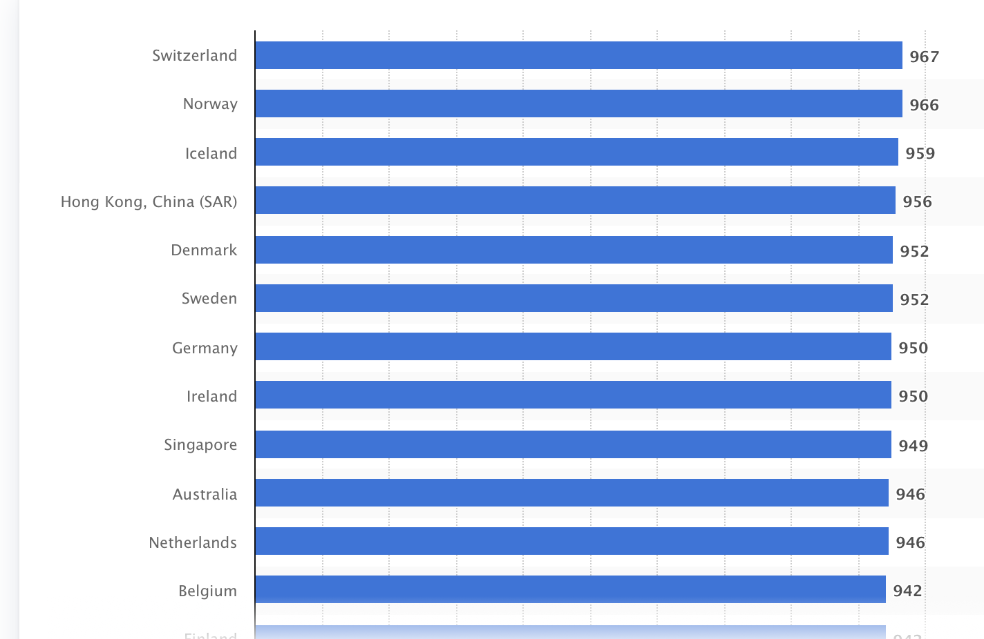
GDP
Ranking of countries with the highest Human Development Index (HDI) value in 2022 (in parts per 1,000) (https://www.statista.com/statistics/264630/countries-with-the-highest-human-development-index-ranking/
Class 1 introduction to the key concepts

Slide 10
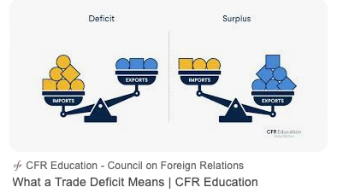
Class 1 introduction to the key concepts
Trade balance (or balance of trade- BOT)
The balance of trade is the account that details the value of exported goods and the value of imported goods over a given period of time. (Insee). In France only goods, elsewhere goods+services
Current account
The current account balance of payments is a record of a country's international transactions with the rest of the world. The current account includes all the transactions (other than those in financial items) that involve economic values and occur between resident and non-resident entities (oecd) (goods, services, income and foreign transfers) https://www.youtube.com/watch?v=TuyPLN8VR1M
Balance of payments :https://www.youtube.com/watch?v=owZh5vthZPk
Notes:
Current account:
Example on the positive side:
- Goods: Exports to the rest of the world
- Income: ex I own a pizza place outside the country, generates income
Money transfer: Someone I know outside the country sends me money
Examples on the negative side:
Goods: Imports
Income: A foreigner owns a pizza place in my country and is making profits
Money transfers: I receive money from some who lives outside the country
Interpretation of trade deficit : not always a bad sign… could indicate that the country may be overly reliant on foreign goods. However, that is not always the case. It could also mean the country is wealthy and has a high level of demand that needs to be satisfied (investopedia: https://www.investopedia.com/terms/b/bot.asp). Means you have to finance your debt on international markets
Trade surplus can be a result of a country having a competitive advantage in the production and export of certain goods, or a country's currency being relatively undervalued, making its exports cheaper for foreign buyers. (cf China, not enough local demand, too much savings). Can reflect of a falling demand, a start a recession… means you LEND money to the others
In itself, not a good indicator of the health of the economy (you need to analyze the context, understand why there is a surplus or a deficit)
+ you can have a deficit in the BOT and surplus in the balance of payments, and vice-versa.

Slide 11
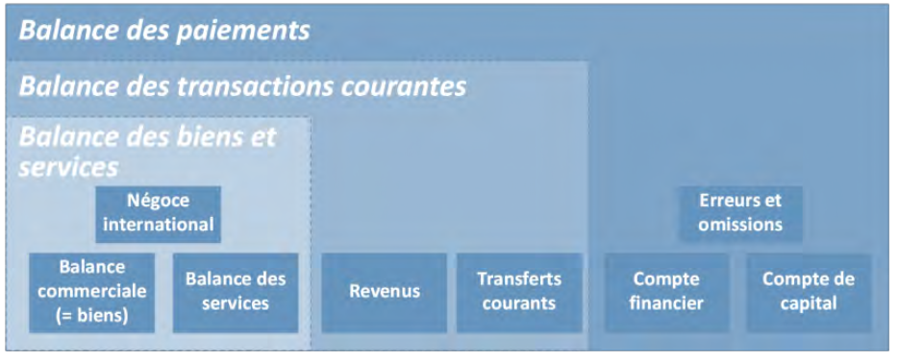
Source : DG Trésor, 2023
Class 1 introduction to the key concepts
Balance of payments= current account+ financial account (direct investment, portfolio investment, financial derivatives, other investment and reserve assets)+ capital account (patents, etc)
Notes:
The balance of payments consists of:
the current account (including the accounts for goods and services trade as well as the primary and secondary income accounts)
the capital account
the financial account (comprising direct investment, portfolio investment, financial derivatives, other investment and reserve assets)
The different accounts within the balance of payments are distinguished according to the nature of the economic resources (e.g. goods, services, income or financial resources) provided and received.
The balance of payments is based on a double-entry accounting system. Each transaction is recorded as consisting of two entries – a credit entry and a debit entry. The sum of the credit entries and the sum of the debit entries are the same. (https://www.ecb.europa.eu/stats/balance_of_payments_and_external/balance_of_payments/html/index.en.html)

Slide 12
Class 1 introduction to the key concepts
Inflation
Definition
Inflation is the loss of purchasing power of the currency that results in an increase general and sustainable prices. (…) . The loss in value of the money is a phenomenon that strikes the national economy as a whole (households, businesses, etc.). (Insee)
Possibles causes
Tensions on the market of most goods (following disruptions of the supply chain, sharp and sudden increase of demand for certain types of goods, which exceeds production capacities)
Sharp increase of staple products: energy products, wheat/ corn, raw materials.
Can be imported (ex gas for France)
Tensions on the labour market, in situation of full employment
Exaggerated growth (/GDP) of the money supply
Notes:
Possible causes:
Covid-19 lockdown, demand for IT goods, construction materials, rescue plan
..
The Big Quit in 2020
The rescue plans post-Covid, 1900 B$ in the US

Slide 13
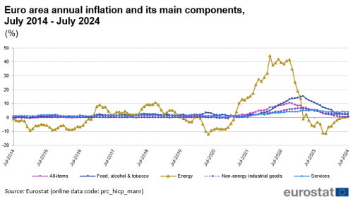
Class 1 introduction to the key concepts

Slide 14
Class 1 introduction to the key concepts
- Why is inflation a problem?
It affects revenues that are not indexed to inflation
Creates a gap between sectors and companies
The wage-price spiral
What can be done to reduce inflation? Risks incurred?
Reduction of the nation’s money supply (Central Banks)
Contractionary policies through the increase of interest rates (key rates)
Control of prices and wages
- Nominal value/ real value
Notes:
- Why
Revenues not indexed: wages, savings in cash
A gap between major actors who can act on prices and others
Wageprice spiral: when inflation is high, workers ask for salary increases, which itself creates inflation
What can be done?
Reduction of money supply by Central banks
Control of prices : practised in the 70’s (following oil shocks, for ex Nixon in the US),now considered largely ineffective
… restrict the access to credit and thus depress supply

Slide 15
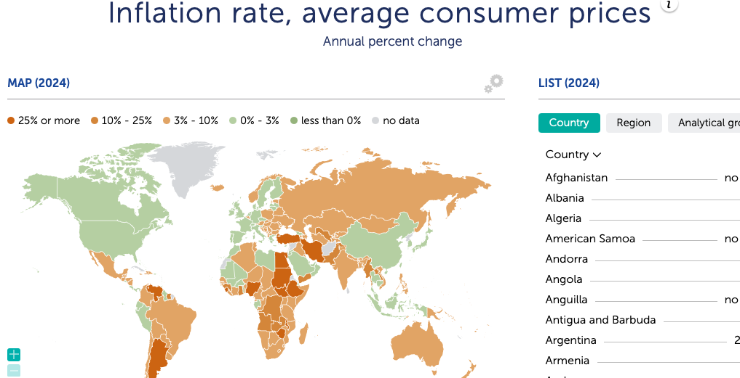
Class 1 introduction to the key concepts
https://www.imf.org/external/datamapper/PCPIPCH@WEO/WEOWORLD/VEN

Slide 16
Public debt
Definition
Debt is the sum of loans issued by the State, local authorities and social bodies, year after year (accumulation if public deficit) and not yet repaid.
Expressed in % GDP- the debt-to-GDP ratio
Difference between public debt and national debt
A few figures for Japan, Greece, the US, Italy, France and Germany in 2022
Who owns the debt? And why it matters
https://www.reuters.com/business/finance/who-owns-frances-debt-why-it-matters-2024-06-26/ - :~:text=Foreign investors own around 50,known to be quite volatile
- How to reduce the debt
Restrictive /austerity policies and their consequences
Ex: the case of Greece
By trying to generate/boost growth
Class 1 introduction to the key concepts
Notes:
Definition:
Difference between public debt (stock) and deficit (a flow)
A few figures for 2022
Japan (214%) , Greece (190%) US (110%) Italy (140%); France (92%),Germany (46%)
Reminder: Maastricht Treaty 1993: goal: reduce the Debt to GDP ratio to 60%
Other European rule : not exceed 3% public deficit (currently Belgium, Italy, Hungary, Malta, Poland and Slovakia and France don’t respect this rule within the E.U)
- Who owns the French public debt? https://www.reuters.com/business/finance/who-owns-frances-debt-why-it-matters-2024-06-26/#:~:text=Foreign%20investors%20own%20around%2050,known%20to%20be%20quite%20volatile.
In 1993, 33%, in 2020 50%
Bps: basic point (measure of interest rate or other financial instrument)
- Austerity measures: when you raise taxes/ decrease public spending , you run the risk of decreasing economic activity, thus degrading the ratio debt/GDP; Recession means less revenue for the State, so the state ends up poorer; exemple Eurozone 2010-14, the case of Greece Ratio debt/GDP 2009: 126%, 2014: 180%
- How to reduce the debt

Slide 17
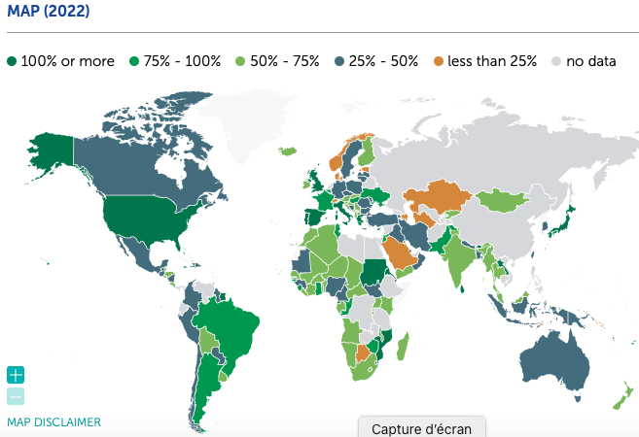
Class 1 introduction to the key concepts
https://www.imf.org/external/datamapper/CG_DEBT_GDP@GDD/CHN/FRA/DEU/ITA/JPN/GBR/USA/BRA/COL
Only central governement debt
Notes:
- Who owns the French public debt? https://www.reuters.com/business/finance/who-owns-frances-debt-why-it-matters-2024-06-26/#:~:text=Foreign%20investors%20own%20around%2050,known%20to%20be%20quite%20volatile.
A few figures
Netherlands: 45%
- How to reduce the debt: 2 options, whether you want to act on the numerator or denominator

Slide 18
Class 1 introduction to the key concepts
1) Exchange rate/
2) Foreign exchange market/ 3) exchange rate system
Definition
1) The value of a currency for the purpose of exchanging it for another (Oxford)
Example 1 Euro= X USD, 1USD= X’ Euro
2) FOREX (or FX) over-the-counter (OTC) global marketplace that determines the exchange rate for currencies around the world. Participants in these markets can buy, sell, exchange, and speculate on the relative exchange rates of various currency pairs ( in a system of floating rates). (https://www.investopedia.com/terms/forex/f/foreign-exchange-markets.asp)
3) Exchange rate system: all the rules and regulations that govern the exchange rate of a currency
Free-floating or fixed floating
Most liquid trading pairs
Notes:
Definition 2) who can participate? banks, forex dealers, commercial companies, central banks, investment management firms, hedge funds, retail forex dealers, and investors.
Most liquid trading pairs: EUR/USD
USD/JPYen
GBP/USD
Brief history of the Exchange rate systems
Bimetallism (1870-75)
Classical God standard (1875-1914)
Interwar period (1915-44)
Bretton Woods system (1944-1973)
Flexible exchange rate system (1973-now)

Slide 19
Class 1 introduction to the key concepts
1) Exchange rate/
2) Foreign exchange market/ 3) exchange rate system
- Effects of a devaluation or depreciation?
First  in the price of X in foreign currency
And of M in domestic currency= cost-push inflation
➔ degradation of current account (X-M in domestic currency)= the PRICE EFFECT
Then,  of the price of X in foreign currency ➔  of the volume of X
of M in domestic currency ➔ in volume of M
➔ Improvement of the current account the QUANTITY EFFECT
These mechanisms imply that M and X are rather elastic… if not Price effect > quantity effect ➔degradation of the current account
Notes:
- This assumes that demand for exports and imports are relatively elastic.. Not the case often in the short-term, yet over a longer period of time, demand becomes more elastic and so there is an improvement in the current account (https://www.economicshelp.org/blog/437/trade/effects-of-falling-exchange-rates/)

Slide 20
Consequences of devaluation or depreciation of domestic currency
J curve of the evolution of current account
X-M
Phase 1 :
Price effect
Phase 2 :
Quantity effect
T= 0
devaluation
Time
Notes:
Il all OECD countries and in China, price-elasticity of imports is very low ; Elasticity-price of exports is high in France, Spain, China and India.

Slide 21
Class 1 introduction to the key concepts
1) Exchange rate/
2) Foreign exchange market/ 3) exchange rate system
- Who are the winners?
Notes:
The impact of a fall in the exchange rate depends on a few factors:
State of the economy. If the economy is in a recession, a depreciation may help boost growth with little effect on inflation. But, if inflation is already high, a fall in the exchange rate will make inflation worse.
Other components of Aggregate Demand. If the exchange rate falls, this increases export demand. However, if there is a fall in consumer confidence, there may be no overall increase in AD.
Time lag and elasticity of demand. In the short term, demand for exports tends to be inelastic (therefore only a small increase in demand). Over time, demand becomes more elastic. Therefore there is a bigger increase in demand for exports.
Depends on the cause of the fall in the exchange rate. For example, countries experiencing a balance of payments crisis (e.g. Russia 2007/17) will see an outflow of capital as investors become nervous over the speed of the currency devaluation.

Slide 22
Class 2 Le’ts use the concepts in context
Class 2 Sept 30th Present for each country
1) A general profile: Land area, population, political system
2) A focus on this country’s economy
- its current GDP (in 2023)/the evolution of GDP over the last 20 years/ GDP per capita/ / HDI Index/ Gini coefficient
- Trade balance/ Current account balance/ Balance of payments
- Main trading partners
- Inflation rate (over the past 5 to 10 years)
- Debt/GDP Ratio (over the past 5 to 10 years)
- Exchange rate system /$
- FDI inflows and outflows
Figures and some explanations
https://unctadstat.unctad.org/CountryProfile/GeneralProfile/en-GB/004/index.html
Sources used
-

