Slide 1
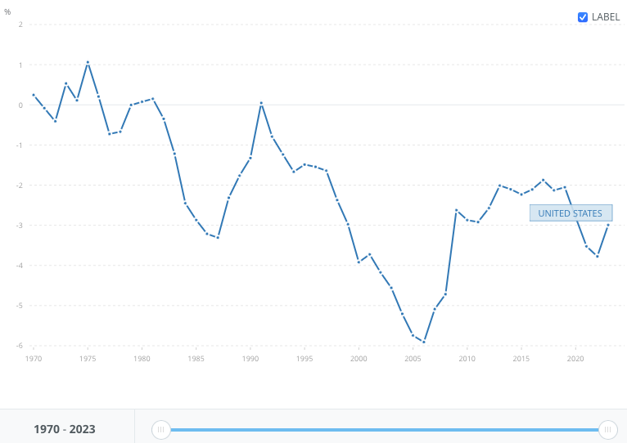
US current account deficit: should we worry?
Reminder definition
https://data.worldbank.org/indicator/BN.GSR.MRCH.CD?locations=US
Current US deficit: 818 B$
2023: 3% GDP (3.8% in 2022)
Notes:
(current account deficit- a flow and not debt- a stock)
Since the 1970’ s, constant deterioration,
Now: $818.8 billion in 2023. The narrowing mostly reflected a reduced deficit on goods. The 2023 deficit was 3.0 percent of current-dollar gross domestic product, down from 3.8 percent in 2022.
DEF: The current account balance of payments is a record of a country's international transactions with the rest of the world. The current account includes all the transactions (other than those in financial items) that involve economic values and occur between resident and non-resident entities (OECD)

Slide 2
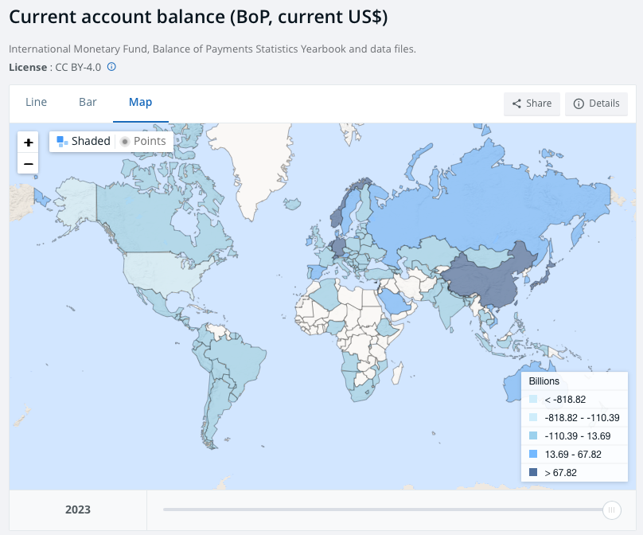
US current account deficit: should we worry?
Comparison with other countries
From the current account deficit to the foreign debt
https://data.worldbank.org/indicator/BN.CAB.XOKA.GD.ZS.
Notes:
From the current account deficit to the growing foreign debt (to be distinguished from the national debt, which includes public services)
China owned as much as 12% of the US debt in 2012; as the debt is in $, the US could pay back China directly if the Fed bought back Treasure Bonds and credited the Bank of China.
Especially in the period 2000-2008-
But the confidence in the $ is very strong, so the US still have the priviledge of paying their debt in $.. It could change at some point if the remnibi becomes an International and trusted currency

Slide 3
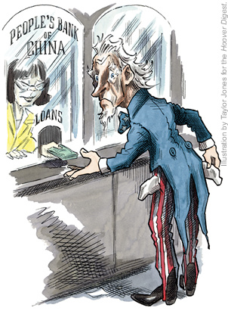
US current account deficit: should we worry?
The US deficit is largely financed by Treasure bonds held by China
China’s currency reserves
See article ‘China’s war chest: What’s the state of China’s US$3 trillion forex reserves war chest, and where is it invested
Notes:
China foreign currency reserves have massively increased in the years 2000’s and have been invested in Treasuries by the Bank of China
China has the world’s largest foreign exchange reserves, which totalled US$3.22 trillion in January, according to State Administration of Foreign Exchange; The dependency on foreign owners of the debt has increased over the past years
(Article, Chinese War chest)
Corresponding to the China shock in the years 2000’s

Slide 4
US current account deficit: should we worry?
Explanations: massive imports of goods from China in the 2000’s (China joins WTO in 2001)
Advantages for the US
Cheap goods from China for US consumers (furniture, toys, machinery, electronics), more variety of goods
Price of houses rise
Inflation kept low for 10-15 years
Advantages for China
Following the liberalisation movement (Den Xiao Ping 1978), industrialization and economic development, also thanks to a Yuan kept artificially low
Triumph of liberalism, and the theory of comparative advantage (https://www.britannica.com/video/principle-advantage-David-Ricardo/-205504)
Alain Minc La mondialisation heureuse
More integration and convergence will bring benefits for ALL skateholders (as well as democracy) or.. Beggar-thy-neighbour policy?
Notes:
Advantages for the US
2001: China joins the WTO (encouraged by Bill Clinton and liberals)
Advantages for US consumers: we find that retail prices faced by US consumers fall by 2% when China’s market share in the US increases by one percentage point. (https://cepr.org/voxeu/columns/price-effects-trade-new-evidence-us-and-implications-quantitative-trade-models); each US household saw its annual purchasing power increase by $1,500 (+15% for lower-income families); price of locally –made products decreased as well
Advantages for China: more and more competitive, rising out of poverty
Triumph of liberalism : belief that China’s eco devlpt will lead to more democracy in China, ‘Montesquieu ‘partout où il y a du commerce, il y a des moeurs douces’ Ricardo in the XIXth century
A.Minc La mondialisation heureuse (2000)
Bill Clinton (China in the WTO)
Or… beggar-thy-neighbour policy

Slide 5
US current account deficit: should we worry?
Explanations: massive imports of goods from China in the 2000’s
Consequences in the US (and in industrialized countries)
Job losses in the manufacturing sector- 6 M in the US
https://www.youtube.com/watch?v=SreJlZGd1c0
The elephant curve leading to the rise of populism in industrialized countries
https://www.youtube.com/watch?v=t1mWp2qp7A0
Notes:
ripple effect of disindustrialization, job losses, decreasing gvt revenue, undermining public services, depressed home prices, etc, etc, feeding the social malaise and antitrade sentiment, leading to the rise of populism (2016 Brexit and Trump, etc), back to some form of protectionism (Trump)// re-industrialization policies in the US, Trump+Biden )

Slide 6
US current account deficit: should we worry?
How to interpret the deficit
1) Reflects US low savings
2) The fact that foreign investors buy US stocks indicates that they believe the US economy is healthy and safe in the long-run (+ secure political institutions, huge reserves of liquid securities ) ; ‘US stocks had a stellar performance in 2023, with the S&P 500 index gaining 24.3 per cent’
3) The fact that assets are dollar-denominated make them attractive in any portfolio; the dollar still comprises around 60% of global foreign exchange reserves, is involved in 90% of global transactions and is used in over half of all global trade.
4) The fact that the debt is in $ is a huge advantage compared to other countries (the debt service in $ and relative to the US economy does not change)
5) Comparison with countries that have a huge surplus in their current account: the case of Germany
Notes:
Interpretation of the deficit: -
The large trade defiicit also mirrors the low saving rate of American consumers The fact that foreign investors buy US reflects the fact that they believe US economy healthy and safe to invest
Germany ‘Germany must fix its over-reliance on China as its biggest trading partner’ ‘The only way forward for Germany is to invest heavily in infrastructure, research & development (R&D), and more efficient state operations to help companies transform themselves and stay competitive globally. To finance this, greater reliance on debt is unavoidable’. ’ This will attract greater investment from abroad, which will be crucial for Germany and its EU counterparts’ (https://theconversation.com/germanys-economy-must-be-fixed-here-are-three-top-priorities-221464) (attention débat)

Slide 7
US current account deficit: should we worry?
The problem of a huge account deficit is whether or not it can be financed- and at what cost?
investors need to believe that the US debt is safe and promises high return
’The key question for the United States is whether it will be able to attract the same amount of savings from other countries if global investment grows sharply’ (Article by Patrick Artus (text 2)
The situation in the US has changed since 2010, and these changes are accelerating, with a process of re-industrialization started by D.Trump, and re-inforced by Joe Biden (Inflation Reduction Act, see article Bidenomics mixture of protectionism, subsidies and social measures at a time of full employment= ‘repudiation of free trade? ‘ ) (text 3)
In conclusion ‘some current account imbalances are fine but others are catastrophic ‘
Article by Julius Probst (text 4)
In itself a current account deficit cannot be interpreted; you need other data…
Notes:
It’s a political issue: trade war? Back to protectionism ?

